Slide 1
Have YOU been discriminated against -
Here at EMCC?

Slide 2
Discrimination at EMCC
Real or Imagined?
Spring, 2012
EDU 230 Class,
Pete Turner, Mentor

Slide 3
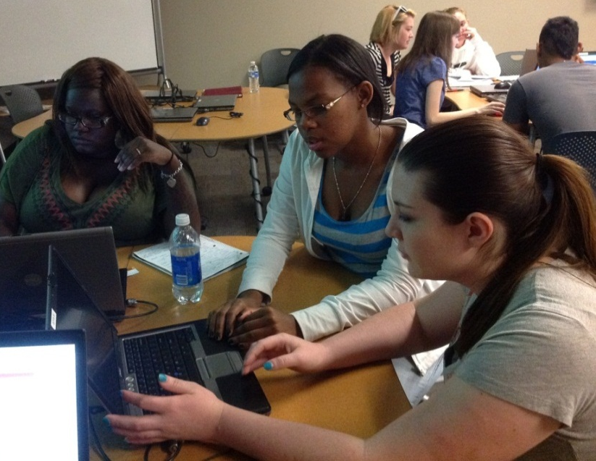
List of Participants
Lezlye Barrios Julia Kilduff Brittany Stephens
Kathryn Brown Brittney Kohanes Ngoc Tran
Lizeth Cabrera Caprice Long Brittney Wolfe
Ericfrancis Clamor Samantha Lopez
Ashley Conner Breanna Madison
Miyoko Fish Marissa Paquette
Tracy Guynn Ginger Patterson
Sharon Hayes Alexis Ronquillo
John Jackson Laura Silvestro

Slide 4
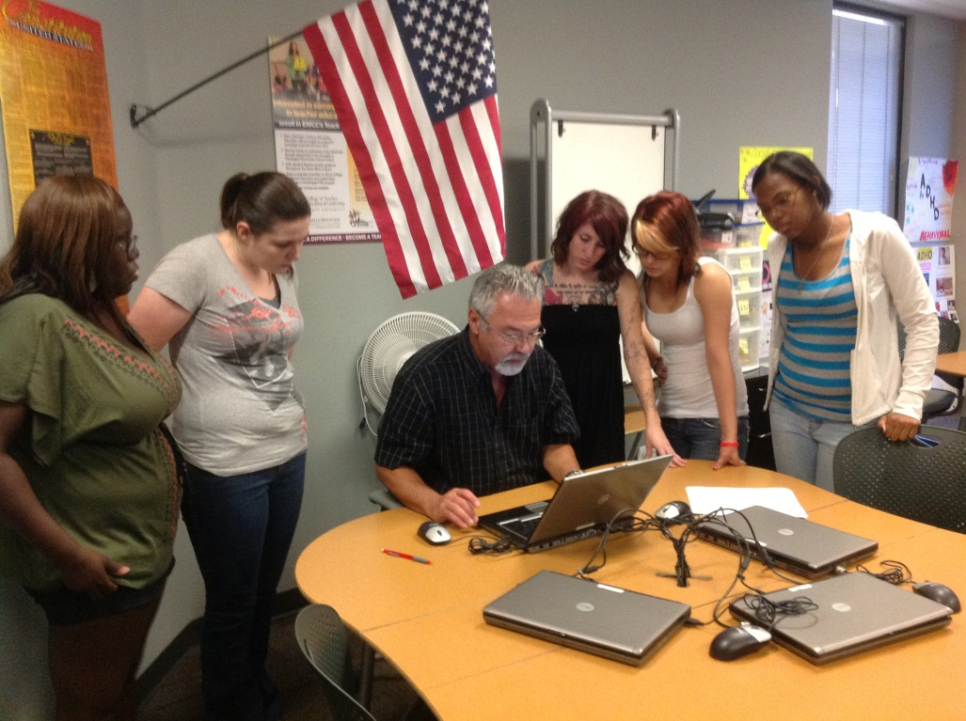
Background
Discussion on Intercultural Competency in Education led to question of “Have any of you been discriminated against on campus?”
Student Caprice Long posed the suggestion that we should conduct a survey to explore the extent of discrimination on campus.
This suggestion received the unanimous support of class.
This study followed!

Slide 5
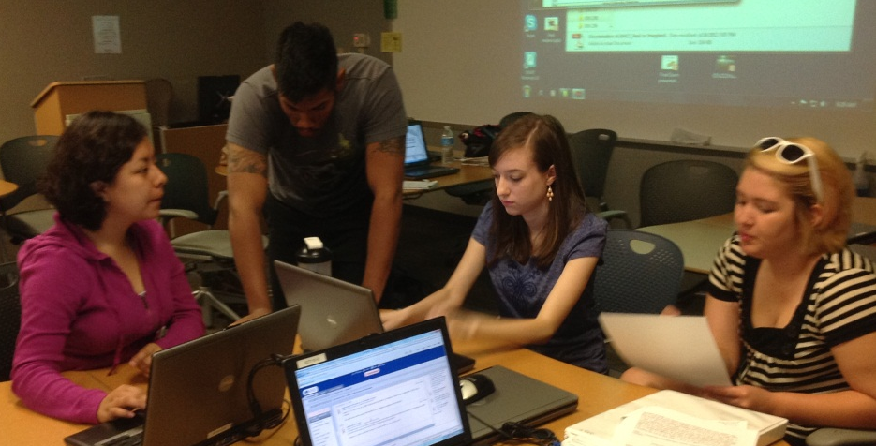
Thesis Statement
Limited research of discrimination on community college campuses (see research summary).
In our class approximately 30% perceive they have been discriminated against.
Approximately 50% have witnessed discrimination on EMCC campus.
THESIS: our survey will yield similar results (25-35% surveyed will say they have been discriminated against; 45 - 55% of respondents will say they have witnessed discrimination).

Slide 6
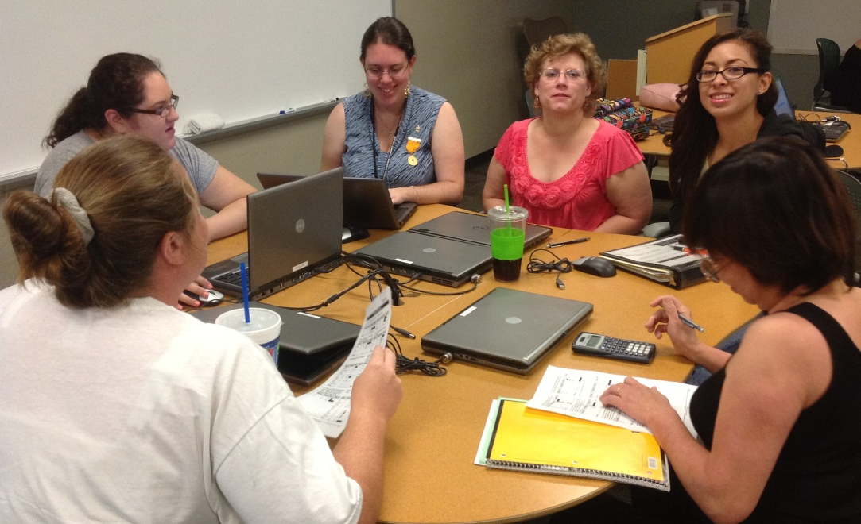
Methodology
4 Original Tasks – 4 Groups of students:
Survey Creation
Research on discrimination on college campuses
IRB Process
Student Conference application, processing

Slide 7
Survey Creation: What We Found Out
.
* How to prevent from accidentally phrasing a vague or sensitive opinion as a survey question (Iarossi, 2006).
* Step by step procedures for conducting research: narrowing the topic, choosing the methodology, conducting survey research, analyzing the data, and sharing the findings with others (Blaxter, Hughes, & Tight, 2010).
*Provided statistics of community college students that responded to an online survey (Sax, Gilmartin, Lee, & Hagedorn, 2008).
* The Rosa Parks experience helped us form discrimination questions for our survey (Theoharis, 2012).

Slide 8
What the Research Said
“According to the National Center for Education Statistics, of the 6.3 million students enrolled in community colleges nationwide, approximately 40% are students of color (Horn & Nevill, 2006). Indeed, Horn and Nevill (2006) found that community college students, in comparison to four-year college students, are more likely to be African American, Latino American, Native American and Pacific Islander” ( as cited in Orozco, Graciela, Alvarez, & Gutkin, 2010, p. 717).
“ The findings suggested that racial discrimination was increasing on college campuses in the United States and that prejudices have become more complex and covertly expressed” (Biasco, Goodwin, Vitale, 2001, p.2).

Slide 9
What the Research Said
"Researchers also argue that ‘prejudice and discrimination in the classroom and on campus has gained attention as the main factor accounting for differences in withdrawal behavior between minorities and non-minorities’” (Cabrera & others, 1999, p. 135).
"Numerous studies have found that minority students do experience insensitive if not discriminatory behavior on college campuses, and students who experience such behavior report lower levels of social integration and institutional commitment” (Miller, & Sujitparapitaya, 2010, p. 29-30).
“In practical terms, in the past decade, female applicants have faced an admission rate that is an average 13 percentage points lower than that of their male peers just for the sake of keeping that girl-boy balance” (Kingsbury, 2007, p.1).

Slide 10
What the Research Said
"Today the Trust does not discriminate with regard to gender, marital status, sexual orientation, race, ethnic origin, color, religion, social background, caste, or disability. There remains one more step the Rhodes Trust should take: removing discrimination on the basis of age” (Reiss, 2011 p.1).
“Previous research has highlighted several stereotypes about those with tattoos, including being unsuccessful in school, coming from broken homes, having an unhappy childhood, rarely attending church, having poor decision-making skills, usually obtaining body modifications while inebriated, and being easy victim to peer pressure (e.g., Armstrong, 1994; Roberts & Ryan, 2002; Owen & Koch, 2004)” (Martin, & Dula, 2010, p.1).

Slide 11
Institutional Review Board
IRB approval needed to conduct survey
Human Subjects Research
Meetings with Dr. William Farrar to review application before final submittal
Survey creation had to be completed before final submittal
CITI Training
Ethics Training for administering survey
Whole class participation

Slide 12
Survey Dissemination
Class discussion, decision – personal, face-to-face surveys
Created hard copy, got feedback from:
IRB reviewers (Dr. William Farrar)
OPIE
Each student responsible for at least
25 student responses
5 faculty/staff responses
Target total of at least 500 overall responses

Slide 13
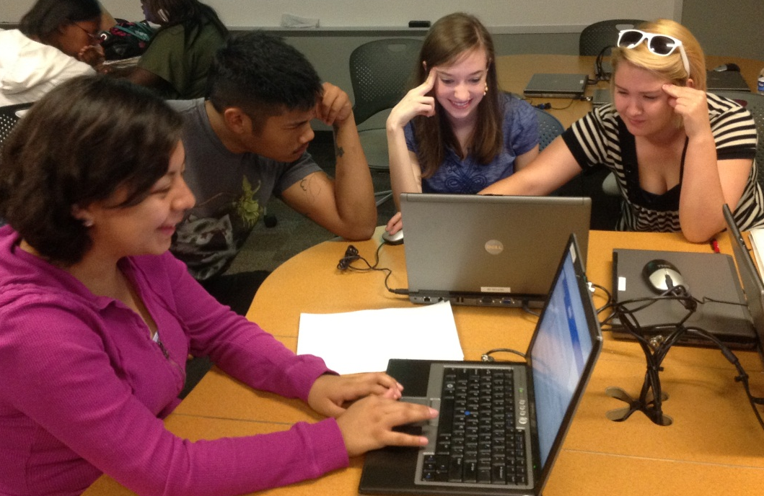
Results
543 Responses
Surveys processed by Office of Planning and Institutional Effectiveness (THANKS!)

Slide 14
Demographics

Slide 15
Results

Slide 16
Results

Slide 17
Results
* 9 more responses received than ‘yes’ responses
**11 more responses received than ‘yes’ responses

Slide 18
Results

Slide 19
Conclusion
Real or Imagined?
Based on survey results, perception of discrimination on campus is real.
Actual discrimination results were approximately equal to what our class predicted, but the perceived discrimination of others was lower than our prediction by about 20%.
Surprisingly, student-on-student discrimination was higher than staff/faculty-on-student discrimination.
The percentage of people who believe discrimination impacts the quality of education at EMCC was much higher than expected; almost twice that of people who said they had been discriminated against or had witnessed discrimination.

Slide 20
Processing Project
Encourage more inclusive activities, such as intramural sports, that will bring students from all cultures, ages, genders, etc. together
Promote more events to encourage school pride and team-building
Increase promotion and awareness of activities such as Welcome Week
‘Discrimination Awareness Month’ activities
Disseminate results to counseling staff

Slide 21
References
Blaxter, L., Hughes, C., & Tight, M. (2010). How to research (4th Edition ed.). Buckingham: Open University Press.
Biasco, F., Goodwin, E. A., Vitale, K. L. (2001) College students' attitudes toward racial discrimination. Patent Searching and Invention Patenting. 35(4), 1-7.
Iarossi, G. (2006). How Easy It Is To Ask The Wrong Question. The power of survey design: a user's guide for managing surveys, interpreting results, and influencing respondents (pp. 29-43). Washington, D.C.: World Bank
Kingsbury, A. (2007). Admittedly Unequal. U.S. News & World Report. 142(23), 50-53.
Martin, B. A., & Dula, C. S. (2010). More than Skin Deep: Perceptions of, and Stigma against, Tattoos. College Student Journal. 44(1), 200-206.
Miller, B., & Sujitparapitaya, S. (2010). Campus climate in the twenty-first century: Estimating perceptions of discrimination at a racially mixed institution, 1994–2006. New Directions For Institutional Research. (145), 29-52.
Orozco, G. L., Alvarez, A. N. & Gutkin, T. (2010). Effective Advising of Diverse Students in Community Colleges. Community College Journal of Research and Practice. 34.9. 717-737.
Reiss, M. B. (2011). Veterans deserve a chance to be Rhodes scholars. Chronicle of Higher Education. 58(8), A28.
Sax, L. J., Gilmartin, S. K., Lee, J. J., & Hagedorn, L. (2008). Using web surveys to reach community college students: An analysis of response rates and response bias. Community College Journal Of Research & Practice, 32(9), 712- 729. doi:10.1080/10668920802000423
Theoharis, Jeanne (2012). The northern promised land that wasn’t: Rosa Parks and the black freedom struggle in Detroit. OAH Magazine of History, Jan2012, Vol. 26 Issue 1, p23-27,

Slide 22
Many “Thanks” to . . .
Dr. William Farrar
The Office for Planning and Institutional Effectiveness – Jann, Sandy, Barb, Kerry & Rene
Rae Scott at the IKON Copy Center
We couldn’t have done it without you!

