Slide 1
A Little Bird Told Me: Using Twitter to Enhance Learning in Engineering
Michelle Breaux

Slide 2
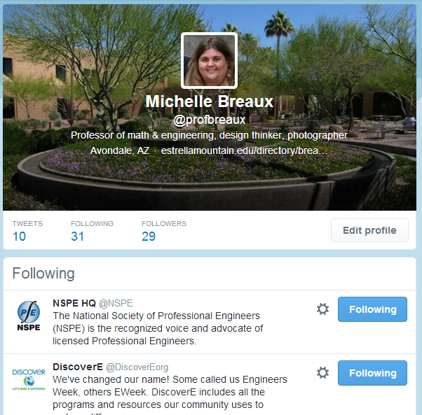
The Assignment
Create a twitter account
Follow me @profbreaux
Follow 5 Engineering societies/accounts
Send me handle & who following
Review each week
Summary of what learned due each Friday

Slide 3
Options Provided to Follow
General Engineering Interest
Discover E (National Engineers Week)
Fulton Engineering (ASU)
Stanford Engineering
NASA
Solar Decathlon
MAKE Magazine
NASA JPL

Slide 4
Options Provided to Follow
Professional Societies
National Society of Professional Engineers (NSPE)
National Society of Black Engineers (NSBE)
Society of Hispanic Professional Engineers (SHPE)
Institute of Electrical and Electronics Engineers (IEEE)
American Society of Civil Engineers (ASCE)
American Institute of Chemical Engineers (AIChE)
American Society of Mechanical Engineers (ASME)
Institute of Industrial Engineers (IIE)

Slide 5
Options Provided to Follow
Women in Engineering/STEM
STEMinist
Society of Women Engineers
She++ (Women in Computer Science)
@femgineer (Empowering Women in Engineering)
Girls Who Code

Slide 6
What did students learn?

Slide 7
That the news and/or instructors aren't your only reliable source for finding cool stories or learning about new things.

Slide 8
I got more of an idea of what engineers do in different disciplines.

Slide 9
I can be one of those students doing research and contributing to the fields of science.

Slide 10
I learned that technology is advancing more rapidly than ever, and I had no idea what was going on in the world of industrial revolution.

Slide 11
Engineering isn't just about making cool things like robots, it's about making the quality of life for everyone better.

Slide 12
Engineering does not come in packets of blue or pink; this woman tells about being in aerospace engineering, how exciting it is, and how she now works at NASA.

Slide 13
Importance of networking and talking with other professionals in your field at other companies.

Slide 14
This post helped me see that there are many different sides to engineering and not all of engineering deals with making things of the movie IRobot ™.

Slide 15
@NSBE didn’t seem tweet out any new interesting advances in the field. However, I like following them because it seems to be more of a networking opportunity. A majority of the tweets this week have been about competitions and contests within their organization. This made me want to possibly think about joining or finding out more information about NSBE and how to join.

Slide 16
@ASME (American Society of Mechanical Engineers) posted an article on the steps to get your professional engineering license. I found this helpful because the field of engineering that I plan on going into needs a PE license to practice in every state.

Slide 17
I would have never thought you could work your way up to a CEO in a company with just an engineering degree. It turns out that many companies look for engineers to be their CEO's. McDonald's, Bank of America, Microsoft, GM and Ford, just to name a few, all have engineers as their CEO's.

Slide 18
I always hear about the gap between genders, but the article went more in-depth giving reasons such as what they described as being a "brogammer". By brogammer they described the atmosphere that these jobs are conducted under caters to males. I found it interesting to know possibly what I’m up against entering the STEM field.

Slide 19
Suggestions for Improvement

Slide 20
Provide tutorial on how to use twitter.

Slide 21
Hold weekly class discussions to share what learned.

Slide 22
Allow students to suggest own societies or people to follow.

Slide 23
Make it due on Sundays.

Slide 24
More frequent reminders.

Slide 25
Find a way to get students who resist to be more open minded & actually embrace the assignment.

Slide 26
And more…

Slide 27
Next Steps…

Slide 28
Find ways to extend this to my other classes.

