Slide 1
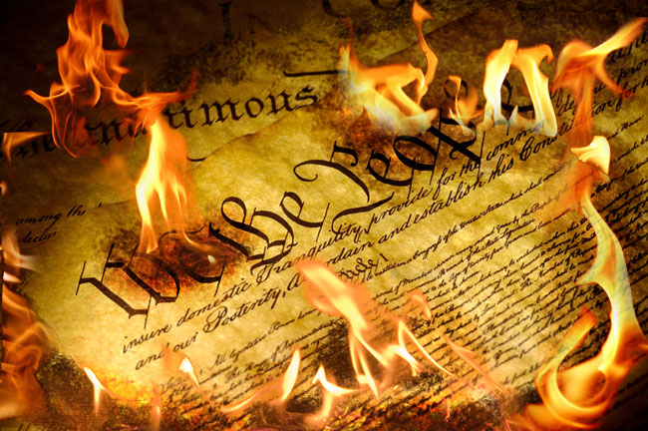
Brown Vs. Board of Edu
Group 2

Slide 2
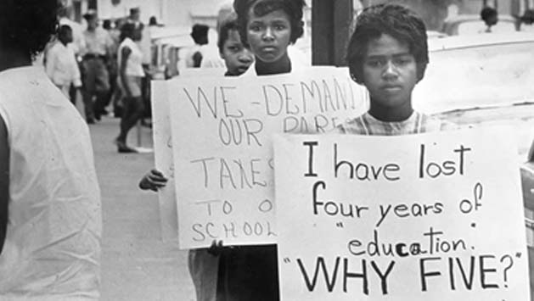
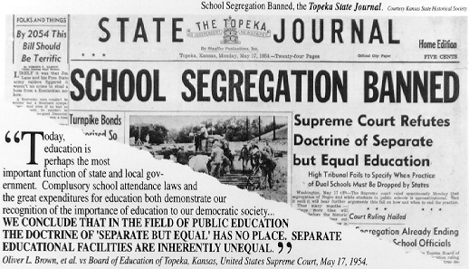
Why?
Separate but Equal?
Proven separating isn’t really being equal
Not necessarily bad facilities
Previous cases that impacted this one
Murray V. Maryland (disputed blacks to enter Universities)
Sweat V. Painter ( Texas Law school sued)
This treatment Violates 14th Amendment

Slide 3
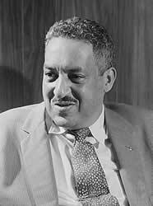
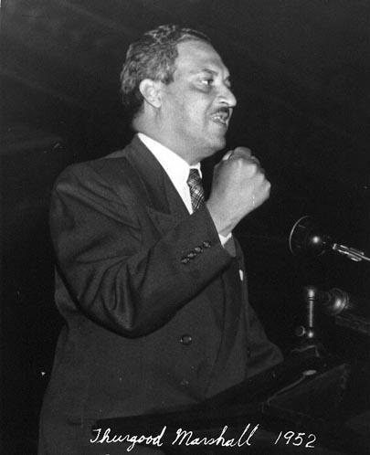
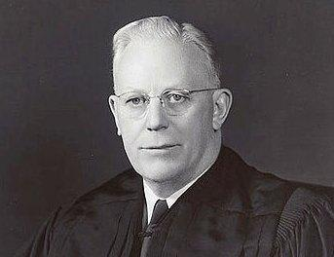
Who was involved?
Oliver Brown
Many people in the States of Virginia, Kansas, South Carolina, and Delaware were finding it to be racist and unfair if a black student weren’t able to attend white school districts. One person named Oliver Brown who is a parent of a African child was denied access to a white school and decided to file a lawsuit for disobeying the rights in the Constitution. With the help of Thurgood Marshall (the first black justice of court) and Earl Warren (the leader of the case), the supreme court decided to have interraciality at any school.
Thurgood Marshall
Earl Warren

Slide 4
Outcome
There was a later case called Brown II.
This case was to make to courts put an end to school segregation by race “with all deliberate speed.”
The Brown decision became the cornerstone of the social justice movement of the 1950s and 1960s.
It finally brought the spirit of the 14th Amendment into practice, more than three-quarters of a century after that amendment had been passed.

Slide 5
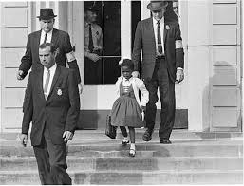
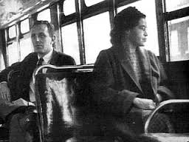
1955
Rosa Parks arrested for refusing to give up her bus seat to a white passenger.
1956
Autherine Lucy is the first African American student to be admitted to the University of Alabama.
Ruby Bridges, 6yrs. Old, integrated into William Frantz Public School.

Slide 6
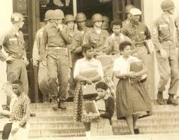
1957
Little Rock Nine
Ernest Green
Thelma Mothershed
Elizabeth Eckford
Terrace Roberts
Carlotta Walls
Gloria Ray
Jefferson Thomas
Melba Patillo
Minnijean Brown
1958
Seven states still segregated.
Virginia
South Carolina
Georgia
Alabama
Florida
Mississippi
Louisiana
1961
Three states with completely segregated school systems.
South Carolina
Alabama
Mississippi

Slide 7
Outcome
Even today after the Brown v. Board there are still 200 desecrated school cases.
President Obama spoke about how segregated schools are still inferior even after 50 years later.
Yes there is a lot of work to be done at least we are headed in the right direction.

Slide 8
Effect on todays teachers?
This case affects teachers today from kindergarten to college level
Cultural differences
Graduation requirements changed
Teachers need to understand a variety of cultures
Teach students to respect others cultures

Slide 9
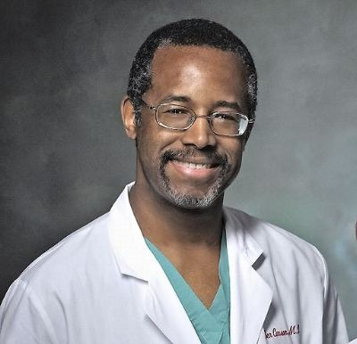
Thanks to Brown V Board great minds could flourish
Dr. Niel Degrasse Tyson
Cal Berkley
Dr. Ben Carson
Yale

Slide 10
Sources
Works Cited
"Brown v. Board of Education." The Leadership Conference on Civil and Human Rights. Web. 05 Sept. 2014.
"History of Brown v. Board of Education." USCOURTSGOV RSS. Web. 04 Sept. 2014.
"Home." Hayden Planetarium. Web. 05 Sept. 2014.
Journal Of Social Issues, Vol. 60, No. 1, 2004, Pp. 1--15. 50 Years After Brown v. Board of Education: The. Web.

Slide 11
Assessment
https://testmoz.com/347947
Interactive assessment. Password required.

