Slide 1
Lau vs. Nichols
Group 1

Slide 2
Case History
In 1971 the San Francisco, California (SFUSD) school system was integrated as a result of a federal court 9decree. Approximately 2,800 Chinese ancestry students in the school system did not speak English. One thousand of these students received supplemental courses in English language, and 1,800 did not receive such instruction. A class action suit was brought by the non-English-speaking Chinese students who did not receive additional instruction against officials responsible for the operation of the San Francisco Unified School District. The students alleged that they were not provided with equal educational opportunities and, therefore, were not being afforded their Fourteenth Amendment rights.

Slide 3
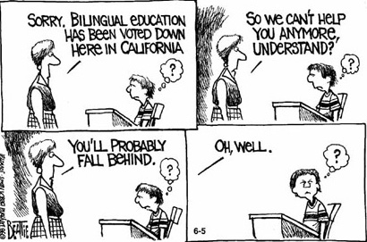

Slide 4
What Happened?
Students argued that they were not receiving equal education opportunities, because:
They were not receiving any special help in their classes
Schools lacked the appropriate accommodations
Were denied aid primarily due to their inability to speak English
The students stated they were entitled to such aid under Title VI of the Civil Rights Act of 1964 that effectively placed a ban on educational discrimination on the basis of national origin.
School district argued that they were nondiscriminatory, because it offered the same instruction to all of its students regardless of language and national origin.

Slide 5
Who Was Involved
Alan Nichols- President of School Board
Kinney Kinmon Lau- Chinese ancestry Student & 1800 other Chinese ancestry students
San Francisco Unified School District.
United States Supreme Court- Granted the petition due to the public importance of the issue.
The Department of Health, Education, and Welfare (HEW)
The panelists were Patricia Gandara, a professor of education and the co-director of the Civil Rights Project at the University of California, Los Angeles; Ed Steinman, a professor of law at Santa Clara University School of Law; and Peter Zamora, the regional counsel for the Washington office of the Mexican American Legal Defense and Educational Fund.

Slide 6
What Was the Outcome
The Supreme Court of the United States in Lau Vs. Nichols ruled that public schools, based on the passing of the civil rights act of 1964, must treat all students equally regardless of their language; therefore, students who are incapable of speaking English must be awarded resources to facilitate their learning.

Slide 7
How It Affects Teachers Today?
Some school districts created bilingual classrooms in which students were taught English slog with their native language as a way to offer "the best of both worlds". ELL students are given vigorous English lessons. Another approach is a combination group which consists of ELL students, and fully bilingual students to increase the amount of English language for them to emerge fully bilingual with time.
Lau vs Nichols did not specify the amount or type of help ELL students should receive. This leaves a broad road for each state and school district to evaluate and decide how to educate their ELL students to help then become fully proficient in English.
Teachers are complaining that schools have:
An inadequate supply of bilingual educators
Inadequate assessments
A lack of appropriate textbooks for ELLs
Teachers who are not prepared to teach such students.

Slide 8
Multiple Choice Q’s
1. In Lau vs. Nichols, the Supreme Court held that:
Maintenance programs are unconstitutional
An individualized Education Program must be written for bilingual students
Teaching students in a language the do not understand was not appropriate education
School districts can not prevent students from acceleration through grade
2. In Lau vs. Nichols (1974), the Supreme Court decided
a.) more federal funds should be available for education.
b.) schools must provide special language programs for non-English speaking children.
c.) there should be an end to legalized segregation.
d.) more monies should be available for vocational training.

Slide 9
Short Answer
Why is this case relevant to your career as a future teacher?
What point was the defendant trying to make in terms of providing an equal education to all students regardless of ethnicity or language? Were they justified? Why or why not?

