Slide 1
Adventures in Learning Kids Camp Pictures
Fall 2015
R. Holmes
EDU

Slide 2
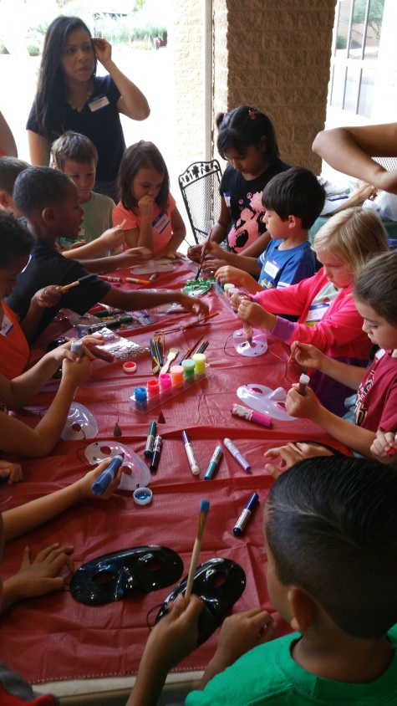
Kinder/1st grade Group

Slide 3
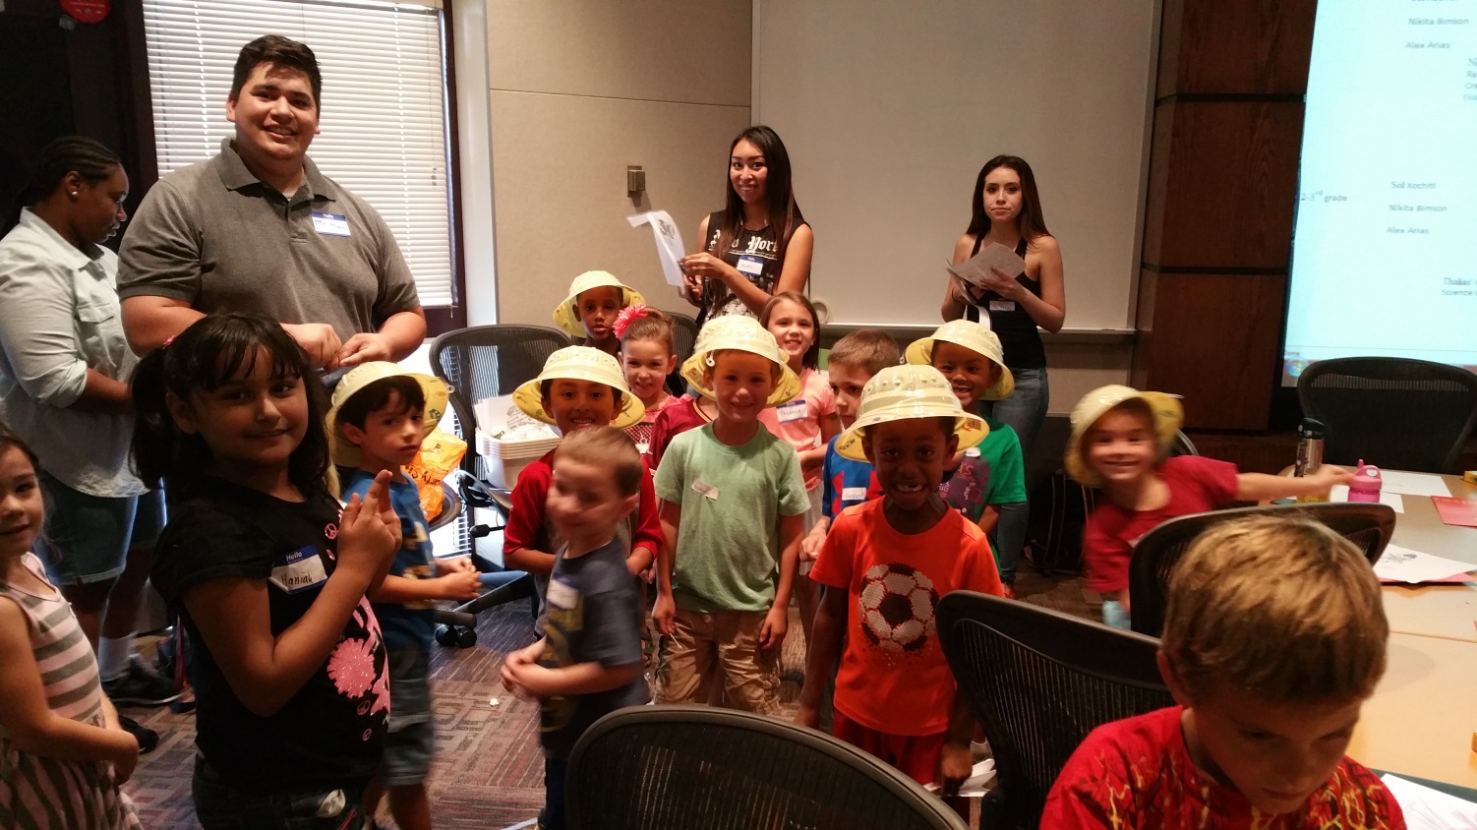
Kinder/1st grade

Slide 4
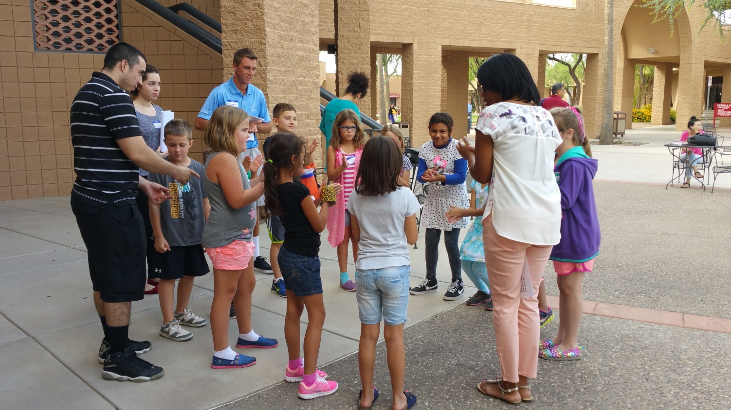
2nd/3rd grade group

Slide 5
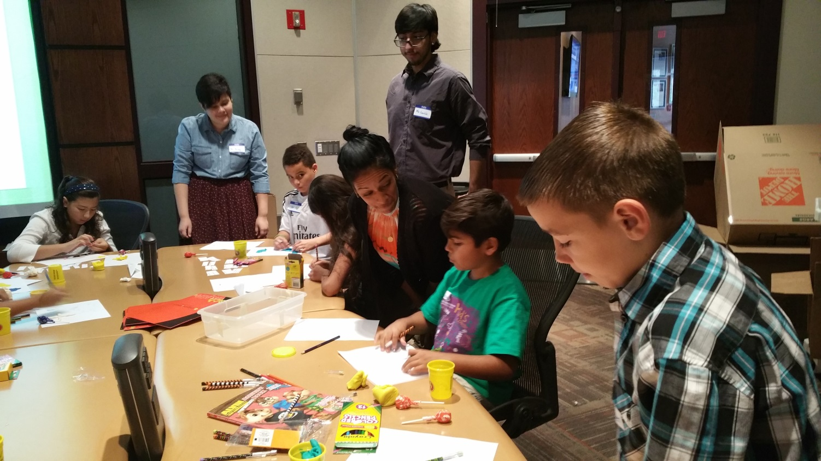
4th/5th grade group (not all children shown here)

Slide 6
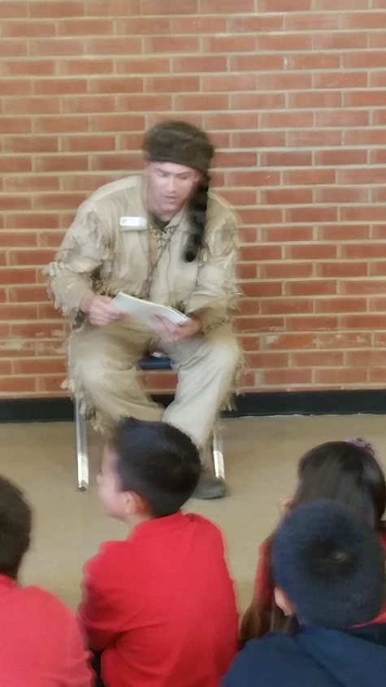
Davy Crockett - Storytelling

Slide 7
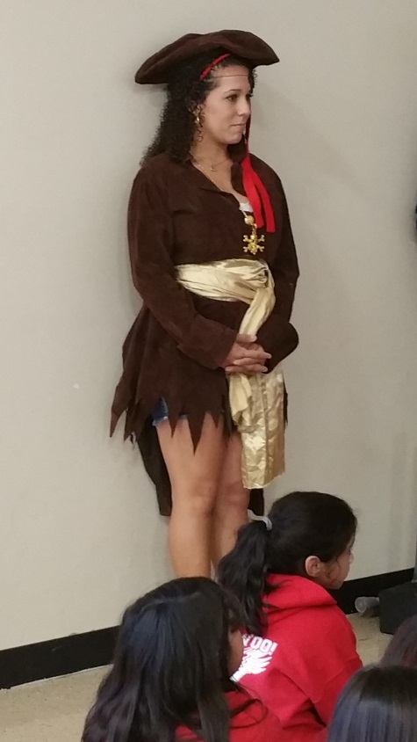
Pirate Skit- Storytelling

Slide 8
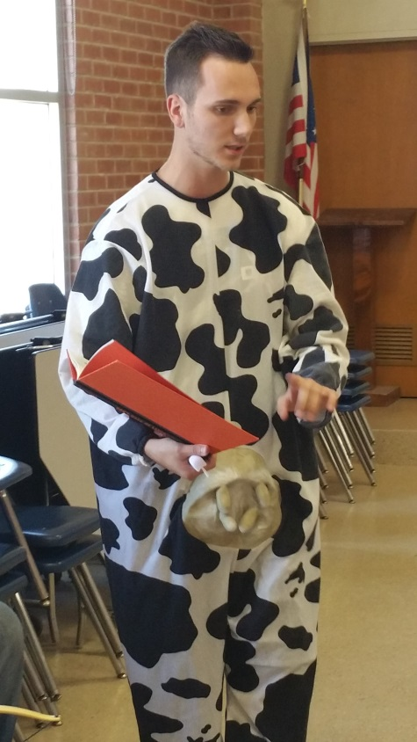
Don’t Make Me Laugh Book- Storytelling

Slide 9
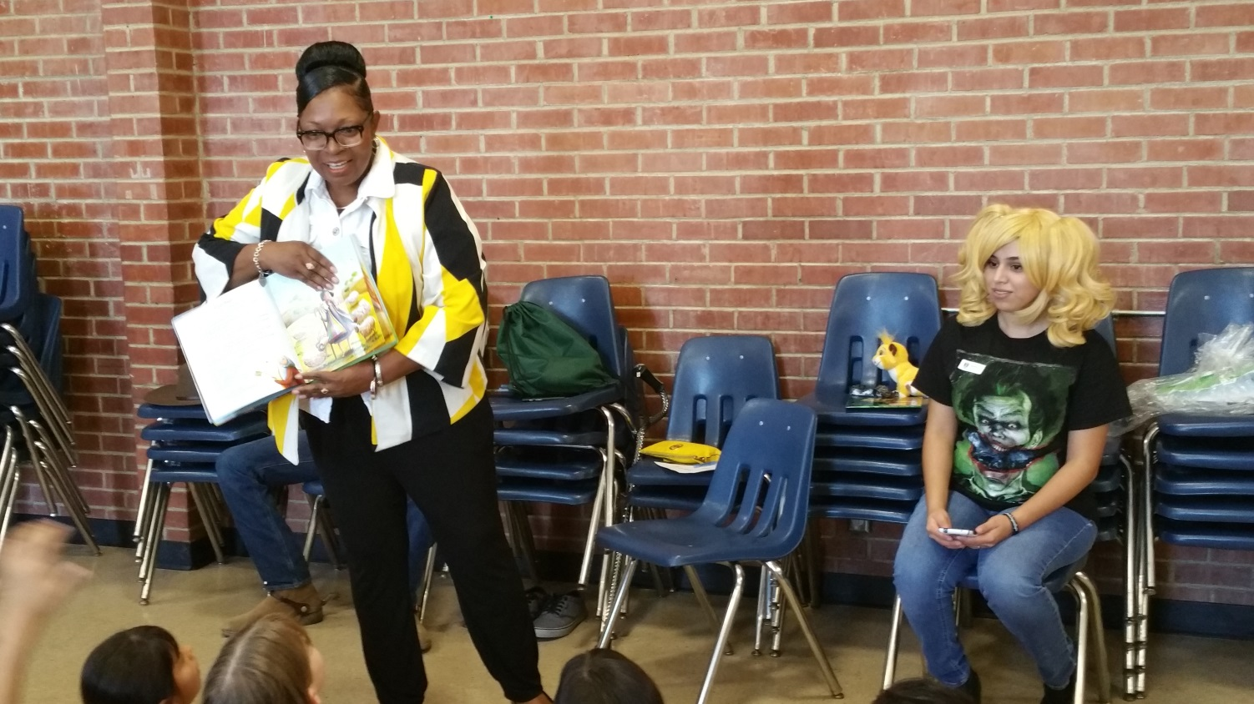
The Coat of Many Colors- Storytelling

Slide 10
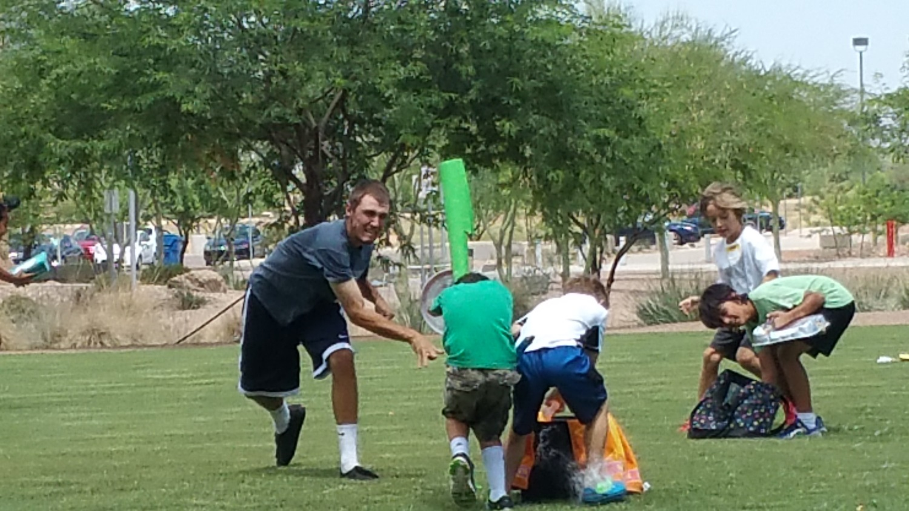
We even had PE, Music, and Art Instruction!

Slide 11
Overall Results
EDU students had the opportunity to lesson plan, teach, and implement classroom management to a group of over 40 children for one week. Their skills in all 3 areas increased, but more importantly, their recognition of their own strengths and weaknesses has greatly improved. Self-reflection on a much deeper level is taking place!

