Slide 1
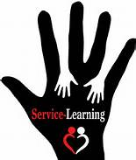
Center for Service Learning & Civic Engagement
Landis Elliott & Rachel Holmes, SL Coordinators

Slide 2
Program Overview

Slide 3
Types of Experiential Education
Service Learning- Meaningful community service, connecting to classroom learning and includes a reflection.
Civic Engagement- Serving the community to take action by working towards a long-term solution and spreading awareness of an issue facing society.

Slide 4
Benefits
Builds Community
Leads to Student Retention
Leadership Development
Real Life Application
Analytical
Community Need
Reflection
Social Responsibility
Learn to Give Back

Slide 5
2015-2016 Goals
14/15 AY
14,633 hours
21 instructors
15/16 AY
17,558 hours
25 instructors
GOAL FOR THIS ACADEMIC YEAR
20% INCREASE
2015-2016AY
20,003 hours
=
Value of Volunteer time is $467,270*
Based on the Estimated Value of Volunteer Time ($23.36) from the 2015 Bureau of Labor Statistics
Notes:
At the beginning of the Fall semester the goal was set to increase service learning by 20%. To date- we have not only exceeded this goal and contributed 17,455 hours to the community but…when you take the estimated value of volunteer time for 2015 which is $23.56 EMCC can estimate the value of the volunteer hours provided at over $400,000.
Based on the Estimated Value of Volunteer Time ($23.36) from the 2015 Bureau of Labor Statistics

Slide 6
2016- 2017 Goals
Increase staff and adjunct faculty participation in Service Learning/Civic Engagement
Award President’s Volunteer Service Award to staff/faculty
5% increase in the number of Service Learning hours per semester
Incorporating the SW Skill Center in Service Learning
Piloting Service Learning in CPD 150
Create a campus-wide Service Learning Project each semester
Create more collaborative Service Learning opportunities between clubs/orgs
Focus on Civic Engagement

Slide 7
We Need Your Support
Participate in Service Learning Projects; Campus-wide events
Consider offering the Service Learning Extra Credit Assignment in one or more classes
Consider implementing a Service Learning project in one class per semester.
Track your own hours for the President’s Service Award
Report your hours and student hours (for in-class SL projects) to The Center for Service Learning and Civic Engagement

Slide 8
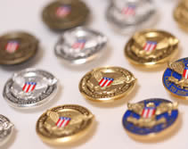
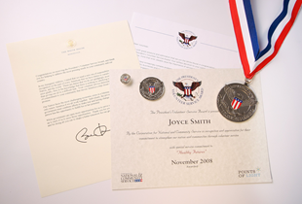
Presidential Community Service Award
Hours by Award | Bronze | Silver | Gold
Kids (5-10) | 26 – 49 | 50 – 74 | 75 +
Teens (11–15) | 50 – 74 | 75 – 99 | 100 +
Young Adults (16-25) | 100 – 174 | 175 – 249 | 250 +
Adults (26 and older) | 100 – 249 | 250 – 499 | 500+
Families and Groups* | 200 – 499 | 500 – 999 | 1,000+
President’s Lifetime Achievement Award: Individuals who have completed 4,000 or more hours in their lifetime
* Two or more people, with each member contributing at least 25 hours toward the total
60 students have received
this honor

Slide 9
Creating and Maintaining Community Partnerships

Slide 10
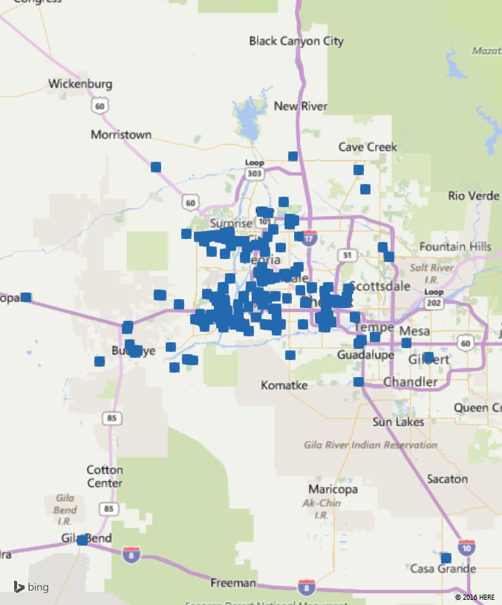
Oak Creek Canyon
The Reach
of EMCC Service Learning Students
EMCC
Mesa
Buckeye
Gila Bend
Casa Grande

Slide 11
What Paperwork is Required
Check out our website:
http://www.estrellamountain.edu/students/service-learning

Slide 12
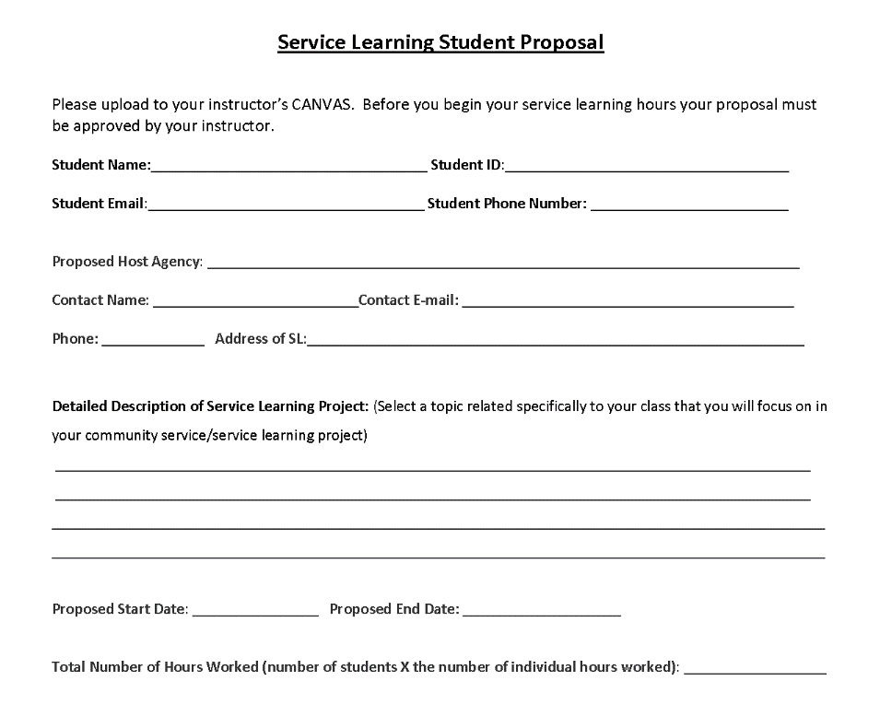
Service Learning Proposal

Slide 13
Student/Agency Agreement

Slide 14
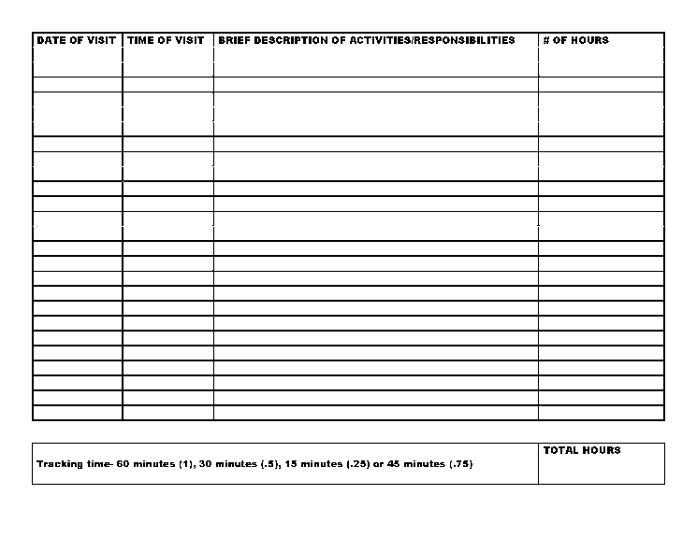
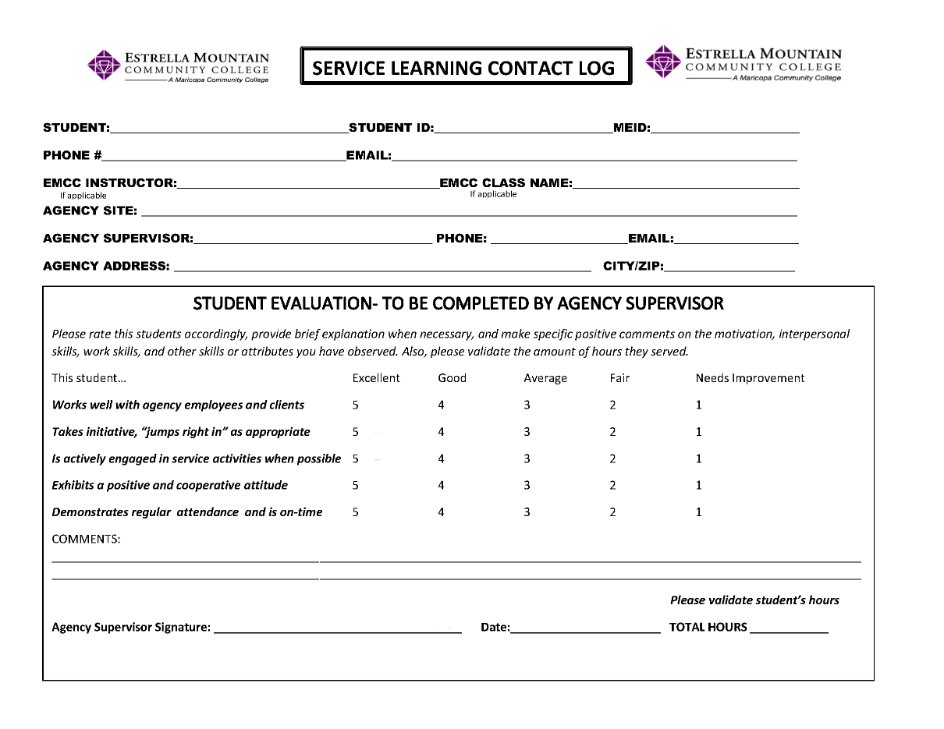
Service Learning Contact Log

Slide 15
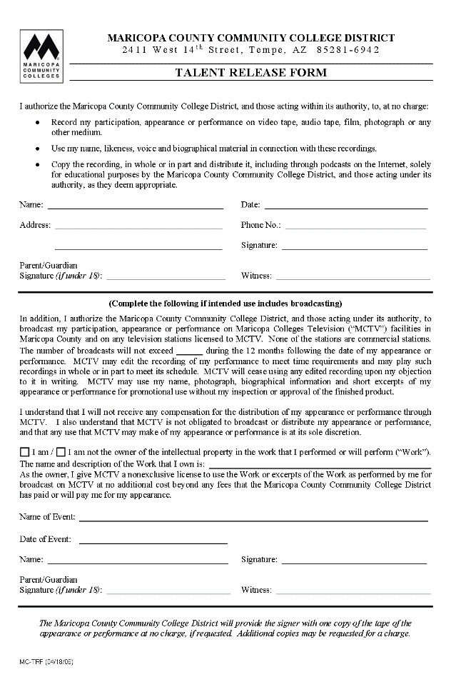
Risk/ Talent Release

Slide 16
For More Information
Landis Elliott
Landis.Elliott@estrellamountain.edu
(623)935-8220
Rachel Holmes
Rachel.Holmes@estrellamountain.edu
(623)935-8407

