Slide 1
The Basics of Service Learning Student Ambassador Presentation
Rachel Holmes, M.Ed.
Faculty Service Learning Coordinator
EMCC

Slide 2
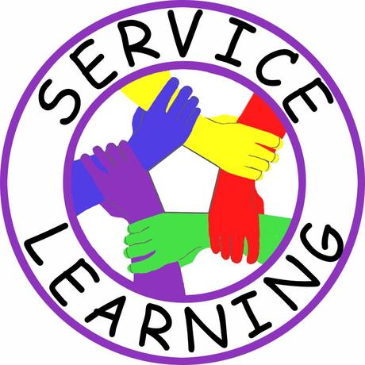
Preview of Today’s Session
Key Components of Service Learning
Easy steps for implementation
Questions

Slide 3
What is Service Learning?
Service Learning
The combination of community service and classroom instruction, with a focus on critical, reflective thinking as well as personal and civic responsibility
May be community service, one or more volunteer events, donations
Civic Engagement
Active participation in the public life of a community in an informed, committed, and constructive manner with a focus on the common good
Civic engagement provides students an opportunity to serve the community (the larger community or the college community) by working towards a long-term solution and/or awareness of an issue facing society
Working towards positive social change

Slide 5
Key Components of Service Learning
Community Service (10 or more volunteer hours) OR participating in 2 SL events
And
Reflection/Final Assignment

Slide 6
Critical Thinking
Service Learning allows the students to learn, volunteer, and work on a project that can and should facilitate reflective and analytical thinking.
Project should be related to what you are learning in your class
i.e. Accounting students providing free tax services to low income families
i.e. Education students providing free tutoring to K-12 students

Slide 7
How Does It Work?
Faculty-Directed Service Learning
Instructor either assigns a specific project OR
Instructor provides a list of projects to choose from
Instructor oversees the student and project to ensure students are making progress and meeting academic requirements

Slide 8
How Does It Work?
Student-Directed Service Learning
The students do the research to
identify a community need
Students develop their own project
complete with goal/outcome
statement, timeline, proposal (ex. Volunteering
at food bank for 10 hours)
The instructor monitors student
progress

Slide 9
Three Types of Service Learning
1.) Individual/Club Placements: Students/Clubs are placed at any of EMCC’s approved agencies. The student/club and agency will determine the goals of the service learning experience, number of hours and duration of the experience.
2.) Class Projects: May be whole-class, small group or individual project (ask your instructor for details) OR may be assigned as an extra credit assignment (10 hours or 2 events)
3.) One-Day Events: A one-day experience for students. This can be held on campus to benefit a specific agency/group of agencies or at the agency site. (2 of these are required in lieu of the 10 hours)

Slide 10
Sample Projects
Packing food at local food bank
Tutoring children
Reading to kids at a local shelter
Planning and facilitating a clothing drive
Teaching senior citizens basic computer skills
Participate in on-campus event such as the Career Fair, Billion Man Rising, or Health Fair
Organize and facilitate an informational table on domestic violence, women’s rights issues, etc.
Fundraising and participating in AIDS Walk or Down Syndrome Walk

Slide 11
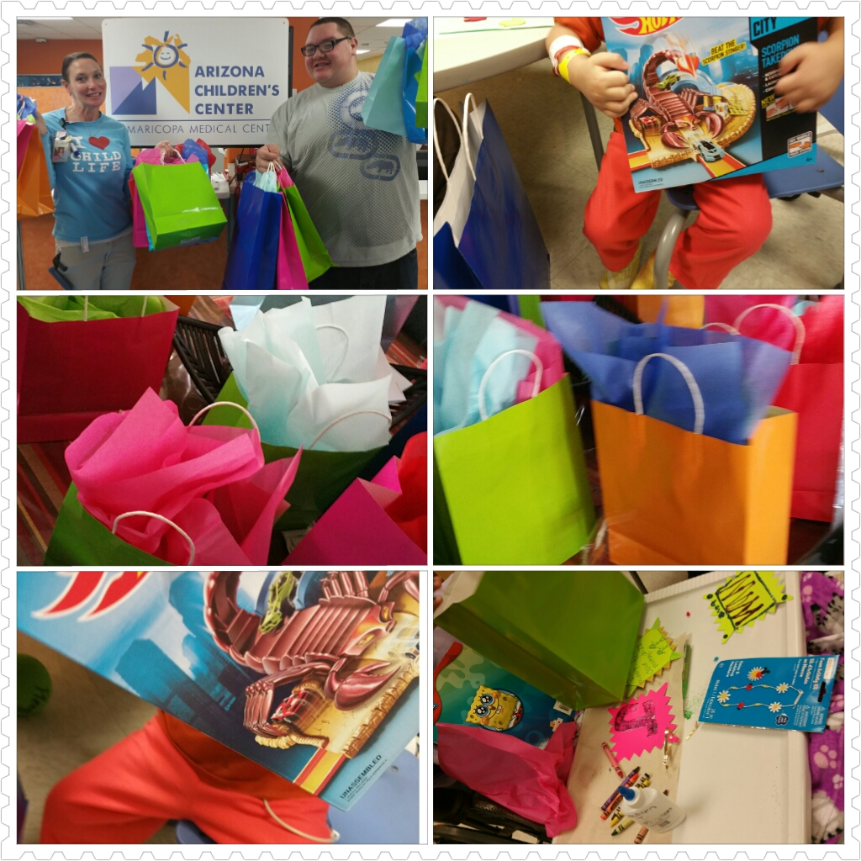
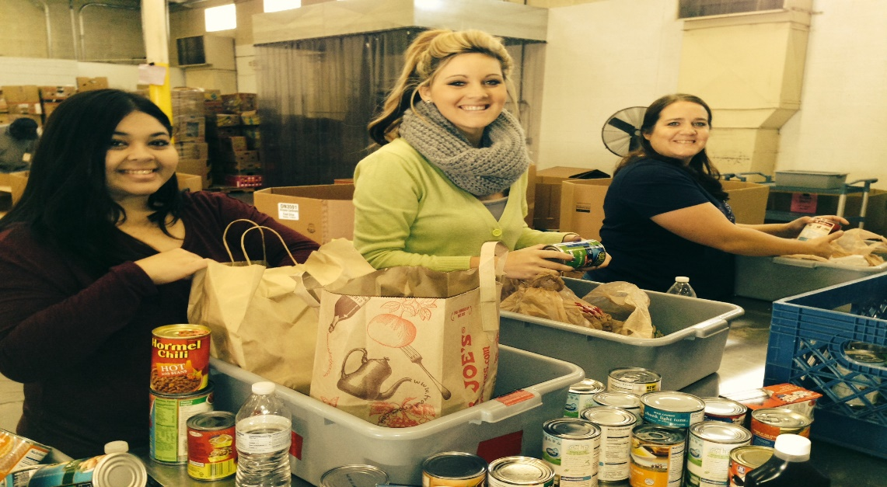

Slide 12
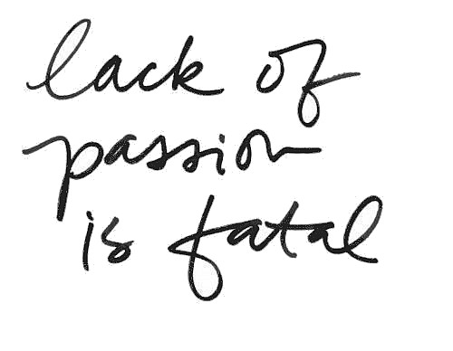
Do It Your Way!
Find your passion!
Determine how YOU would like to organize the SL projects
Start small
Don’t be afraid to try! (and learn from your mistakes)

Slide 13
Student Packet
Required Forms (liability release, time log with supervisor evaluation)
Proposal (submitted electronically)
Final Assignment Requirements (submitted to Canvas)
Reporting Your Hours to the Center for SL and CE online
***All forms can be found on the Center for Service Learning and Civic Engagement website

Slide 14
Any Questions?

Slide 15
For Additional Assistance
Center for Service Learning and Civic Engagement
Located in the Career and Transfer Center
Faculty SL Coordinator- Rachel Holmes x58407
Rachel.Holmes@estrellamountain.edu
MAR108
SL Coordinator- Landis Elliott 623.935.8220
Landis.Elliott@estrellamountain.edu

