Slide 1
Service Learning and Civic Engagement
By Rachel Holmes and Landis Elliott
OFFICE OF SERVICE LEARNING AND CIVIC ENGAGEMENT, EMCC

Slide 3
Definitions
Service Learning
The combination of community service and classroom instruction, with a focus on critical, reflective thinking as well as personal and civic responsibility
May be community service, one or more volunteer events, donations
Civic Engagement
Active participation in the public life of a community in an informed, committed, and constructive manner with a focus on the common good
Civic engagement provides students an opportunity to serve the community (the larger community or the college community) by working towards a long-term solution and/or awareness of an issue facing society
Working towards positive social change

Slide 4
Examples for Service Learning Proposals
Service Learning Examples
Civic Engagement Examples
Food Bank
Food Drive
Planning a Run off Campus
Humannequins
One Billion Rising
Panel Presentations
Guest Speakers

Slide 5
Examples Of Student Life Proposals (non-Service Learning)
Zombie Walk
Art Classes
Dance or Theater Performances
Open Mic
Karaoke Night
Sports Events
These types of events go to Student Life Website

Slide 6
Important Steps
Approved Agency
Risk Form
Talent Release Form
List participants with start/end times and date of event
Event Summary on Student Life Website
Please upload pictures
List of Agencies
Talent/Risk Forms
Proposal

Slide 7
The Center for Service Learning and Civic Engagement at EMCC
2015-2016 Goals:
- Increase SL/CE campus wide- begin with at least 25 instructors willing to implement
- Recognize the efforts of all students, faculty, staff, and community partners through a year-end recognition celebration in the Spring
Coordinators:
Landis Elliott, Manager of Internships and Coordinator of Center for SL/CE
Rachel Holmes, Faculty Coordinator of Center for SL/CE
F- 2014 6,189 hours
S- 2015 8,444 hours
21 instructors
GOAL FOR THIS ACADEMIC YEAR
20% INCREASE
F- 2015 7,426 hours
S- 2016 10,132 hours
25 instructors

Slide 8
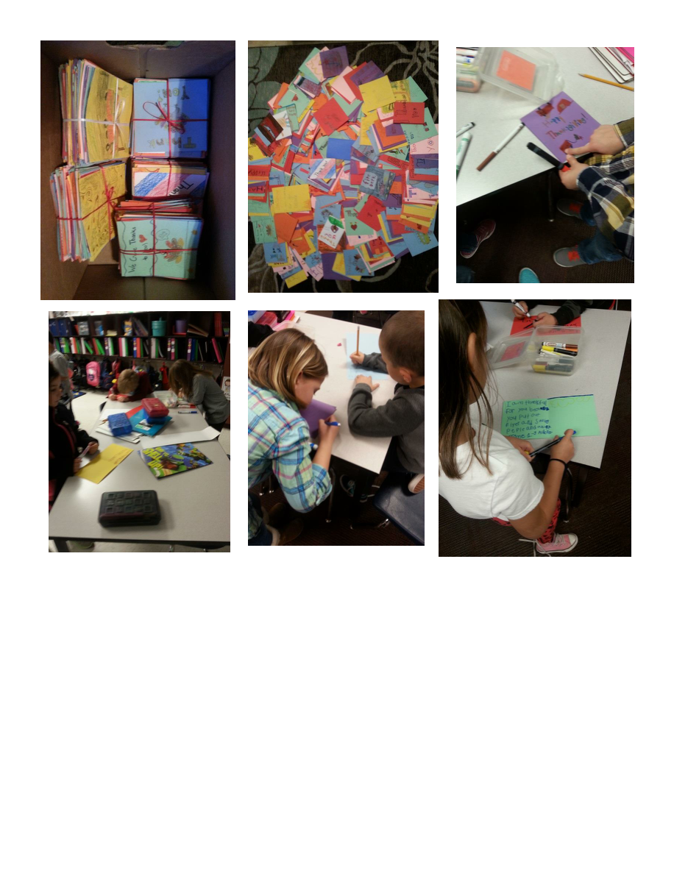
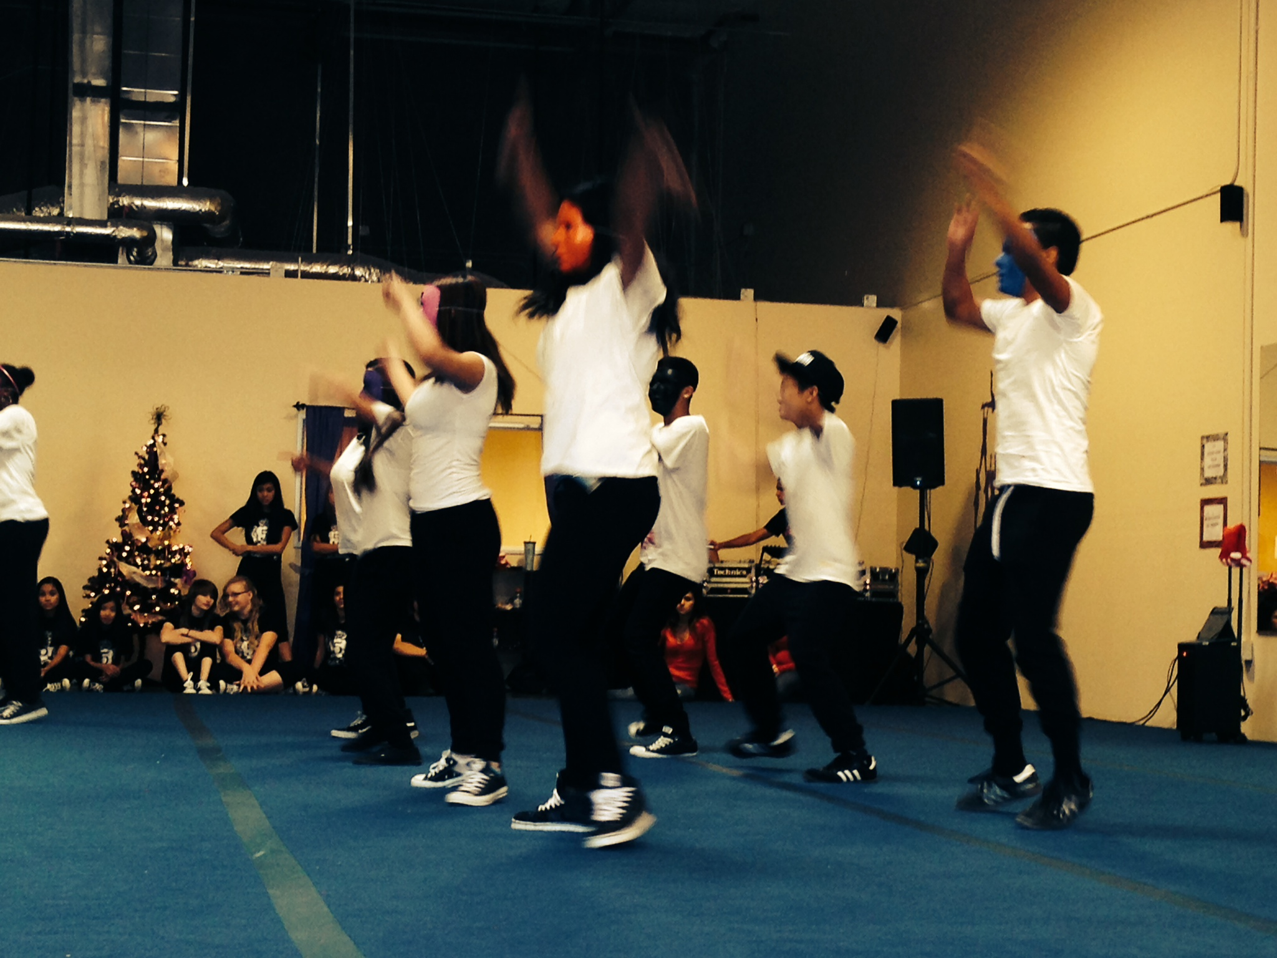

Slide 9
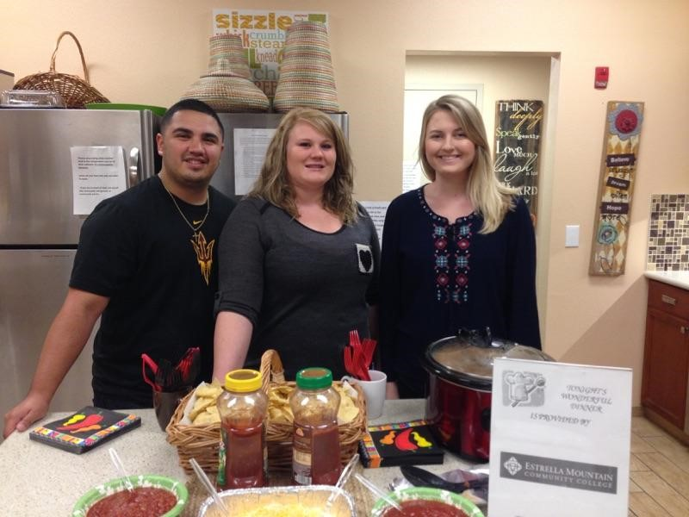

Slide 10
Sample Projects
Consider each of the following and whether it falls under Service Learning or Student Life
Humannequins
One Billion Rising
EMCC Health Fair
Community Garden
Field Day
Create and produce informational videos for non-profit organizations
Teach Senior Citizens basic computer skills
Create an after-school dance class for teens
Ice Cream Social
Volunteering at the local food bank

Slide 11
For More Information
Landis Elliott
Landis.Elliott@estrellamountain.edu
(623)935-8220
Rachel Holmes
Rachel.Holmes@estrellamountain.edu
(623)935-8407

