Slide 1
Day of Learning
Rise to the Challenge of Service Learning &
Civic Engagement
Center for Service Learning &Civic Engagement
Landis Elliott & Rachel Holmes, SL Coordinators
Notes:
Put in the orange hands brochure and play video as they come in

Slide 2
Objectives
Share the successes that EMCC Service Learning and Civic Engagement has experienced in the first year of this newly revived program
Introduce Civic Engagement
Discuss campus-wide projects

Slide 3
Overview of Outcomes after first year
1.) Increased the number of Agencies
2.) Alternative Spring Break
3.) Service Learning Celebration
4.) President’s Volunteer Service Award
5.) Increase the participation and number of hours in service learning

Slide 4
Creating and Maintaining Community Partnerships

Slide 5
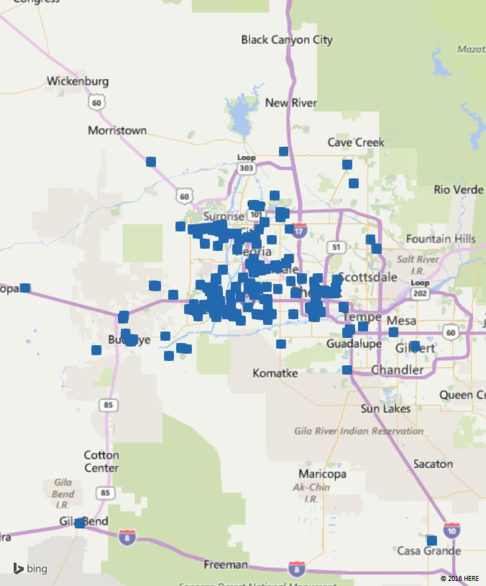
Oak Creek Canyon
The Reach
of EMCC Service Learning Students
EMCC
Mesa
Buckeye
Gila Bend
Casa Grande

Slide 6
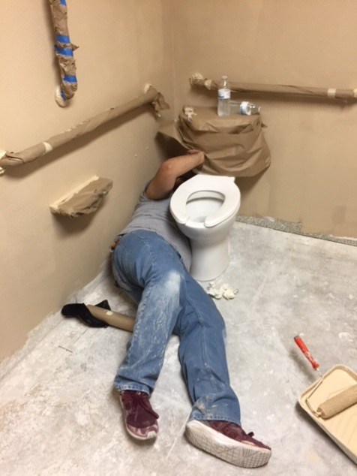
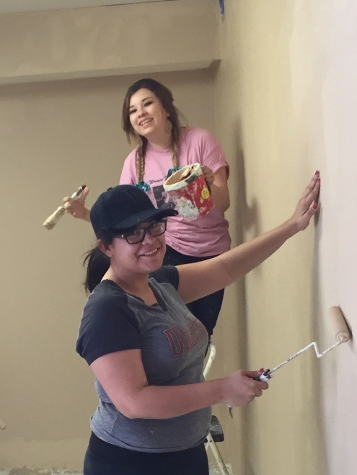
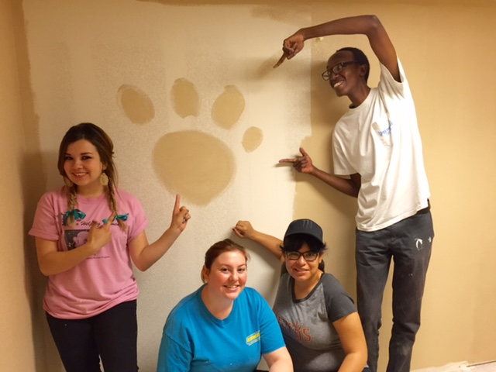
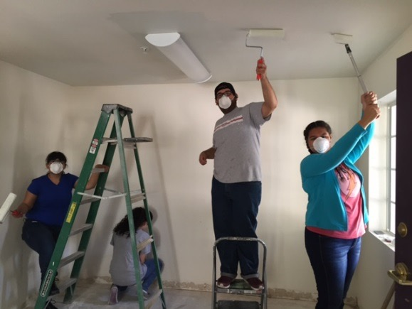
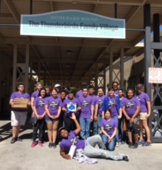
Alternative Spring Break 2016
Homeward Bound
30 Students (24
had no previous SL experience)
370 Hours

Slide 7
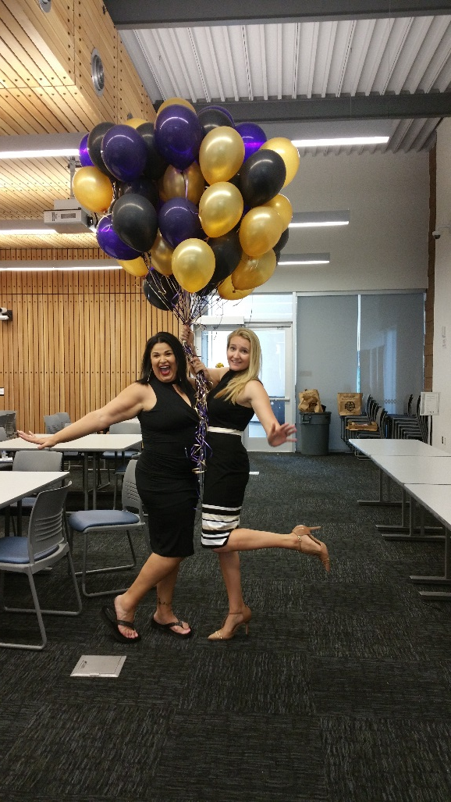
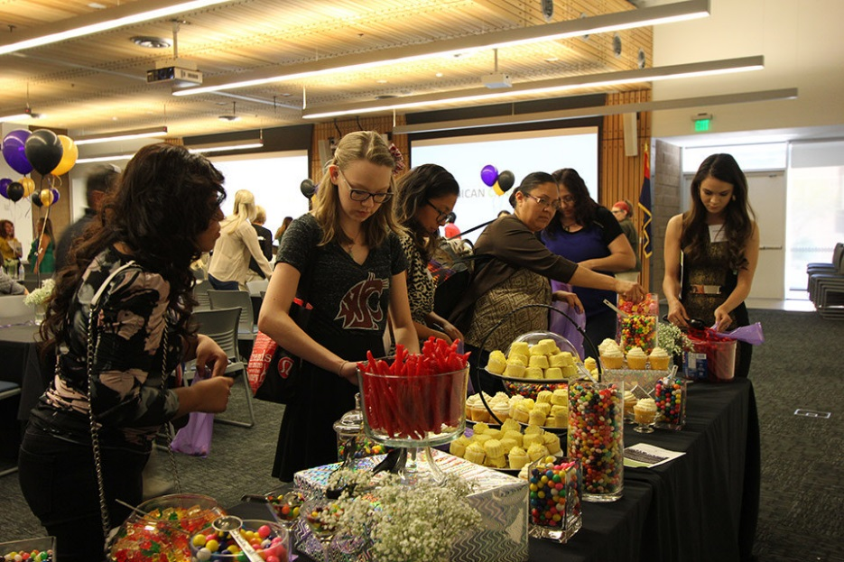
Spring Celebration

Slide 8
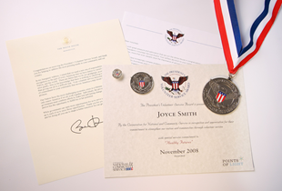
Presidential Community Service Award
Hours by Award | Bronze | Silver | Gold
Kids (5-10) | 26 – 49 | 50 – 74 | 75 +
Teens (11–15) | 50 – 74 | 75 – 99 | 100 +
Young Adults (16-25) | 100 – 174 | 175 – 249 | 250 +
Adults (26 and older) | 100 – 249 | 250 – 499 | 500+
Families and Groups* | 200 – 499 | 500 – 999 | 1,000+
President’s Lifetime Achievement Award: Individuals who have completed 4,000 or more hours in their lifetime
* Two or more people, with each member contributing at least 25 hours toward the total
60 students have received
this honor

Slide 9
2014/15
21 instructors
15/16 AY
17,558 hours
25 instructors
GOAL FOR THIS
ACADEMIC YEAR
20% INCREASE
2015-2016AY
20,003 Hours
25 Instructors
=
Value of Volunteer time is $467,270*
Based on the Estimated Value of Volunteer Time ($23.36) from the 2015 Bureau of Labor Statistics
Notes:
At the beginning of the Fall semester the goal was set to increase service learning by 20%. To date- we have not only exceeded this goal and contributed 17,455 hours to the community but…when you take the estimated value of volunteer time for 2015 which is $23.56 EMCC can estimate the value of the volunteer hours provided at over $400,000.

Slide 10
Recognition of all Service Learning Students
754 EMCC students participated in Service Learning during the
2015/16 Academic Year
Notes:
Campus wide we have had over 754 students that participated in service learning during the academic year. We would like to honor all of the students that are present today and that truly impacted the community thru your work. you may pick up your certificate on the way out after the luncheon but at this time will you all stand and be recognized.
And now for our most prestigious award. The President’s Volunteer Service Award

Slide 11
2016- 2017 Goals
5% increase in the number of Service Learning hours per semester
Incorporating the SW Skill Center in Service Learning
Piloting Service Learning in CPD 150
Create a campus-wide Service Learning Project each semester
Create more collaborative Service Learning opportunities between clubs/orgs
Focus on Civic Engagement
Increase staff participation in Service Learning/Civic Engagement
Award President’s Volunteer Service Award to staff/faculty

Slide 13
What is Service Learning and Civic Engagement?
Service Learning- Meaningful community service, connecting to classroom ___________ and includes a ____________.
Civic Engagement- Serving the community to take action by working towards a long-term ________and spreading awareness of an issue facing _____________.
Notes:
Objectives , reflection
Goal, society

Slide 14
Think/pair/share
What do you already know about Civic Engagement?
What questions do you have about implementation?

Slide 15
Civic Engagement
Volunteerism
Social Engagement
Cultural Events
Political and Social Arenas
Notes:
Civic Engagement: Instruction and activities designed to encourage students to promote the quality of life in our communities in both political and social arenas, while developing the combination of knowledge, skills, values and motivation to create morally and civically responsible citizens.
Volunteerism: Participation in direct or indirect activities designed to improve the quality of life of fellow students or off-campus community residents.
Social Engagement: Participation in any on or off campus activity that encourages social connections with peers, faculty, staff, or community.
Cultural Events: Campus-based or community events that bring people of different backgrounds, ethnicities, preferences, and experiences together in ways that allow expression of ideas, traditions, values, and social/political concerns.

Slide 16
Difference Between SL and CE
Let’s discuss ….
Notes:
SL- related to course competencies, content, major
Includes reflection piece
CE- related to societal issues/topics that promote positive change
Some projects may fall under both:
Club: STEM, water conservation activity at a local elementary school, reflection for Student Life (in this case, the activity relates to an societal topic and it may relate to the students’ major, as well.
Example:
Veteran’s Day Run:
Culinary Club- Service Learning
Veterans Club- CE

Slide 17
Creating a Culture of Civic Responsibility
A great way to start is with a whole-class activity
I.e. Host an environmental fair
Plan issue-specific, campus-wide forums.
Students, faculty, community members, and agency partners can share information about topics such as substance abuse, domestic violence, homelessness, family planning, women’s rights, etc.
These types of projects encourage teamwork and allow students to ease into CE in a relevant manner

Slide 18
Methods of Implementation
Political and social arenas: developing the combination of knowledge, skills, values and motivation to create morally and civically responsible citizens.
Volunteerism: Participation in direct or indirect activities designed to improve the quality of life of fellow students or off-campus community residents.
Social Engagement: Participation in any on or off campus activity that encourages social connections with peers, faculty, staff, or community.
Cultural Events: Campus-based or community events that bring people of different backgrounds, ethnicities, preferences, and experiences together in ways that allow expression of ideas, traditions, values, and social/political concerns.

Slide 19
Matching Activity
Political and social arenas
Volunteerism
Social Engagement
Cultural Events
Notes:
Political and social arenas: developing the combination of knowledge, skills, values and motivation to create morally and civically responsible citizens.
Volunteerism: Participation in direct or indirect activities designed to improve the quality of life of fellow students or off-campus community residents.
Social Engagement: Participation in any on or off campus activity that encourages social connections with peers, faculty, staff, or community.
Cultural Events: Campus-based or community events that bring people of different backgrounds, ethnicities, preferences, and experiences together in ways that allow expression of ideas, traditions, values, and social/political concerns.

Slide 20
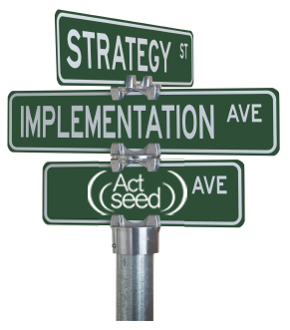
Implementation of CE
Direct Service
Capacity Building
Advocacy
Philanthropy
Notes:
You can take any of the methods from slide 20 and execute using one of these 4
Direct Service: Hands-on community service, primarily off campus, e.g. tutoring, environmental restoration, senior companionship
Capacity Building: Enhancing the organizational capacity of a community agency, school, or non-profit organization, e.g. web design, marketing, strategic planning
Advocacy: Raising awareness of issues; political participation; influencing public opinion and/or policy, e.g. CCE public forums, voter registration, campaigns
Philanthropy: Fundraising for causes and community organizations
***DEPENDING ON TIME: we may do this whole-group quickly

Slide 21
4 Square
In small groups, let’s brainstorm some practice ways that we can implement the 4 Types of CE at EMCC– JIGSAW Activity
Whole-group discussion
Notes:
Ex. Direct service- casita at New Life
Philanthropy- fundraising for New Life Center
Advocacy- Voter registration push on campus
Capacity building-

Slide 22
Implementation of CE
A variety of opportunities to get involved on campus and at the district level
Town Hall- (set up by Mesa CC)
One Billion Rising
District SL Feed My Starving Children
Adding a CE component to your curriculum
This is more than CE projects; it’s teaching the fundamentals of CE and creating a culture of understanding
Creating a CE activity that directly relates to your curriculum and allows students to truly make an impact.

Slide 23
CE Documentation Process
Follow the same process currently used for on-campus events
Step 1
Track hour on a spreadsheet
Name, Student ID, # of hours etc
Spreadsheet can be emailed
Step 2
Event Data Collection
Name of Event, Date, Time Span, Head Count (estimated or sign in sheet)
Notes:
Same time-log for service learning

Slide 24
Campus –Wide Projects
IDEAS FOR CAMPUS-WIDE PROJECTS
Holiday Helping Hands- “in the works”
Overview
Saturday Celebration
4 Hour Event
50+ Families
Read Across America Day
Spring Fling
Community Outreach Day
Notes:
Receive a food box (Specify one or two clubs to run the drive and prepare boxes- AJS? PRIDE)
Shop at the Clothing Closet (Specify one or two clubs to run the drive and prepare the clothing closet- Feminist? PTK?)
Play games in the game room (educational games, EDU students and Storytelling classes will read to children and dress up like characters in the books, carnival-like atmosphere, all clubs can host one or more games)
Parents attend parent workshops/tabling event with community resource information, information on Kids Camp, information on VITA, free health screenings, health and wellness info, and more (Business, Career and Transfer Center, Community Partners, Lyle)
Outdoor BBQ with free food (Culinary)
Receive one gift per child (Specify one club to run the toy drive and wrap gifts- Student Life? International? MeCha) (if we do this in December)
Provide translators in parent workshops/tabling/game room (MeCha, EDU)
Face-painting (Art Club)
Outdoor dance performance/Music and Dance Event that gets attendees involved (Dance/Choir Departments)
Santa (Student Life) or Thanksgiving Turkey
Turkey Trot if we do it in November (Veterans Club)

Slide 25
Stay and Stray
1.) What is the 1st step you are going to take to implement civic engagement?
2.) What do you feel is the most effective way to get student buy-in?
4.) Civic Engagement Project List
5.)Benefits to the students, community, faculty/staff
Notes:
Need chart paper/markers

Slide 26
Thank you
Landis Elliott
Landis.Elliott@estrellamountain.edu
(623)935-8220
Rachel Holmes
Rachel.Holmes@estrellamountain.edu
(623)935-8407

