Slide 1
Center for Service Learning & Civic Engagement
Landis Elliott & Rachel Holmes, SL Coordinators

Slide 2
2015-2016 Goals
- Increase SL/CE campus wide- begin with at least 25 instructors willing to implement
- Recognize the efforts of all students, faculty, staff, and community partners through a year-end recognition celebration in the Spring
F- 2014 6,189 hours
S- 2015 8,444 hours
21 instructors
GOAL FOR THIS ACADEMIC YEAR
20% INCREASE
F- 2015 7,426 hours
S- 2016 10,132 hours
25 instructors

Slide 3
Building the Foundation
Faculty Handbook
- Extra Credit Assignment
Website
CTL Workshops
End-of-the Year Celebration

Slide 4
Partnerships
Presidential Scholars
Engage Estrella
Student Life- Ambassadors
Agency Partners
Advisory Board

Slide 5
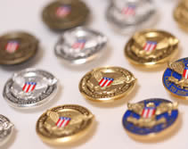
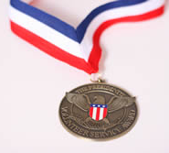
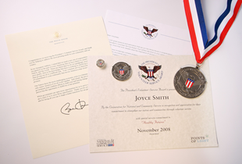
Presidential Community Service Award
Hours by Award | Bronze | Silver | Gold
Kids (5-10) | 26 – 49 | 50 – 74 | 75 +
Teens (11–15) | 50 – 74 | 75 – 99 | 100 +
Young Adults (16-25) | 100 – 174 | 175 – 249 | 250 +
Adults (26 and older) | 100 – 249 | 250 – 499 | 500+
Families and Groups* | 200 – 499 | 500 – 999 | 1,000+
President’s Lifetime Achievement Award: Individuals who have completed 4,000 or more hours in their lifetime
* Two or more people, with each member contributing at least 25 hours toward the total

Slide 6
Upcoming Events
EMCC campus-wide events
Supporting the Veteran’s Run- Fall 2015
Supporting the United Way Committee – Food Drive Fall 2015
Dr. Suess’ Birthday - Spring 2016
District-Wide
Feed Our Starving Children – Spring 2016

Slide 7
We Need Your Support
Class presentations on Service Learning
Implementation of SL and/or Extra Credit Assignment
Attend our CTL workshops
Recommend Agency Partners

Slide 8
For More Information
Landis Elliott
Landis.Elliott@estrellamountain.edu
(623)935-8220
Rachel Holmes
Rachel.Holmes@estrellamountain.edu
(623)935-8407

