Slide 1
Presidential Scholarship Service Learning
Landis Elliott
Manager of Internships, Service Learning & Civic Engagement
EMCC

Slide 2
Presidential Scholar SL Requirements
Complete 10 hours of volunteer service OR participate in 2 specific events
Choose an Agency
Submit SL Project Proposal October 16th
Volunteer
Complete the SL Reflection Assignment Due December 1st

Slide 4
What is Service Learning?
Service Learning
The combination of community service with a focus on critical, reflective thinking as well as personal and civic responsibility
May be community service, one or more volunteer events, donations

Slide 6
Key Components
Connecting Service with Learning
Reflection
Reciprocity
Critical Thinking

Slide 7
Key Component 1: Connecting Service with Learning
A successful SL project must include meaningful service and is directly tied to your major/area of study
This service may be in the community or solely on the college campus
Impacts all stakeholders positively
Requires a final assessment/reflection
Dual focus– the service and knowledge gained from that service

Slide 8
Key Component 2: Reflection
Reflection by the student is ongoing throughout the project

Slide 9
Key Component 3: Reciprocity
Service Learning makes it possible for the student to both give and to receive!
t/p/s
Imagine that you are volunteering in the local domestic violence shelter or the local food bank. What would you ‘receive’ from this experience?

Slide 10
Component 4: Critical Thinking
Service Learning allows the students to learn, volunteer, and work on a project that can and should facilitate reflective and analytical thinking.

Slide 11
How to Get Started
Research Partner Agencies and identify a community need
Submit your Service Learning Proposal for approval
Complete your 10 Service Learning hours
Upload the Reflection Assignment to CANVAS

Slide 12
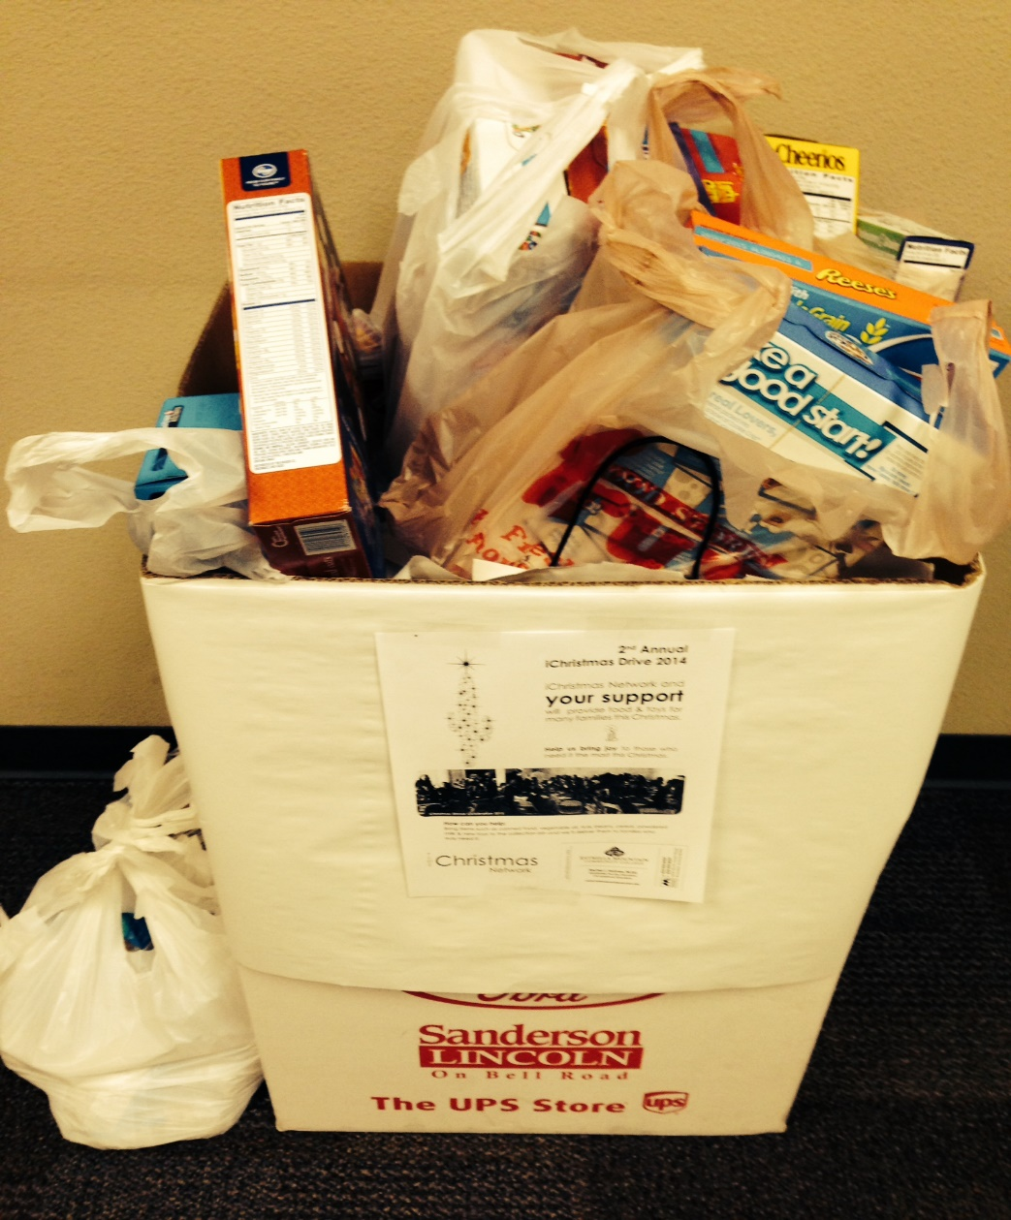
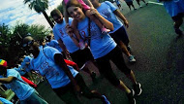

Slide 13
For Additional Assistance
Center for Service Learning and Civic Engagement
Located in the Career and Transfer Center (CTC)
Rachel Holmes, Faculty SL Coordinator
623.935.8407
Rachel.Holmes@estrellamountain.edu
MAR108
Landis Elliott, SL Coordinator
623.935.8220
Landis.Elliott@estrellamountain.edu
CTC

