Slide 1
Center for Service Learning & Civic Engagement
Landis Elliott & Rachel Holmes, SL Coordinators

Slide 2
Program Overview

Slide 3
Types of Experiential Education
Service Learning- Meaningful community service, connecting to classroom learning and includes a reflection.
Civic Engagement- Serving the community to take action by working towards a long-term solution and spreading awareness of an issue facing society.

Slide 4
Benefits
Builds community partnerships
Leads to greater student retention and degree completion
Provides real-life application of what students are learning in the classroom.
Provides an opportunity for students to learn about and give back to the community
Stimulates intellectual and leadership development
Helps prepare students for their future careers
Allows students to serve as involved citizens in their communities and heightens awareness of community needs
Develops critical thinking, communication, and problem-solving skills

Slide 5
2015-2016 Goals
F- 2014 6,189 hours
S- 2015 8,444 hours
21 instructors
F- 2015 7,426 hours
S- 2016 10,132 hours
25 instructors
GOAL FOR THIS ACADEMIC YEAR
20% INCREASE
Fall 2015: Over 10,000 hours

Slide 6
Fall 2015/16 Accomplishments
1.) Marketing Materials
2.) Creation of Advisory Board
3.) Increased the number of Agencies
4.) Alternative Spring Break
5.) Service Learning Celebration
6.) President’s Volunteer Service Award

Slide 7
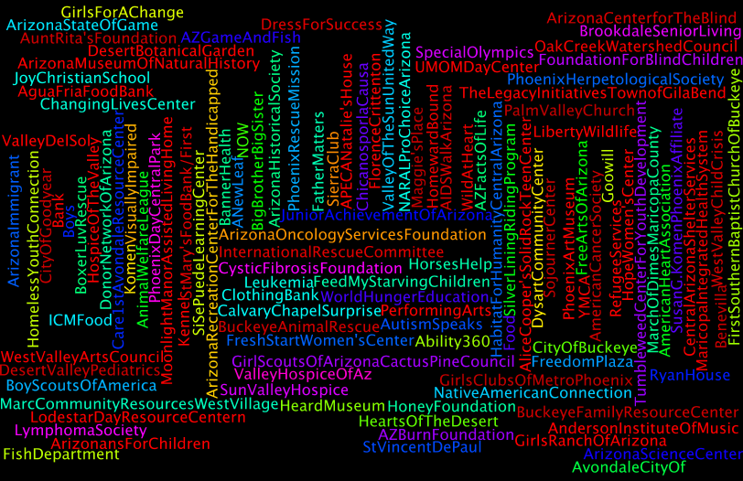

Slide 8
Fall 2015/16 Accomplishments
1.) Marketing Materials
2.) Creation of Advisory Board
3.) Increased the number of Agencies
4.) Alternative Spring Break
5.) Service Learning Celebration
6.) President’s Volunteer Service Award

Slide 9
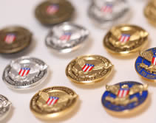
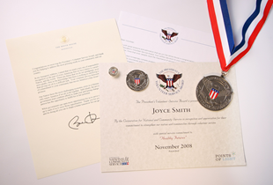
Presidential Community Service Award
Hours by Award | Bronze | Silver | Gold
Kids (5-10) | 26 – 49 | 50 – 74 | 75 +
Teens (11–15) | 50 – 74 | 75 – 99 | 100 +
Young Adults (16-25) | 100 – 174 | 175 – 249 | 250 +
Adults (26 and older) | 100 – 249 | 250 – 499 | 500+
Families and Groups* | 200 – 499 | 500 – 999 | 1,000+
President’s Lifetime Achievement Award: Individuals who have completed 4,000 or more hours in their lifetime
* Two or more people, with each member contributing at least 25 hours toward the total

Slide 10
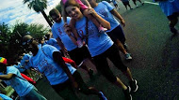
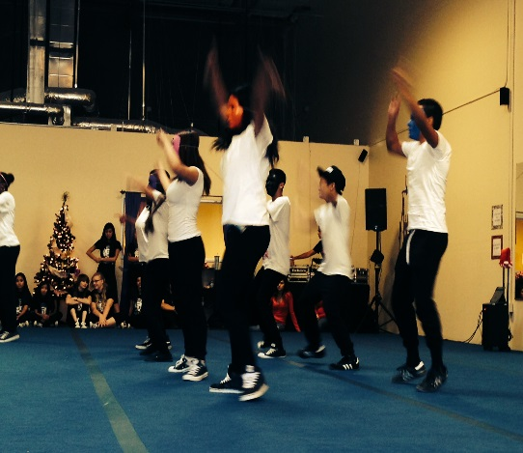
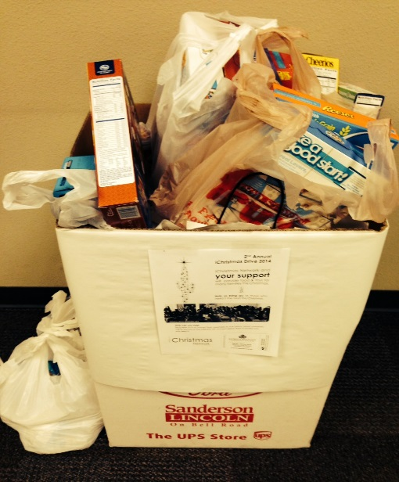
Service Learning Examples and Successes

Slide 11
Campus Events
Fall 2015
Supporting the Veteran’s Run
Supporting the United Way Committee – Food Drive
Spring 2016
Alternative Spring Break with Homeward Bound- March 14th- 17th
Feed Our Starving Children- April 1st
Opportunity Fair- April 6th
Service Learning Celebration- April 29th

Slide 12
We Need Your Support
Become a Service Learning Agency
Service Learning Advisory Board Member
Partner during on campus events such as the Opportunity Fair.

Slide 13
For More Information
Landis Elliott
Landis.Elliott@estrellamountain.edu
(623)935-8220
Rachel Holmes
Rachel.Holmes@estrellamountain.edu
(623)935-8407

