Slide 1
Feminist Club Tables Outside to Educate on Intersectionality and Feminism

Slide 2
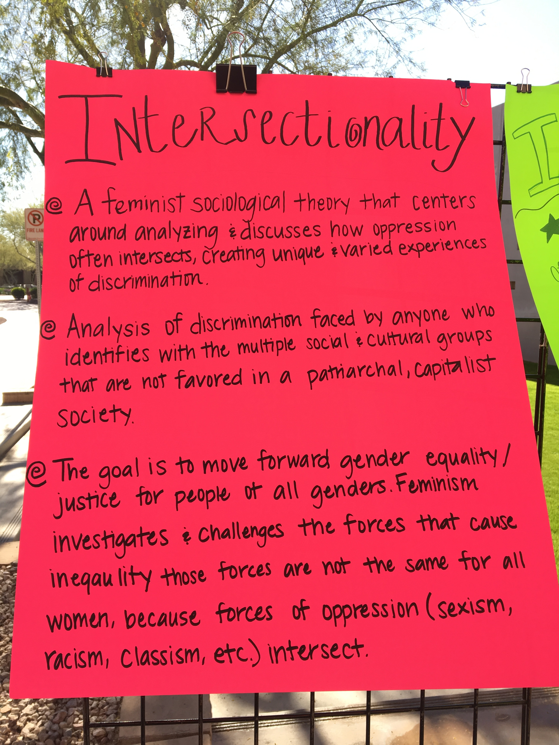
POSTERS DISPLAYED To cREATe coNVErSATION ON THE TOPIC

Slide 3
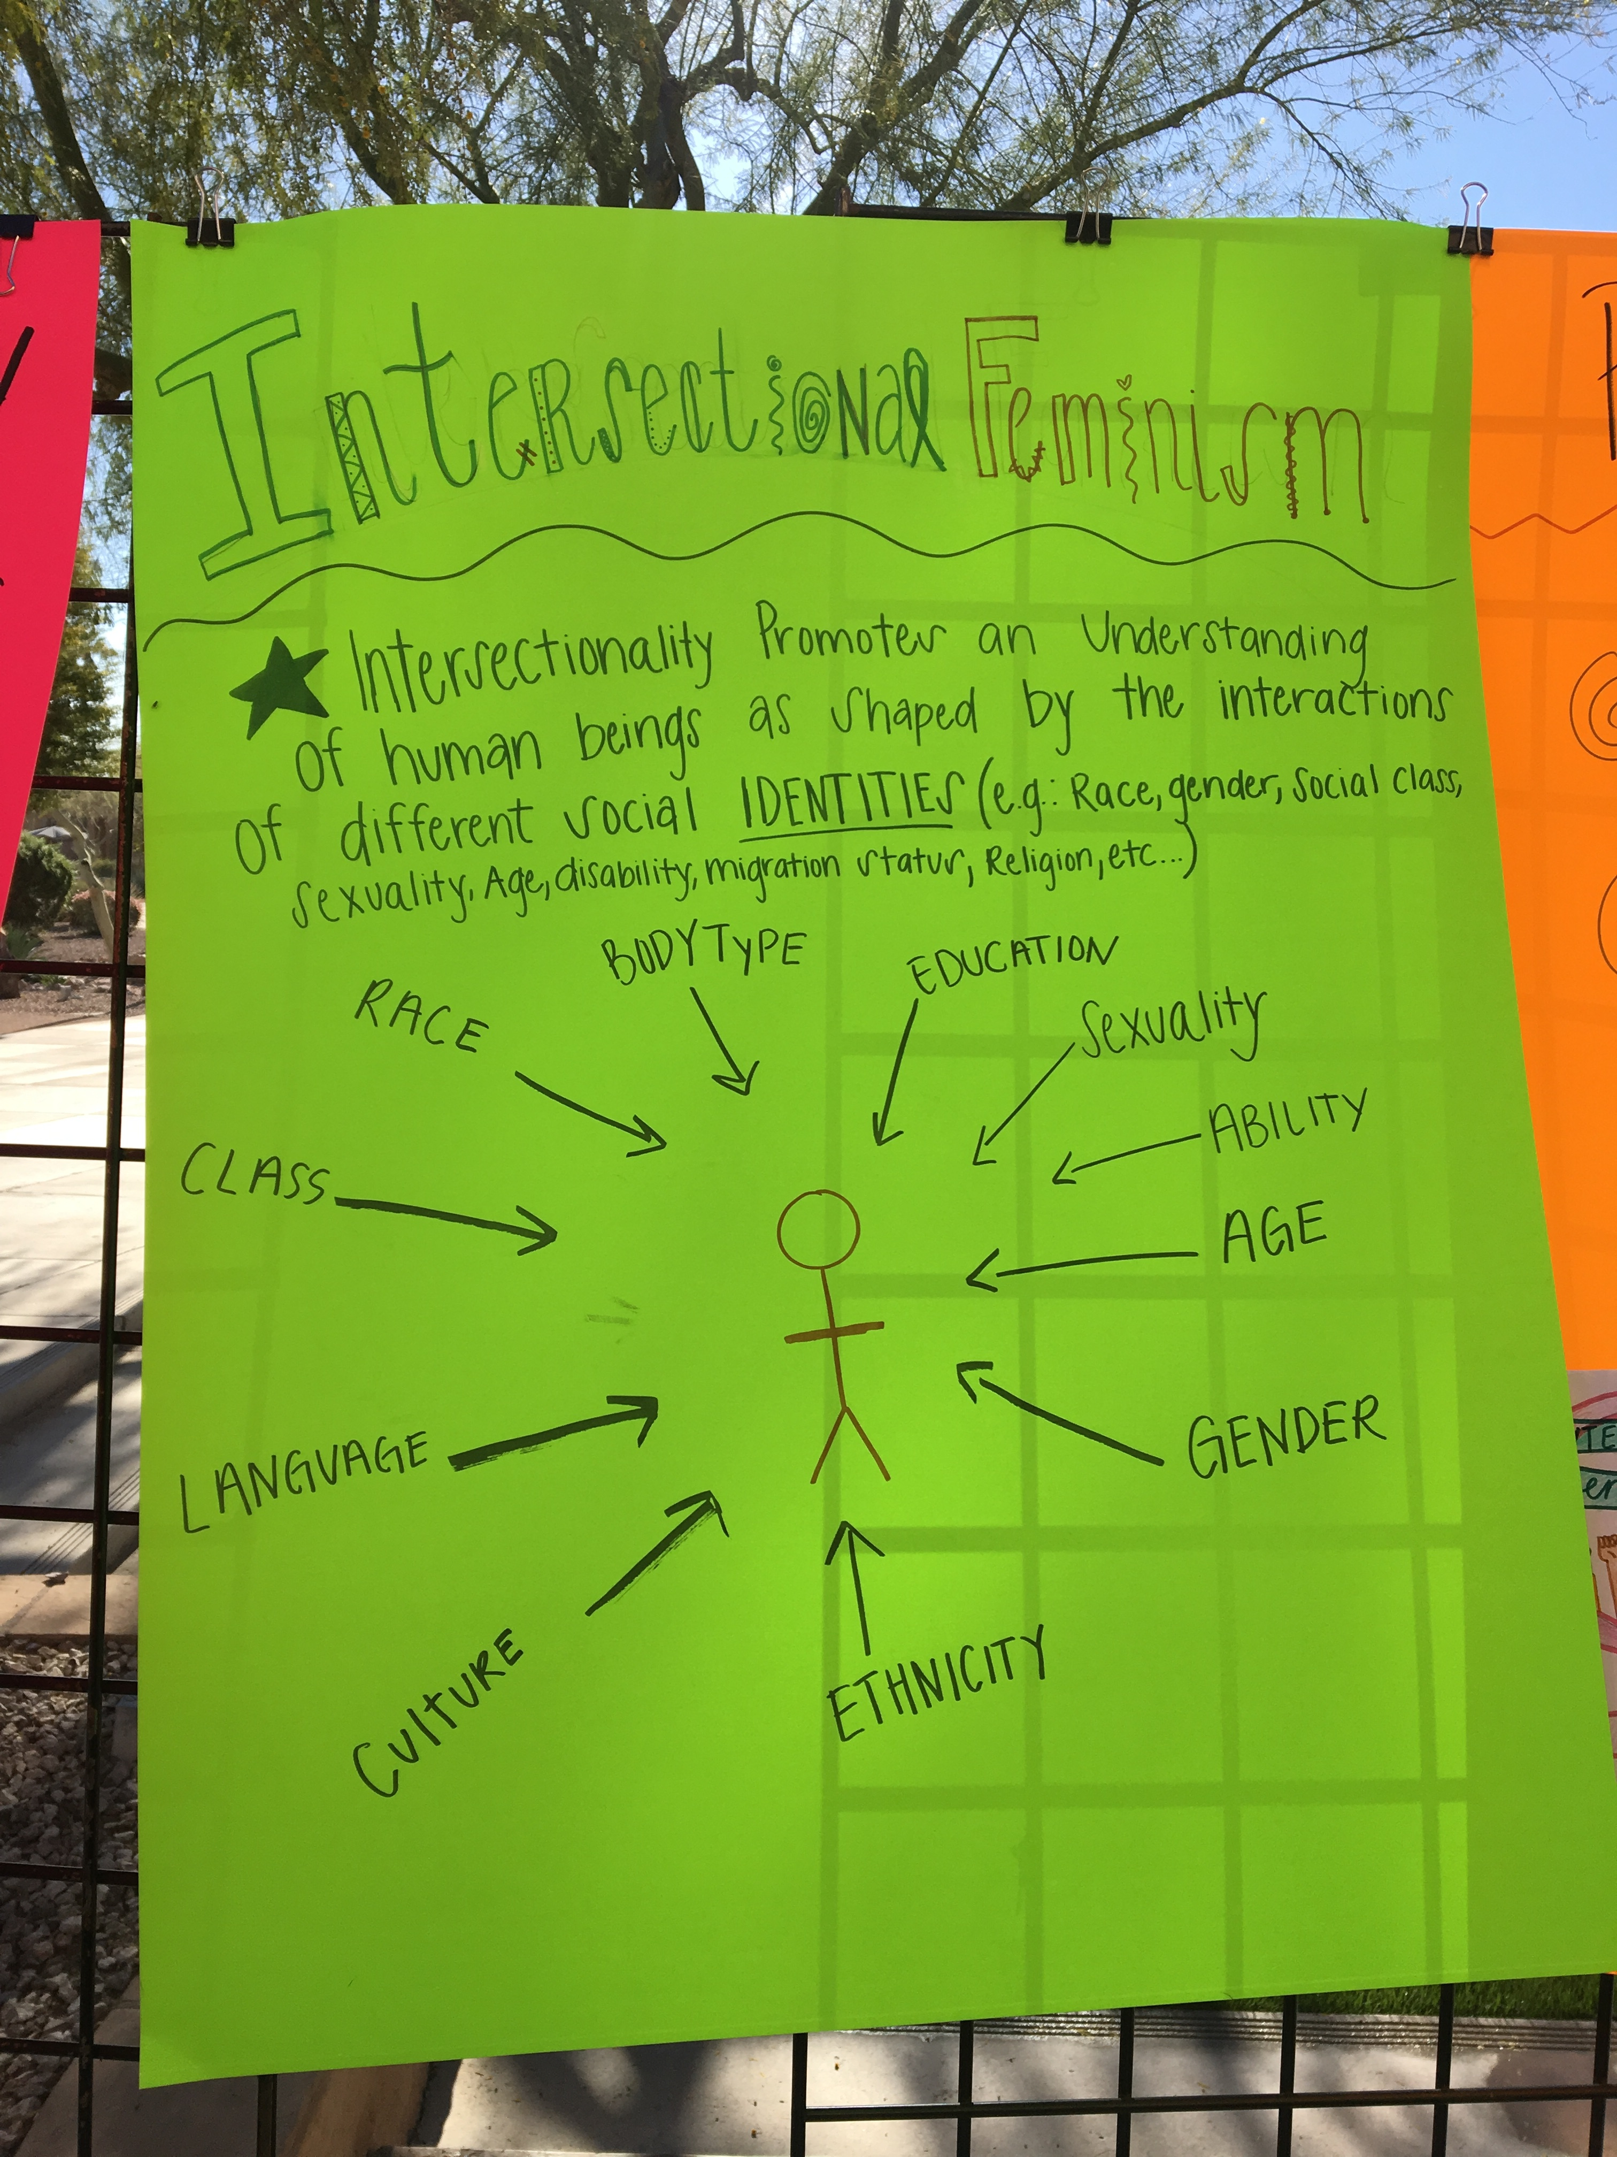

Slide 4
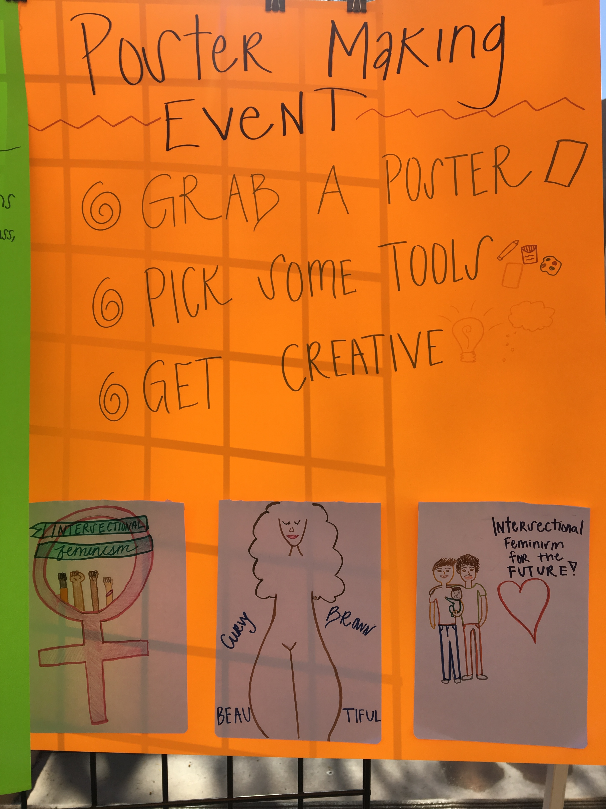

Slide 5
SAMPLE POSTER TO MODEL ACTIVITY

Slide 6
SAMPLE POSTER TO MODEL ACTIVITY

