Slide 1
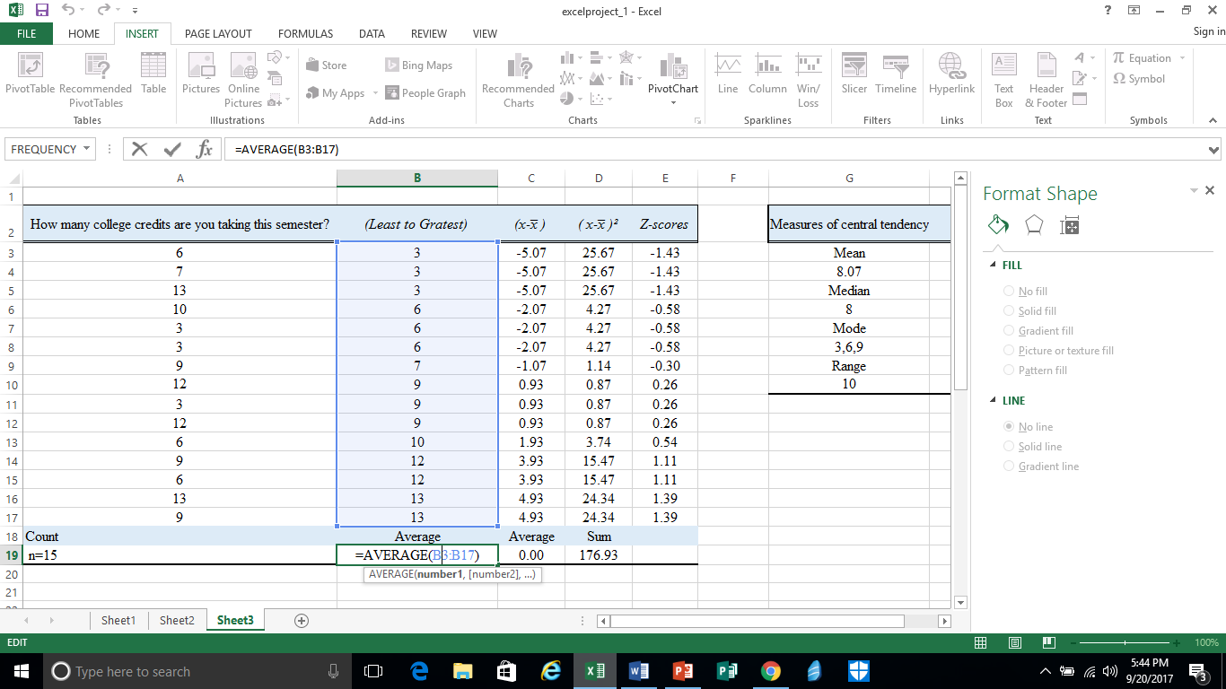
Step 1: Arrange all data from least to greatest to make it easier to calculate central tendencies. When arranged from least to greatest, you find the median by finding the middle number. Mode is the score that occurs most often. In this case, the Mode(s) are 3, 6, and 9. To find the Average (mean), click on the box that you want to display the information and click on the fx at the top of the screen. Select “Average” and ensure that you are averaging the correct boxes (B2:B17).

Slide 2
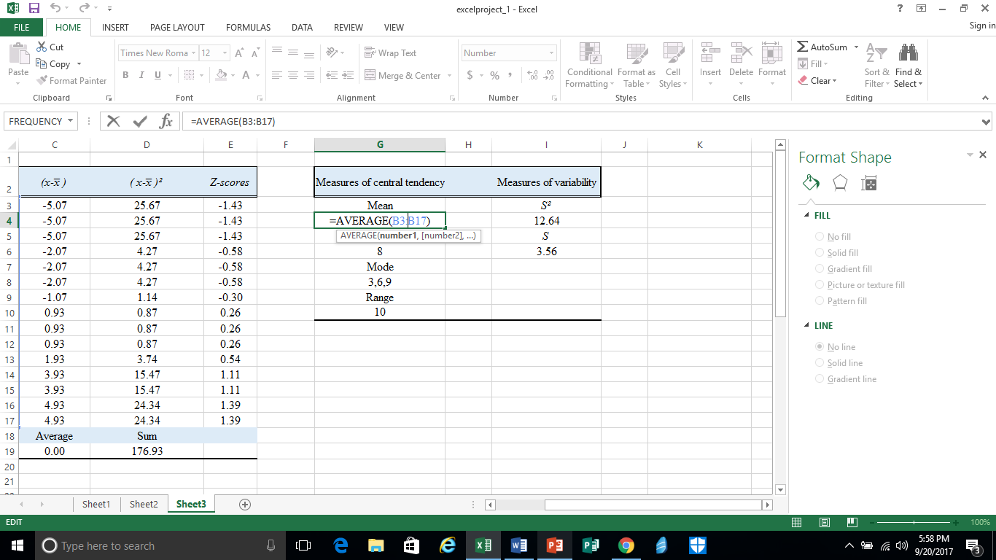
Step 2: Follow step 1 to get the mean of the data.

Slide 3
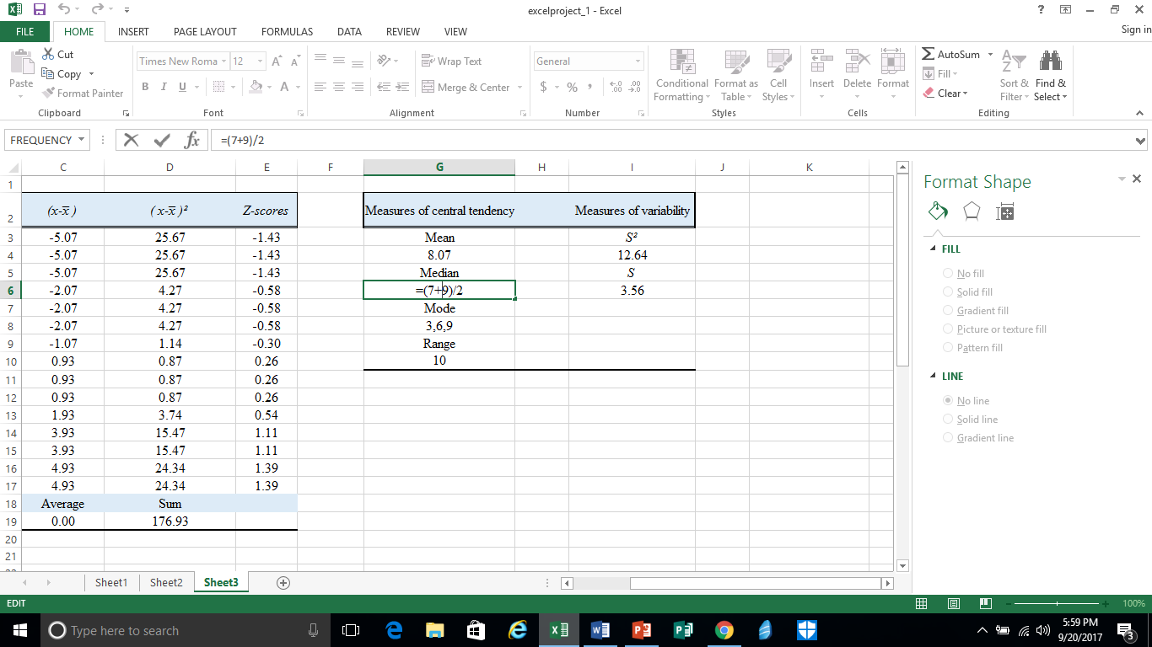
Step 3: To find the median, arrange the data from least to greatest. If you get an odd count of numbers, just add the two numbers and then divide the answer by 2 Ex: =(7+9)/2.

Slide 4
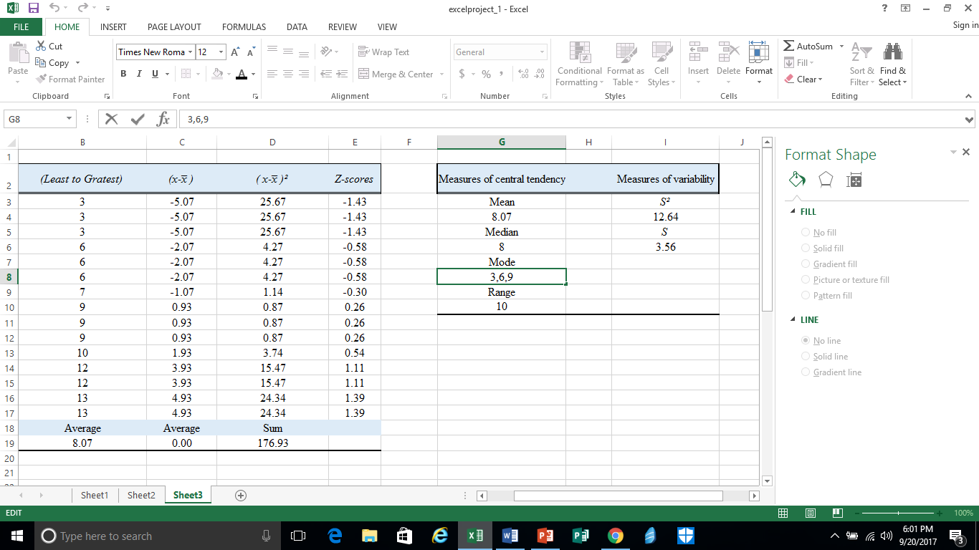
Step 4: To find the mode of the data, look at the sample data and find the number that appears most often. In this case, we have 3 numbers that appear the same amount of times.

Slide 5
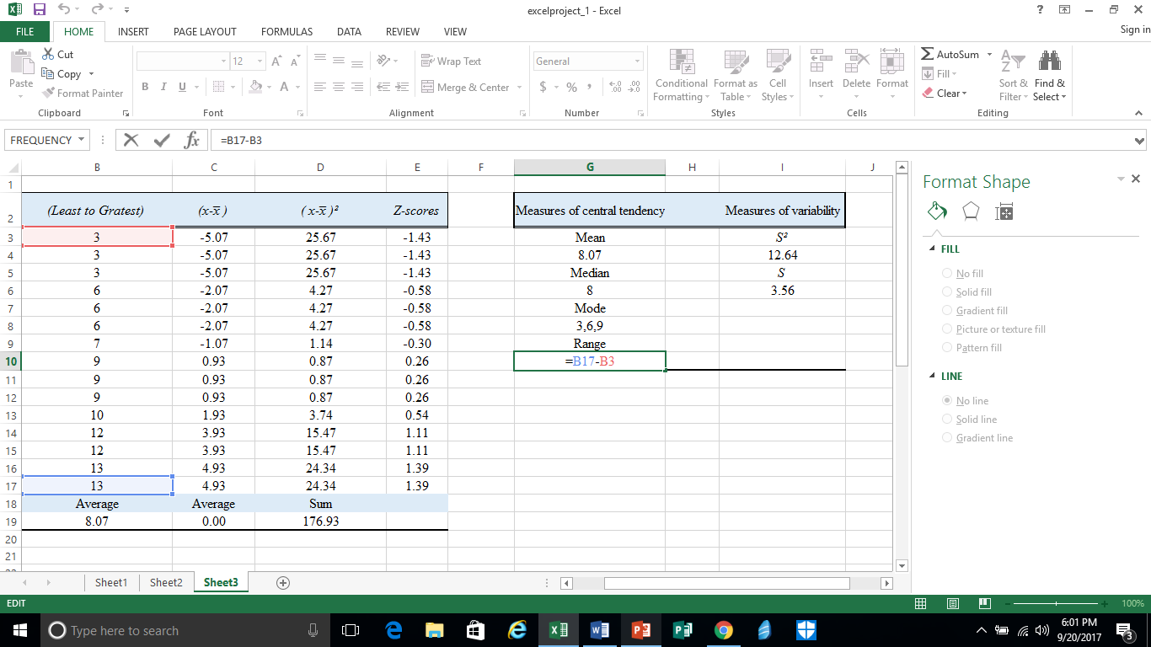
Step 5: To find the range of the data, you need to find the largest number and subtract it from the smallest number.
Ex: =13-3

Slide 6
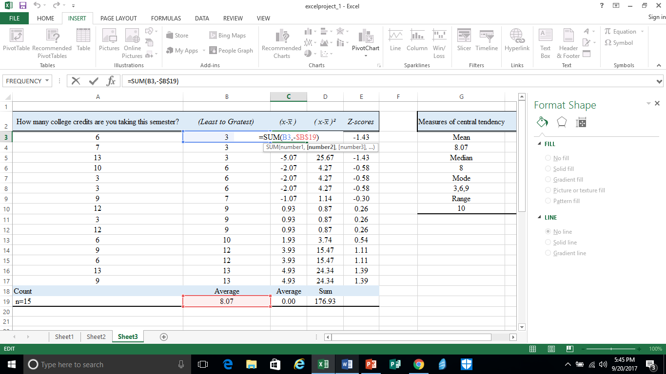
Step 6: To find the deviation of a sample number you need to choose the cell you want to place the data and you type =SUM in the function bar at the top. Then, apply the sample number minus the mean, as shown in the picture. Ex: =SUM(B3-$B$19) The 2 money signs are added to the formula to follow the formula to the next cell without having to type the formula again and again.

Slide 7
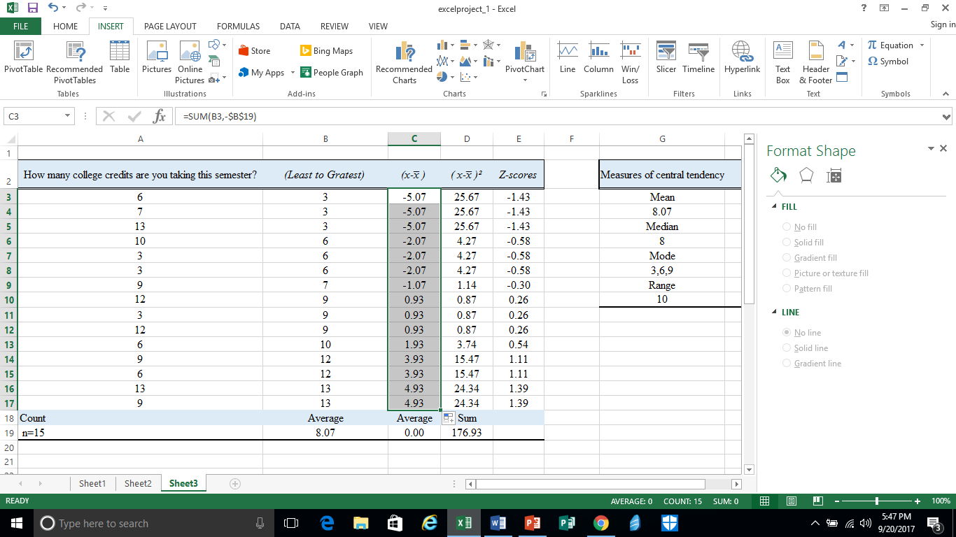
Step 7: Drag the cursor down the column (signified by a black cross). As you drag the cursor down, it should highlight the column and the deviation formula should follow along .

Slide 8
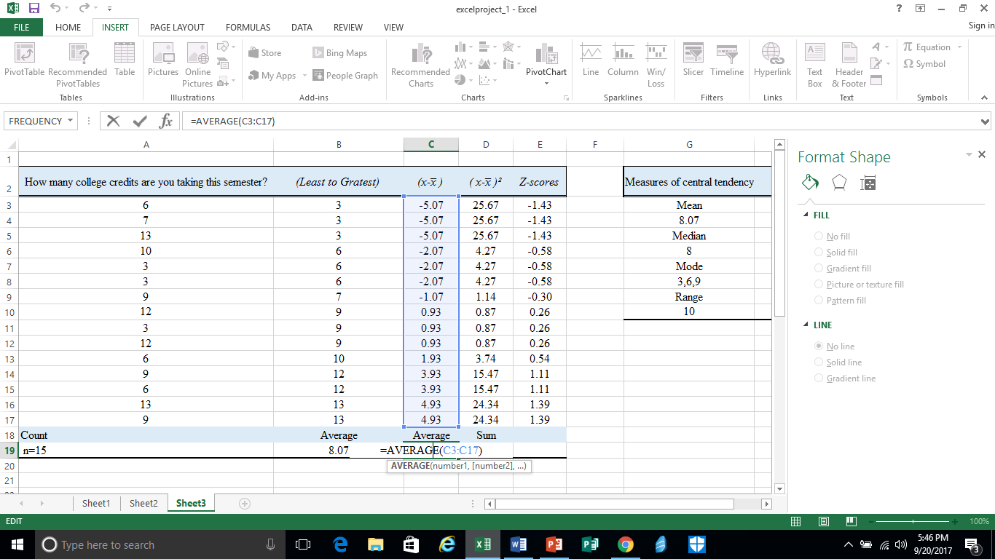
Step 8: To find the average of the deviation column follow the steps for step 1, and just highlight the C column instead. The average should always be equal to zero.

Slide 9
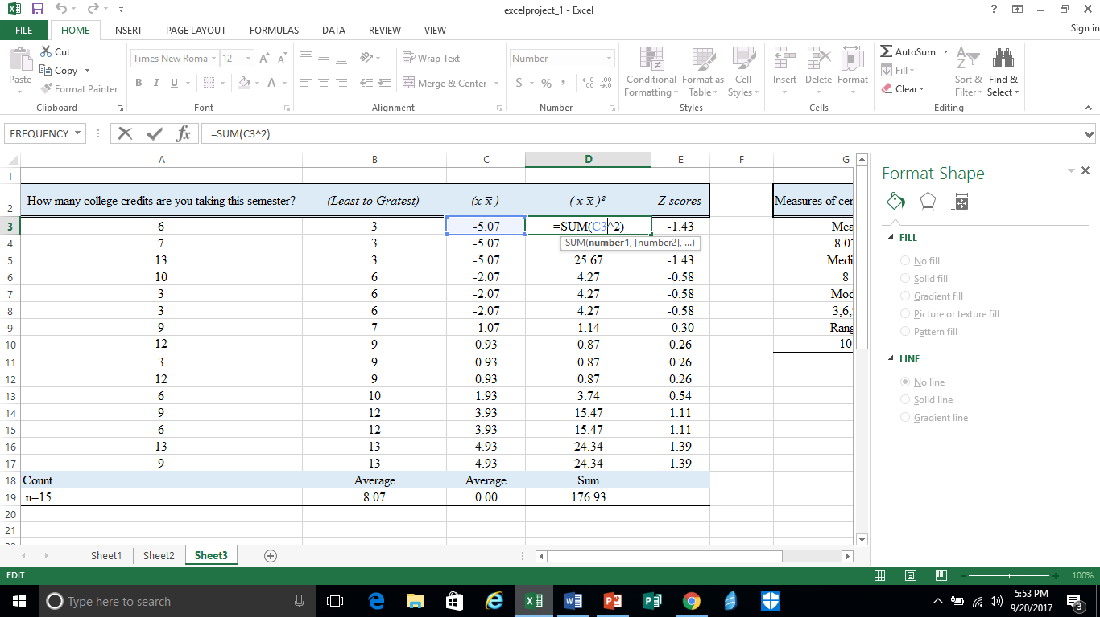
Step 9: To find the deviation squared, you need to click the cell you want to display the information in and then hit =SUM. Then, apply the deviation and ^2. That should give you the deviation squared of the sample deviation.

Slide 10
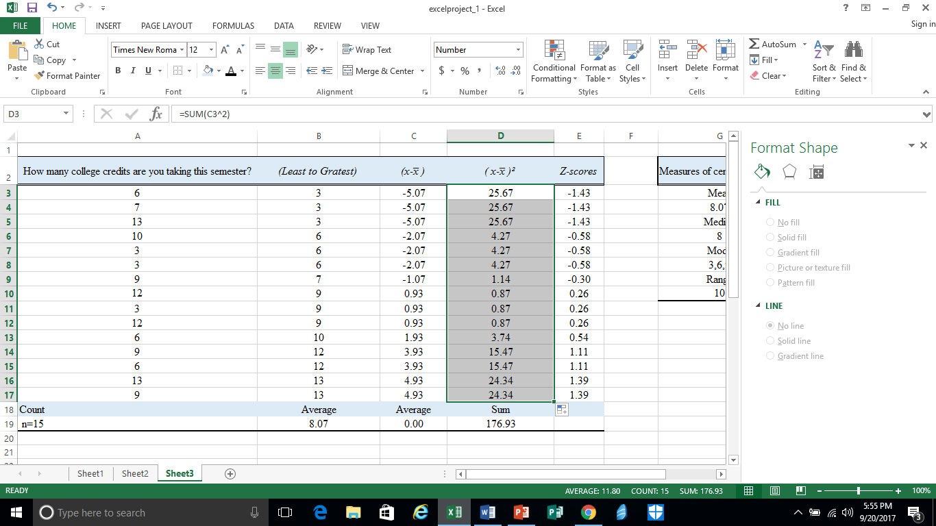
Step 10: Drag the cursor down column D so the formula can follow.

Slide 11
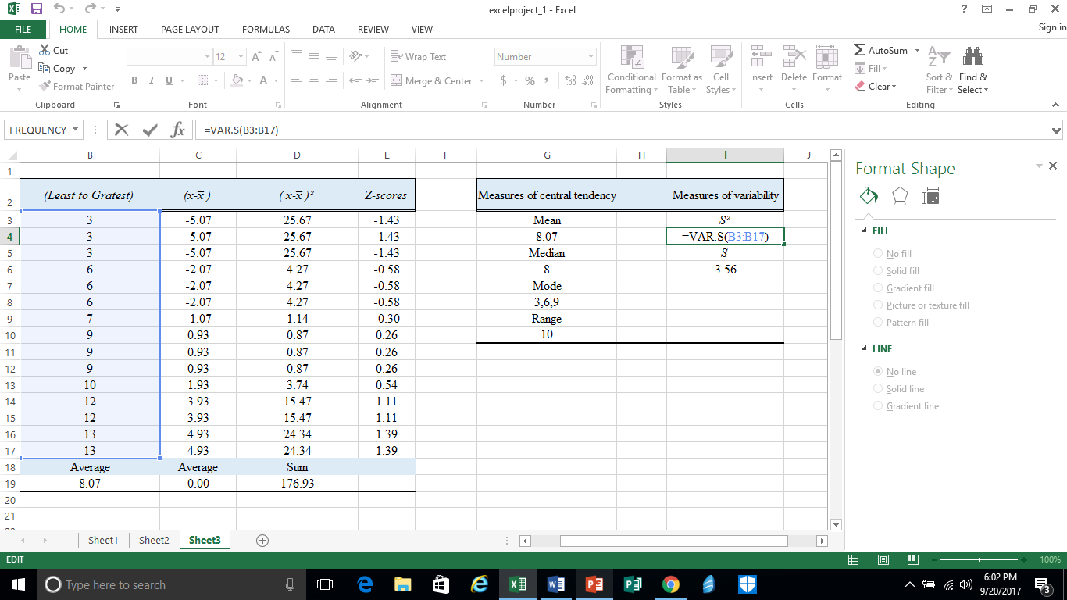
Step 11: To find the variance click a cell, and then type =VAR.S in parentheses in the function bar. Highlight the sample data. Ex: =VAR.S(B3:B17)

Slide 12
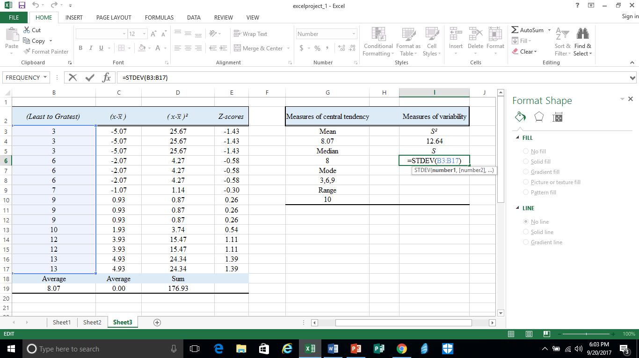
Step 12: To find the Standard deviation, choose a cell and then type =STDEV in the function bar. Then, highlight the column with the sample data in column B. Ex: =STDEV(B3:B17)

Slide 13
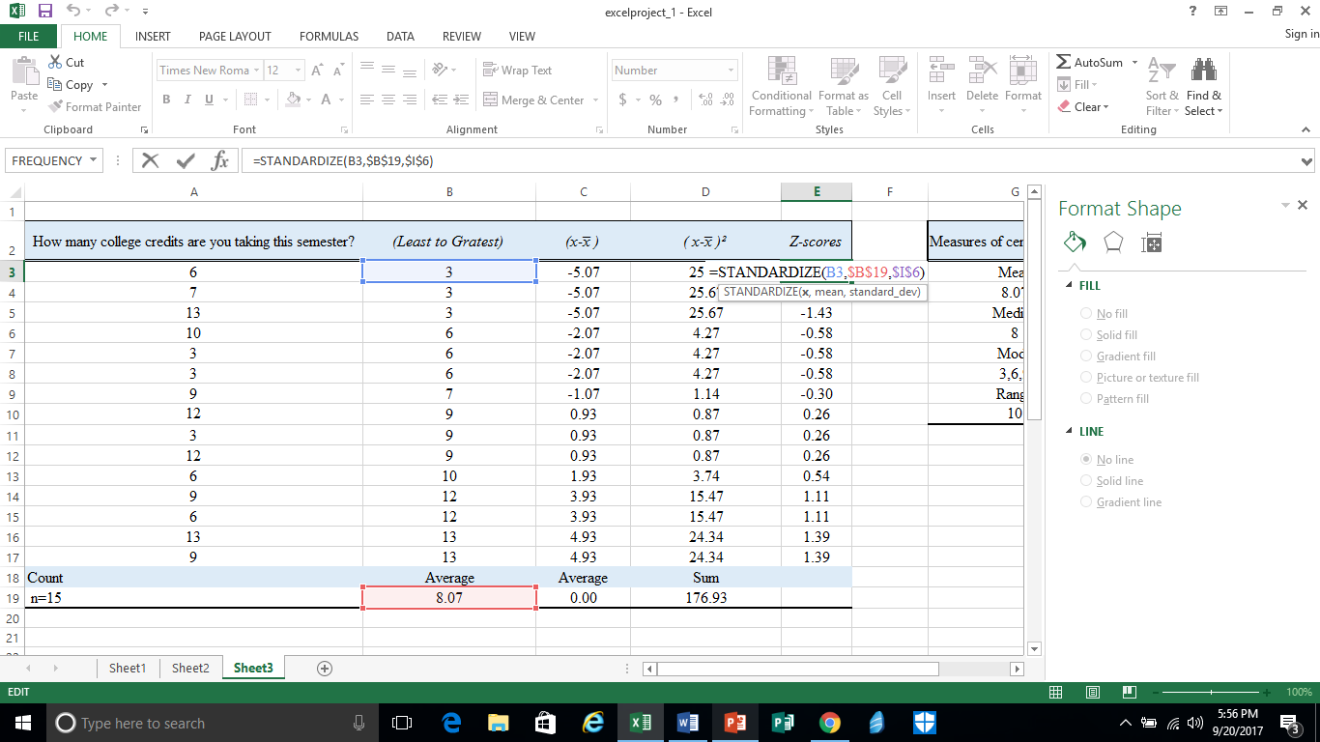
Step 13: To find the Z-score of each sample, choose cell E3 and type =STANDARDIZE in the function bar. Then, in parentheses, type the sample data, mean and standard deviation. That should give you the Z-score of that specific data.

Slide 14
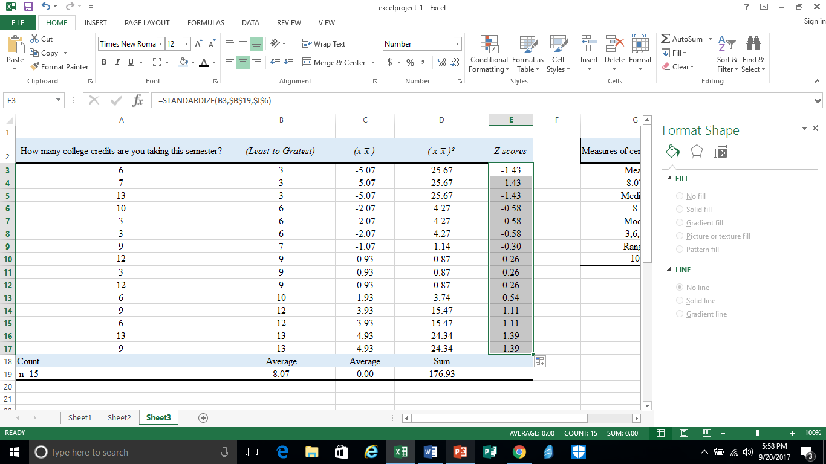
Step 14: Drag the cursor down the column so the formula follows and gives you the rest of the Z-scores.

Slide 15
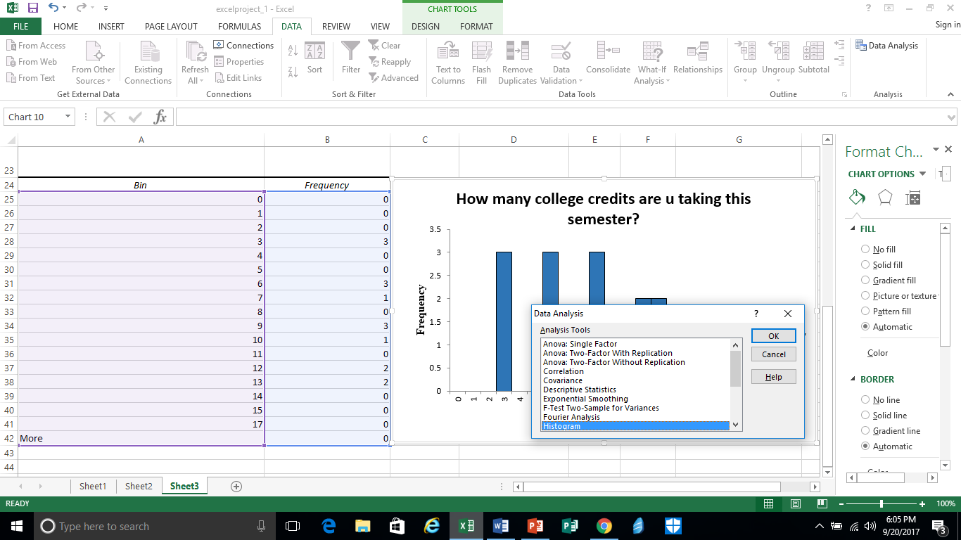
Step 15: To create a histogram, you click on data analysis in the top right corner of the screen. Then, an option box should pop up. Click histogram and then click Ok.

Slide 16
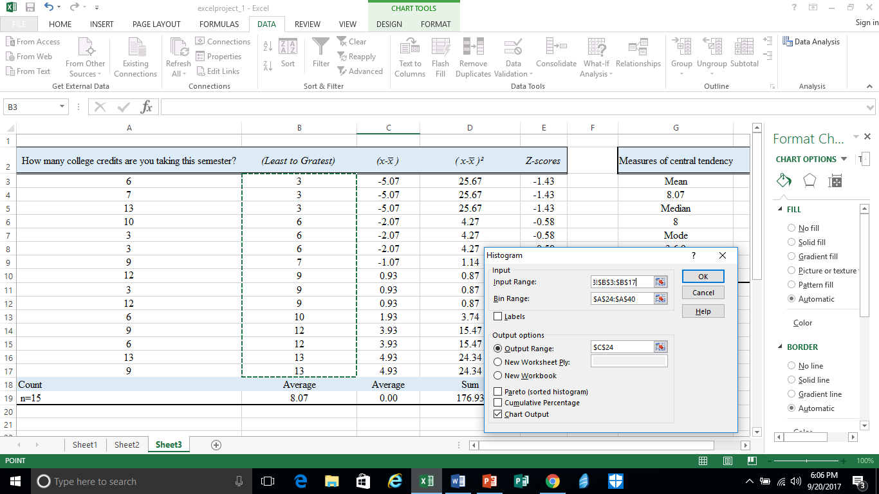
Step 16: Another small options box should pop up. In the Input Range box, highlight the sample data and press enter.

Slide 17
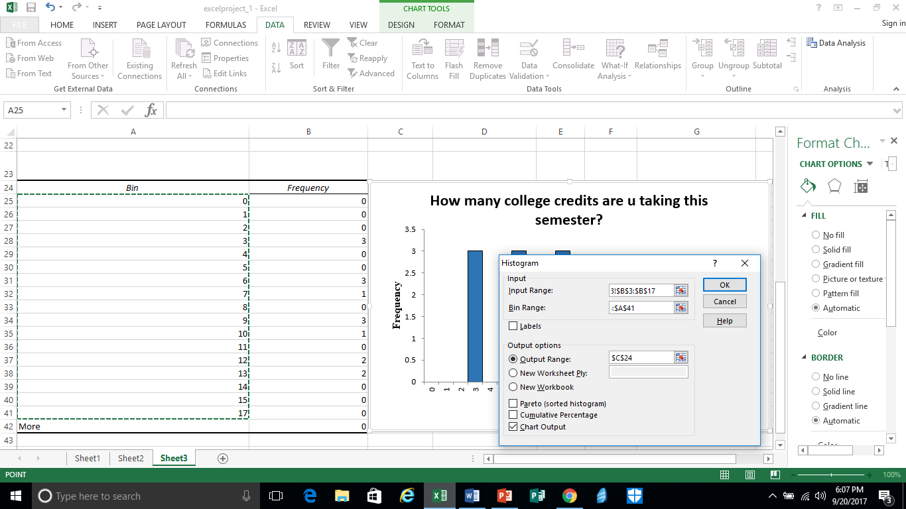
Step 17: In the bin range, highlight the bins you want the histogram to show. You can create bins at any increments you want. Then, click Ok.

Slide 18
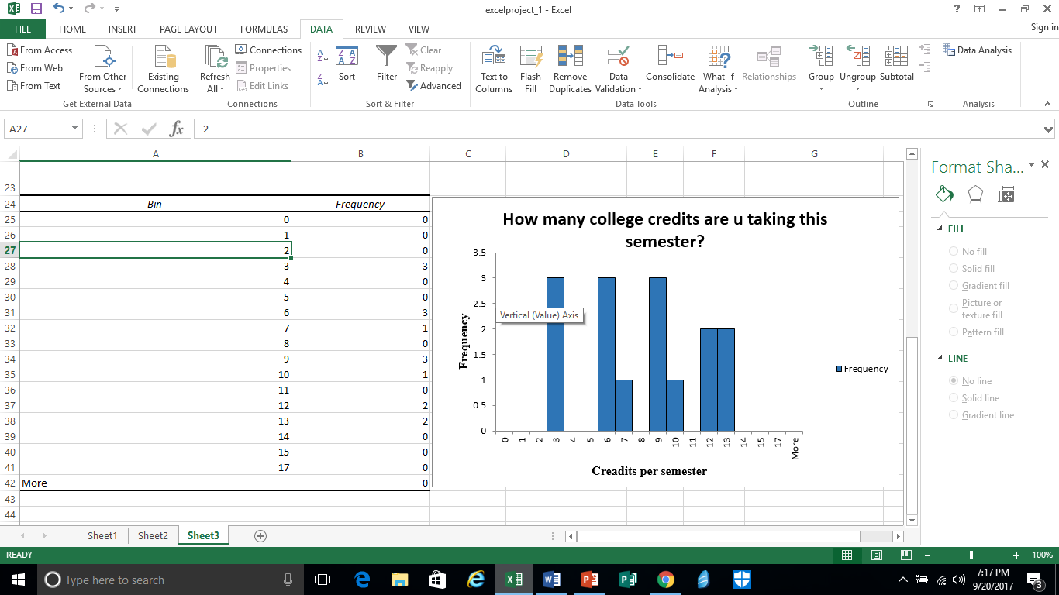
The histogram should look like this.

