Slide 1
Intrusive Advising Outcomes Summary
Fall 2017

Slide 2
Presentation objectives
Descriptive Data on Fall 2017 Intrusive Advising Services
Successful Course Completion Outcomes
Fall 2017 to Spring 2018 Persistence Outcomes
Caveats & Limitations of Findings

Slide 3
Descriptive Data: Intrusive Advising
N = 767

Slide 4
Aggregate Success Metrics

Slide 5
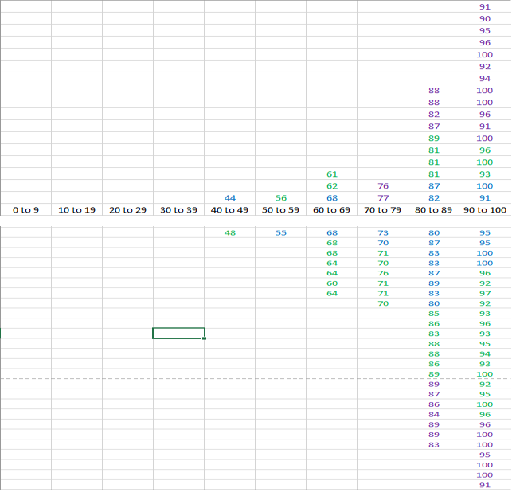
Successful Course Completion Distribution

Slide 6
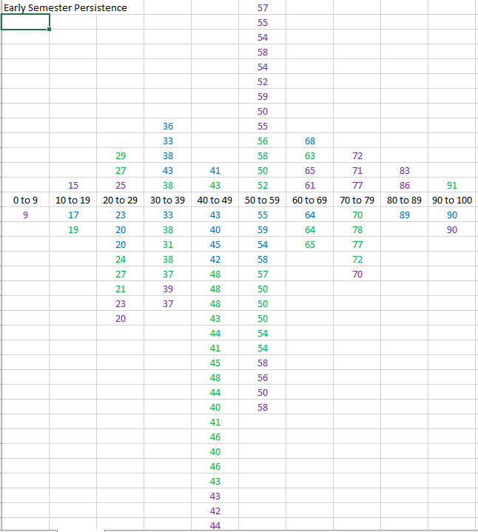

Slide 7
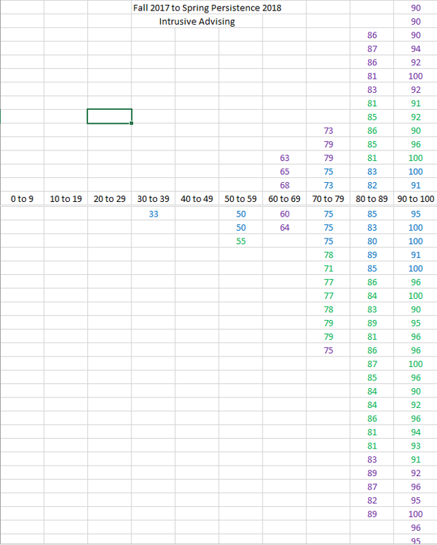

Slide 8
Successful course completion outcomes

Slide 9
Early Semester Persistence

Slide 10
Fall 2017 to Spring 2018 Persistence Outcomes

Slide 11
Summary of Findings
54% persistence by priority registration (intrusive advising sections)
48% persistency by priority registration (non-intrusive advising sections)
Persistence Cluster Range (IA Sections) = 50% - 80%
Persistence Cluster Range (Non-IA Sections) = 20% -50%
Fall 2016 – Spring 2017 Persistence = 76%
Fall 2017 – Spring 2018 Persistence = 85%

Slide 12
Next Steps
Expand to CPD 150 sections in addition to self-selected Developmental Education Courses
Introduce Open Lab Sessions to increase 1 on 1 support, promote early registration, and map course sequencing
Ongoing evaluation of services in Open Lab Sessions

