Slide 1
Mobilize Data to Action: Assessing the Student Experience
MCCCD Student Success Conference
November 5, 2021

Slide 2
Researchers
Body copy area.

Slide 3
Overview of Title V research
The timeline of our research:
Spring 2020: Literature Review
Fall 2020: Data Audit
Spring 2021: Focus Groups & Survey
Summer 2021: analysis
Fall 2021:
Study continues...

Slide 4
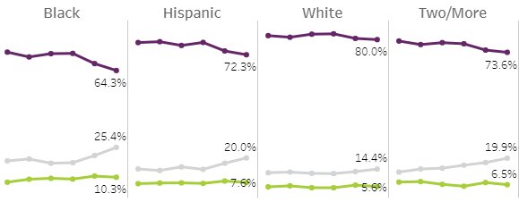
Background Research
Race and Ethnicity
Before Fall 2020 trends continue:
‘19
‘19
‘20
‘21
‘19
‘19
‘20
‘20
‘21
‘20
‘21
Successful grades
‘21
Withdrawals
Fails
Slides from Jan 2021 presentation: HERE
W

Slide 5
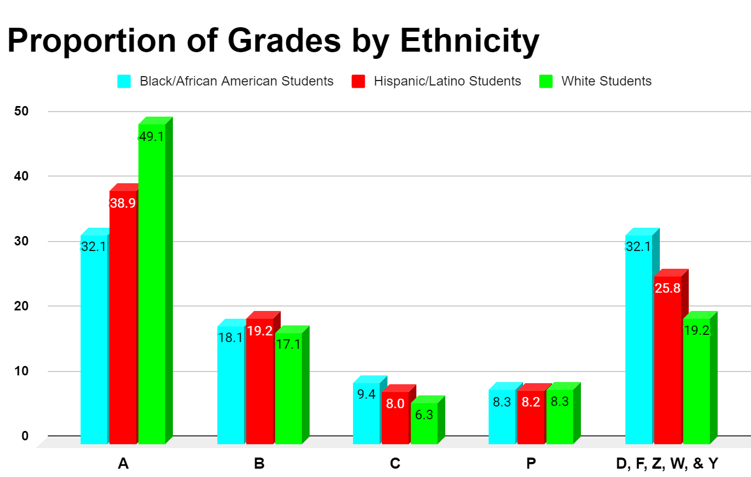
Background Research
Race and Ethnicity
In Spring 2020:
-Black students were just as likely to get an A as they were to fail/withdraw
-White students 2.5x as likely to get an A than fail/withdraw
-Hispanic/Latinx students 1.5x as likely to get an A than fail/withdraw
W
Notes:
The chi-square statistic is 6.7722. The p-value is .033841. The result is significant at p < .05.

Slide 6
Using Mentimeter:
What are the typical characteristics of a successful student in the Maricopa Community Colleges?
Link ready day before
Go to www.menti.com and use the code

Slide 7
Students’ Voice:
Successful Student Characteristics

Slide 8
Focus groups in Spring 2021
4 Focus Groups took place online by 3 SERT Researchers
LatinX Group #1
African American Group
LatinX Group #2
White Group
Semi-structured
Verbal responses
Chat responses
Thematic coding
Notes:
25 EMCC students participated

Slide 9
Focus groups in Fall 2021
6 Focus Groups took place online by 3 SERT Researchers
LatinX Group #1
African American Group
LatinX Group #2
White Group
2 or more races/Hawaiian
LatinX Group #3
Collection & Analysis:
Semi-structured
Verbal responses
Chat responses
Thematic coding
Notes:
25 EMCC students participated

Slide 10
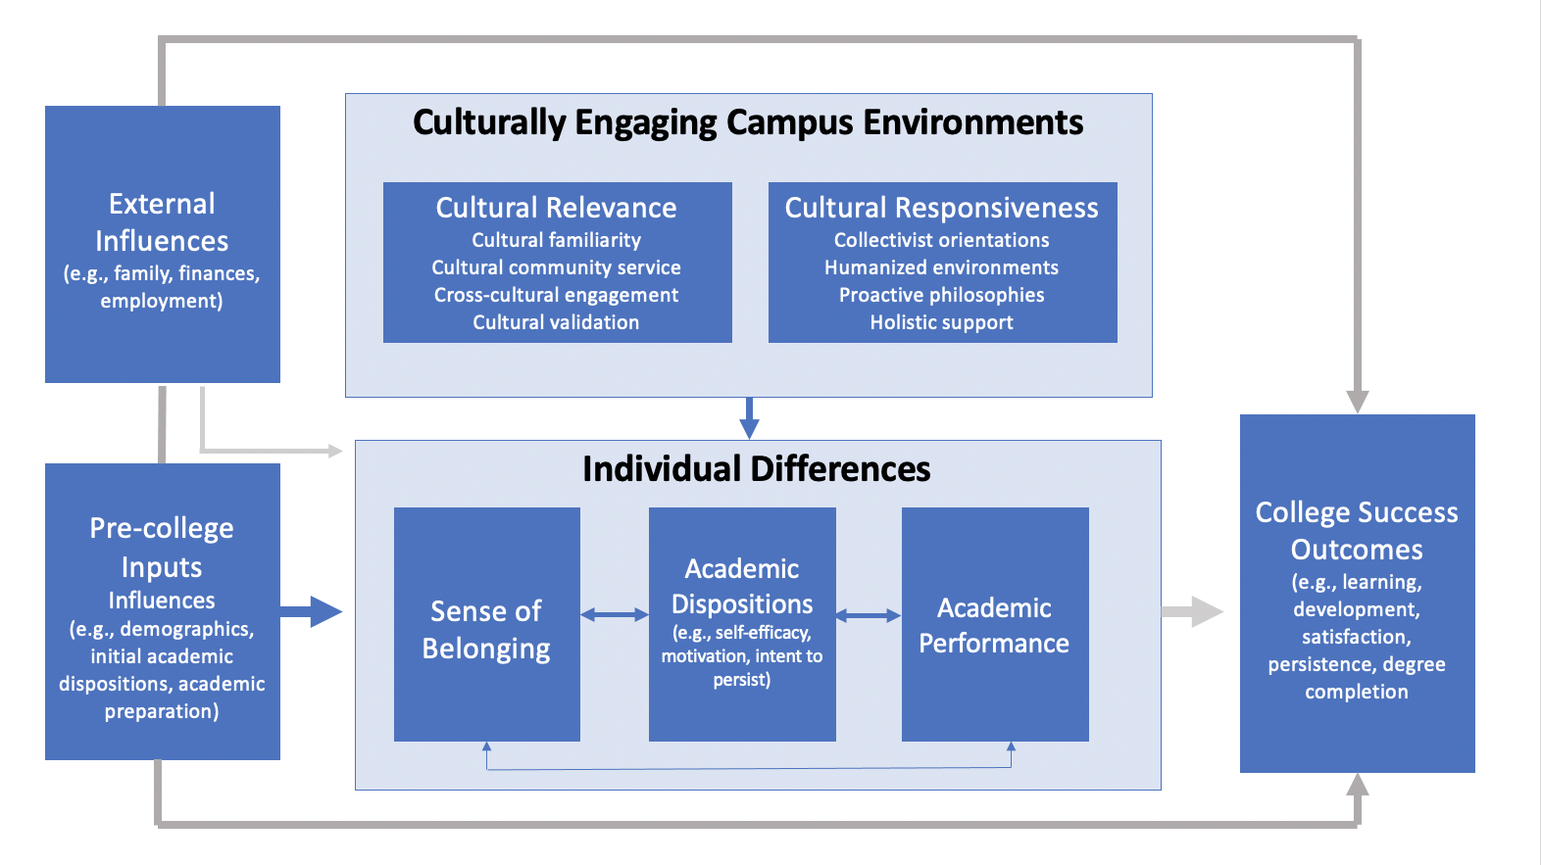
Culturally Engaging Campus Environments Model
Model adapted from Museus (2014), cited in: Museus, S. D., & Smith, E. J. (2016). The culturally engaging campus environments model and survey. A report on new tools for assessing campus environments and diverse college student outcomes.

Slide 11
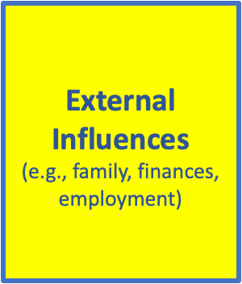
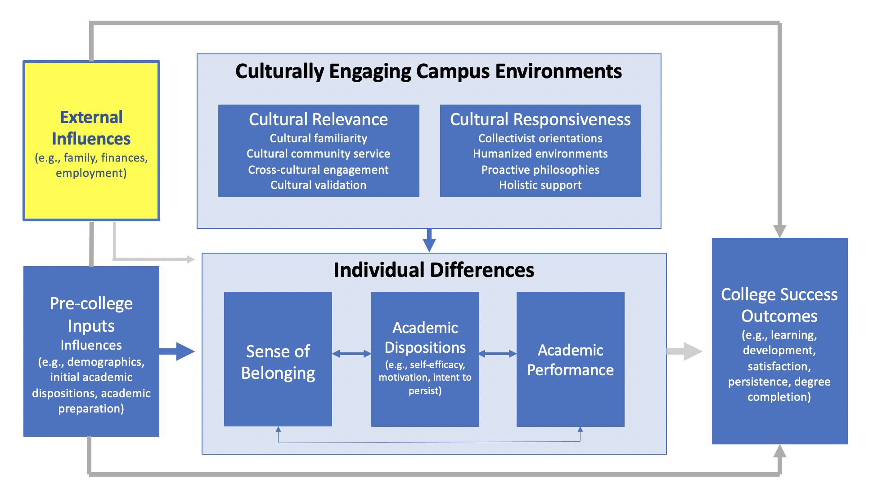
External Influences
EMCC Fast Facts:
65% First-Generation
37% Pell-Eligible
71% Minority Population
Notes:
Many students enter EMCC with some life circumstances.

Slide 12
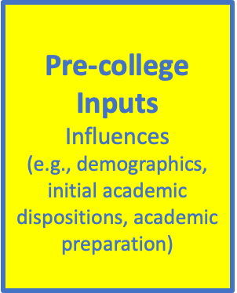
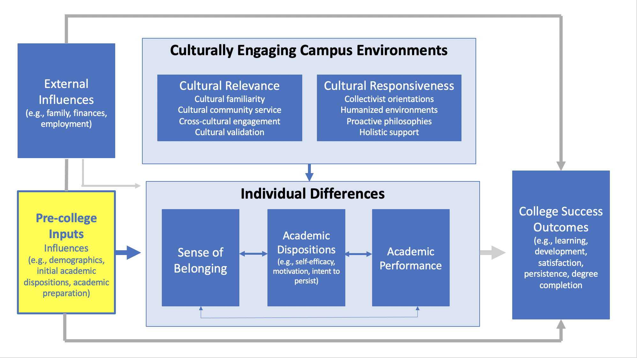
Pre-College Inputs
“I just got curious and started talking to people. There’s a lot of resources EMCC has that some people are completely unaware of and are just sitting. They’re literally just sitting here.”
-Tasha
“I also learned a lot of things because I ask a lot of questions. I’m a curious person. So I go in and I actually found out the rental for the calculators through computer commons. I started asking questions. I was a like, ‘Oh, what is over there?’ I started roaming the area so I can see what exactly is around.”
-Jeniah
So if I may say, I feel if I was not as inquisitive, I would have not found those resources. So maybe if the teachers can start implementing those resources, not only in the syllabus, because we know everyone does not read the syllabus, I'm guilty of it sometimes, too. So maybe implement it in talking about it during a class session or something, doesn't take that long.
-Shanice
C

Slide 13
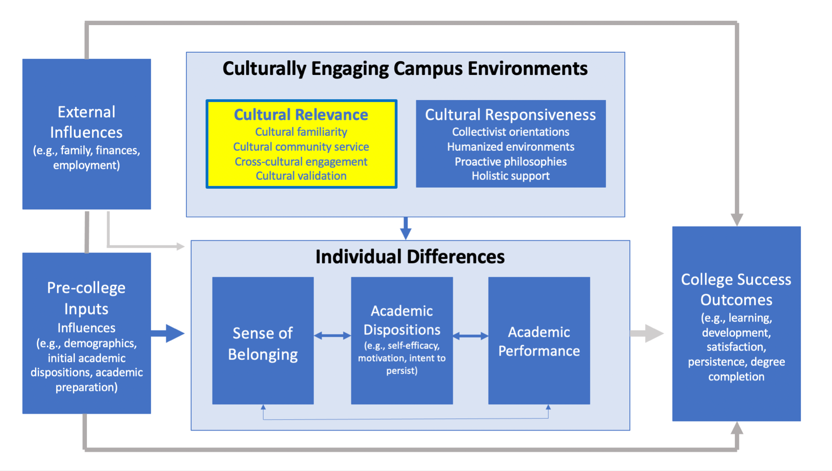
Culturally Engaging Campus Environments:
Cultural Relevance
Opportunity: Culturally-Relevant Toolbox
Notes:
Dr. Clarissa Davis Ragland - funding has been extended for toolbox - Feature - Repository where you have the ability to share what the culturally responsive assignments and activities you have now.. as well as learn from others.

Slide 14
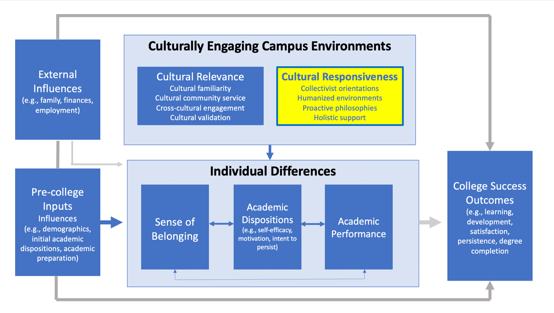
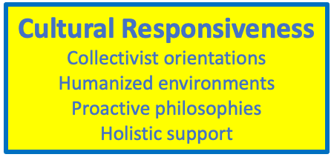
Culturally Engaging Campus Environments:
Cultural Responsiveness
“I don’t have an advisor. I’ve had to ask my brother or other students for help.”
-Mya
“I agree with [Mya]. I also don’t have an advisor. I have been the one to reach out to others and ask or call EMCC.”
-Alejandra
“My biggest challenge has been mental health. Since everything was online, I felt like I was alone since I didn’t know anyone and couldn’t make any friends since I only knew kids from their name on the discussion board. I felt I couldn’t connect to them. The deadlines became closer and I kept losing more and more motivation to do them.”
-Maria
“The teacher making an introduction video helped me connect with them. Just being reminded that they are human made me comfortable taking the class.”
-Maribelle
W

Slide 15
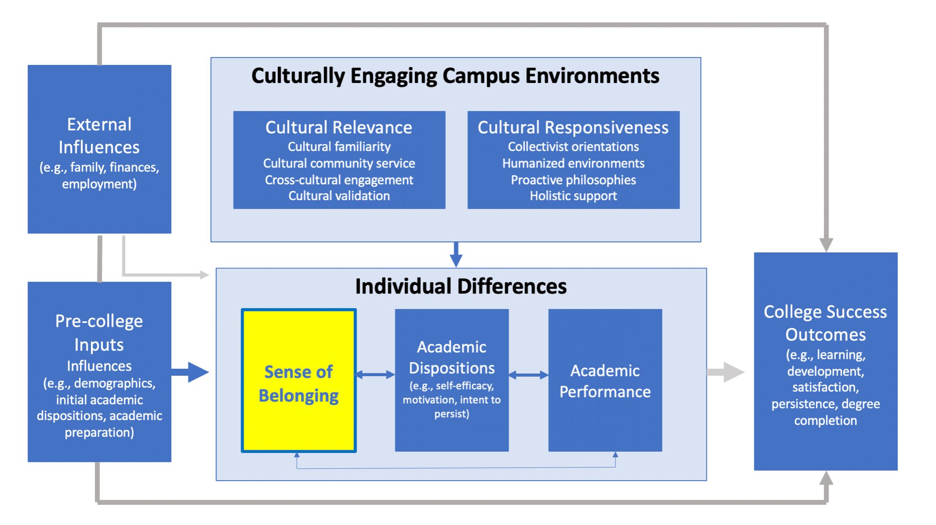
Individual Influences
Sense of Belonging
“I didn’t necessarily have a problem with academic stuff, but rather the whole sense of belonging and sense of community, that it’s hard to find… I think that was my biggest challenge.”
-Demetrius
“I remember seeing somewhere that there was an international student meeting that was happening every week. I was always looking for it or looking for some club that was open for it. [I tried to inquire about it] but I don’t know if it closed or they had no advisor or whatever. And it’s probably been closed since then.”
-Amir
C

Slide 16
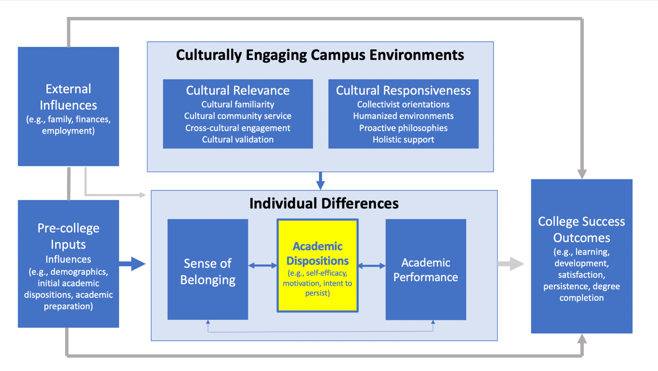
Individual Influences
Academic Dispositions
“While learning the fundamentals and basics, some students become unmotivated and bored with the content. They want to skip straight to the success because they think about the future too much, without thinking about the present benefits.”
-Carlos
“My biggest challenge has definitely been staying motivated. There are many times I’m like, ‘I don’t get it. I can’t do it. I quit.’ But I have to remind myself what I’m here fore, what I actually want to be, because all of my classes right now I don’t have any one-on-one, or any… I don’t see anybody. It’s just turn in the assignment, move on to the next course, turn in the assignment, move on to the next course. So having the motivation to log on, do this, do everything is difficult.”
-Aaliyah
“I'm the type of person where I just go with the flow. If we're going to do it online, I'm going to be the best at online. I know that sounds a little too much. But that's just how I am, how I learned to be, I'm a mother. I didn't really get that experience of, "Hey, let meet these people and see if we can do homework together." It was me, my schedule was this way, I need to do my work this way. So it's really hard for me. That's why I'm able to do online, and do in-person and be okay with it. “
-Tannesha
W

Slide 17
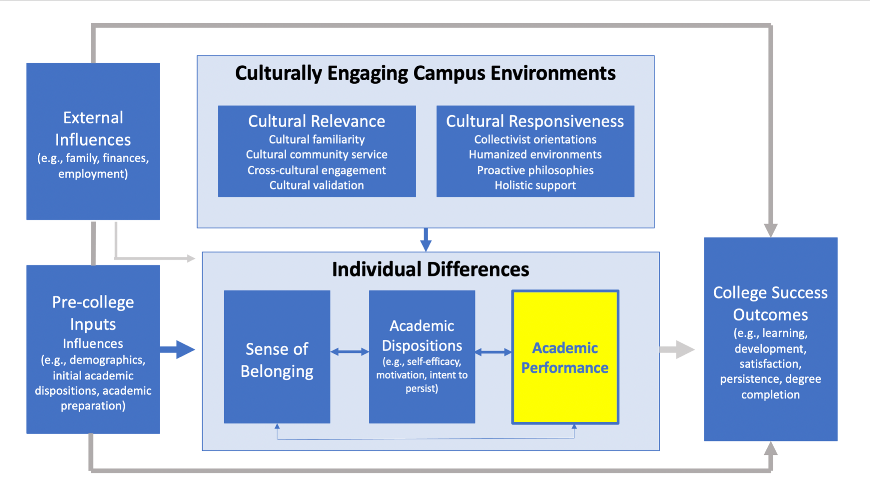
Individual Influences
Academic Performance
In Spring 2020 and ongoing:
Black students were just as likely to get an A as they were to fail/withdraw
White students 2.5x as likely to get an A than fail/withdraw
Hispanic/Latinx students 1.5x as likely to get an A than fail/withdraw
Notes:
From slide #65

Slide 18
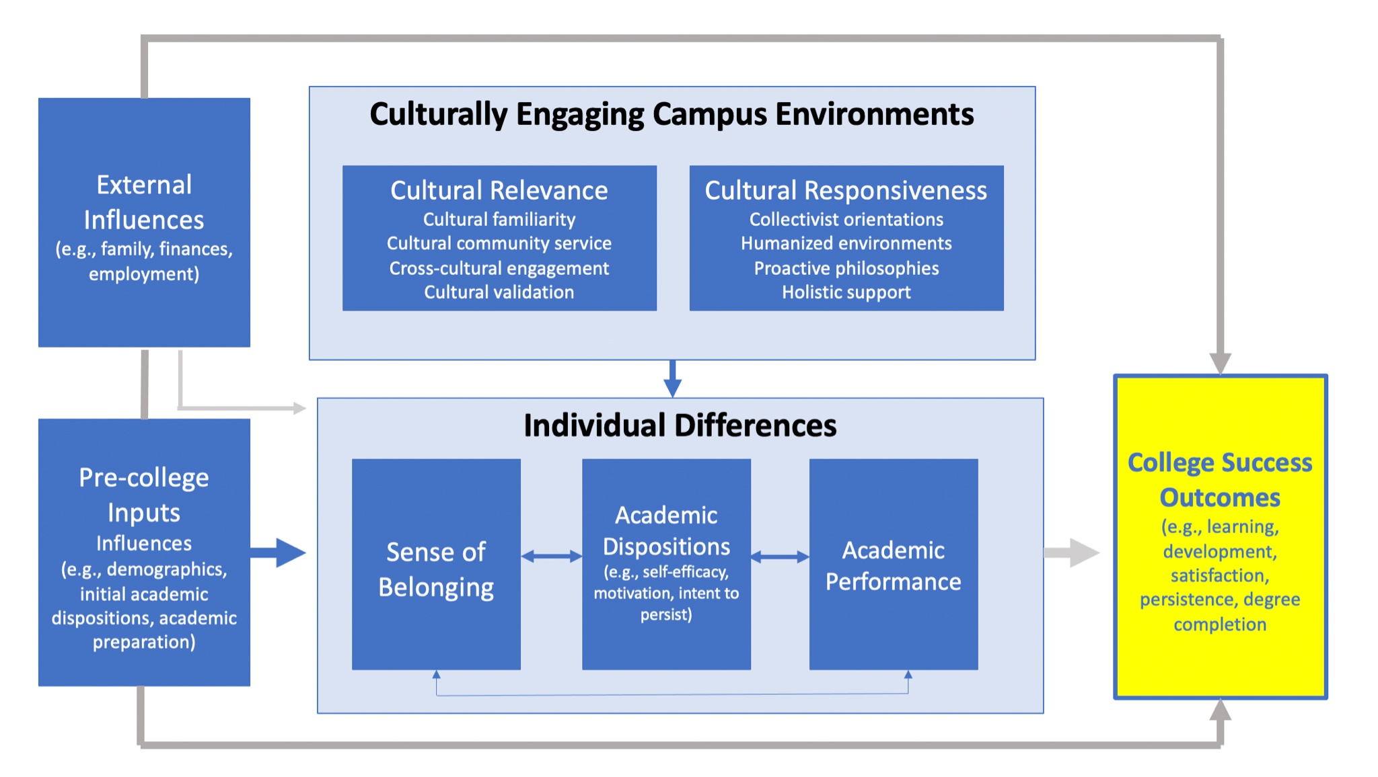
College Success Outcomes
It's just the only thing that is killing me is the math. I'm looking at it right now and I'm like, "He's not helping me. He's giving me answers. He's just making it worse." So maybe figuring out how they decide to teach it rather than just giving answers and throwing a quiz on you expecting you to know the material when you don't. Luckily, I worked with a guy who's going to be a math professor. He's going to school for that. So I'm like, "Please help me because my professors doing it and I'm paying him to do it." Seems like he should be better at it.
-Hannah

Slide 19
Focus groups in Spring 2021
Other Central Themes:
Differential communication regarding campus resources
Those who received information:
Most from faculty via “Announcements”
Extremely helpful:
Writing Center
Tutoring
Those who did not
No advisor / advisor updates
Sought information outside EMCC

Slide 20
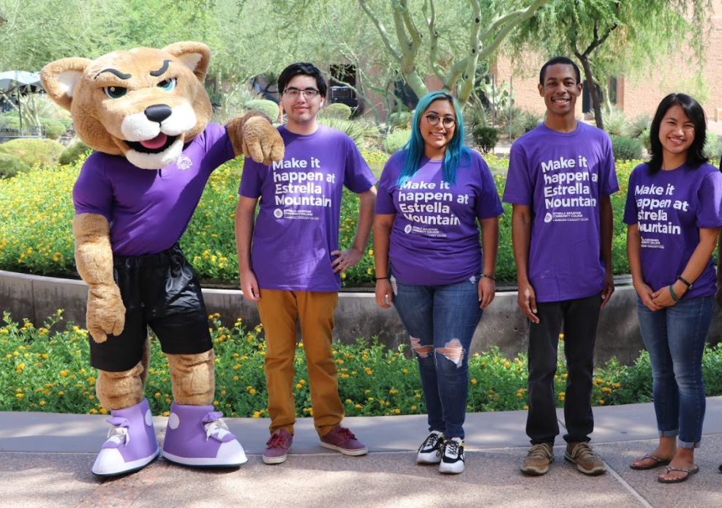
Focus groups in Spring 2021:
Additional Themes (LatinX & African American)
Differential communication regarding campus resources
Those who received information:
Most from faculty via “Announcements”
Extremely helpful:
Writing Center
Tutoring
Those who did not:
No advisor / advisor updates
Sought information outside EMCC
Notes:
Universal finding: The absence of interaction with other students is the most significant challenge
Breakout session: Ideas on how to make online more instruction more interactive between students

Slide 21
Using Mentimeter: What is one thing you want to work on given these focus group results?
Link ready day before
Go to www.menti.com and use the code

Slide 22
>450 students completed survey in Spring 2021
Average Age: 23.59 yrs
Gender Identity:
99 Male
348 Female
4 Nonbinary or NA
179 First Generation College Students
Avg Reported GPA: 3.33
Race/Ethnicity breakdown:
28 Black/African American
211 Hispanic/Latinx
25 Other (w/Asian, Pacific Islander, American Indian)
46 Two or more races
141 White

Slide 23
Major breakdown (Survey):
28 Students
62 Students
Grouped w/Cultural Studies
27 Students
115 Students
141 Students
42 Students
Oher/blank or could not categorize: 35 students
W
Notes:
Other

Slide 24
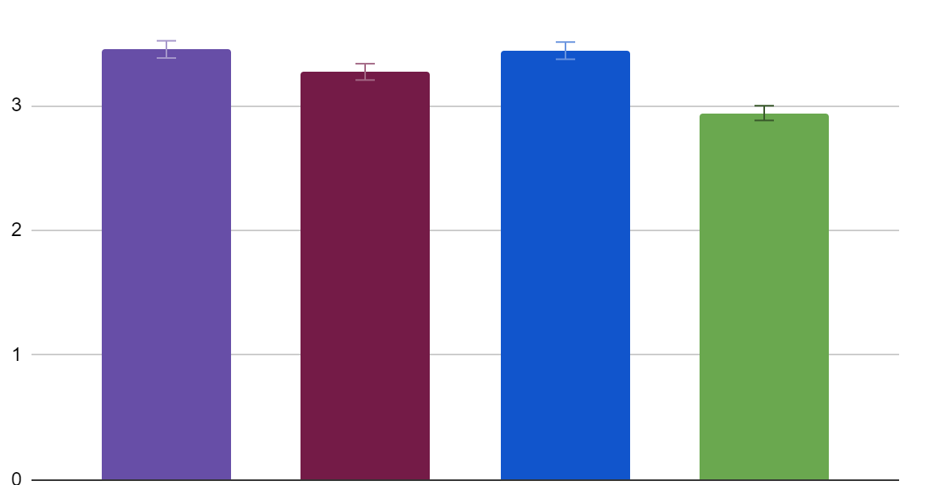
Student Experiences (Survey):
General findings (Belonging)
3.45
3.44
3.27
2.94
This portion of the survey had a flipped response scale and was mirrored for analysis
Overall belief that EMCC values cultural differences and diversity
Belonging inside the classroom
Belonging outside the classroom
EMCC general belonging
W
Notes:
Instructors/Faculty at EMCC are able to determine my level of understanding of the course material
Instructors/Faculty at EMCC provide me with feedback that helps me judge my progress
I feel like my contributions are valued in class
Instructors/Faculty at EMCC encourage me to meet with them after or outside of class
Instructors/Faculty at EMCC encourage me to ask questions and participate in discussions
Instructors/Faculty at EMCC show concern about my progress
Instructors/Faculty at EMCC empower me to learn here
Instructors/Faculty at EMCC believe in my potential to succeed academically
At least one instructor/faculty member at EMCC has taken an interest in my development
At least one staff member at EMCC has taken an interest in my development
Staff at EMCC encourage me to get involved in campus activities
Staff at EMCC recognize my achievements
Estrella Mountain Community College promotes appreciation of cultural differences
Estrella Mountain Community College has a commitment to diversity
Estrella Mountain Community College accurately reflects the diversity of the student body in publications (e.g., brochures, website, etc.)
Estrella Mountain Community College appreciates differences in sexual orientation
Estrella Mountain Community College has campus administrators who regularly speak about the value of diversity
People here notice when I am good at something
Other students in this school take my opinions seriously
People at this school are friendly to me
I am included in lots of activities at this school
Other students here like me the way I am
I like to think of myself as similar to others at Estrella Mountain Community College
People at Estrella Mountain Community College care if I am absent
I feel like my ideas count at Estrella Mountain Community College
I feel like I matter to people at Estrella Mountain Community College
People really listen to me when I am at school

Slide 25
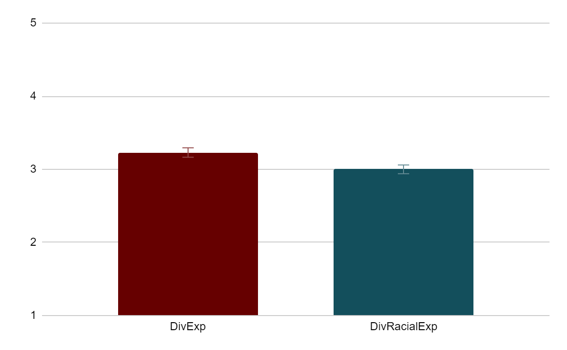
Student Experiences (Survey):
General findings (Diverse Experiences)
3.23
3.00
Diverse Experiences (e.g. with students of other religions, genders, sexual orientations, beliefs)
Diverse Racial Experiences (e.g. with students of other races or ethnicities)
W
Notes:
A student from a socioeconomic class different from your own
A student from a religion different from your own
A student of a sexual orientation different from your own
A student from a country other than your own
A student with a disability if you do not have a disability, or a student without a disability if you have a disability
How often do you discuss issues related to sexism, gender differences or gender equity
Had intellectual discussions outside of class with a student or students from a racial/ethnic group other than your own
Shared personal feelings and problems with a student or students from a racial/ethnic group other than your own
Dined or shared a meal with a student or students from a racial/ethnic group other than your own
Had meaningful and honest discussions about race/ethnic relations outside of class with a student or students from a racial/ethnic group other than your own
Socialized or partied with a student or students from a racial/ethnic group other than your own
Studied or prepared for class with a student or students from a racial/ethnic group other than your own

Slide 26
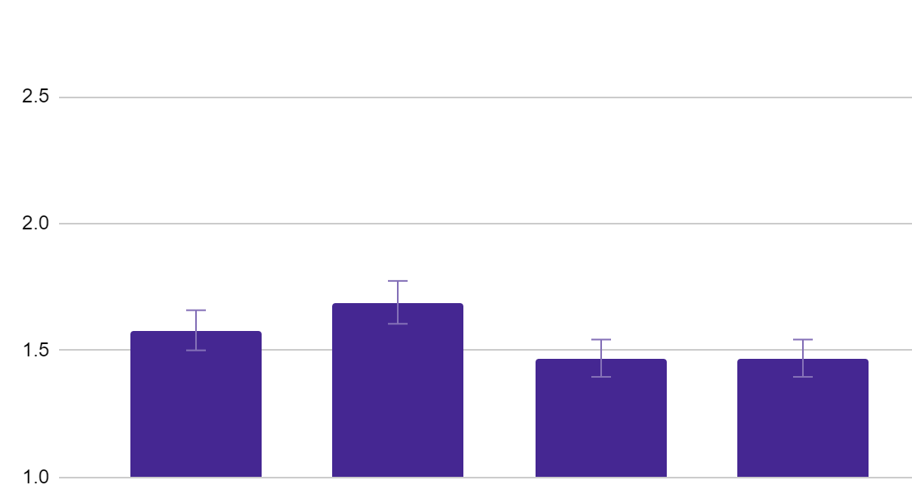
Student Experiences (Survey):
General findings
(Experiences of disparaging remarks or discrimination)
Discrimination by other students
Discrimination by instructors
Discrimination by staff
General Discrimination
1.69
1.58
1.47
1.47
W
Notes:
Heard insensitive or disparaging remarks from an instructor/faculty
Heard insensitive or disparaging remarks from students
Heard insensitive or disparaging remarks from staff
Heard any verbal comments
Witnessed discrimination
Saw written comments (e.g., emails, texts, writing on walls)
Saw offensive visual images or items
Witnessed exclusion (e.g., from gatherings, events)

Slide 27
Student Experiences (Survey):
Encouraging takeaways from demographic breakdown:
Students who speak two or more languages feel similar belonging in and out of the classroom to students who speak only English
W
Notes:
Language, n.s.
Full and part time in class, n.s.
Age and belonging, n.s.

Slide 28
Student Experiences (Survey):
Encouraging takeaways from demographic breakdown:
Students did not significantly differ by race in the extent that they believe that EMCC values diversity
W
Notes:
Language, n.s.
Full and part time in class, n.s.
Age and belonging, n.s.

Slide 29
Student Experiences (Survey):
Encouraging takeaways from demographic breakdown:
Different age groups were similar in their sense of belonging in and out of the classroom
In the classroom, full- and part-time students both felt a similar sense of belonging
W
Notes:
Language, n.s.
Full and part time in class, n.s.
Age and belonging, n.s.

Slide 30
Student Experiences (Survey):
Room for growth:
Outside of the classroom, part-time students had significantly lower sense of belonging than full-time students
First generation students reported lower sense of belonging in the classroom than non-first generation college students (approaching marginal sig.)
W
Notes:
First gen x belong, p=.21, marginal almost?
Full and part time outside class, p=.097

Slide 31
Student Experiences (Survey):
Room for growth:
Experiences of discrimination were signicantly higher for Black/African American students and students of Two or more races, particularly discrimination from other students
W
Notes:
Race x discrimination, p=.02
On a Scale from 1-5, how often have you witnessed any of the following instances of discrimination and bias on our campus? (1=Never, 5=Very Often)
Heard insensitive or disparaging remarks from students

Slide 32
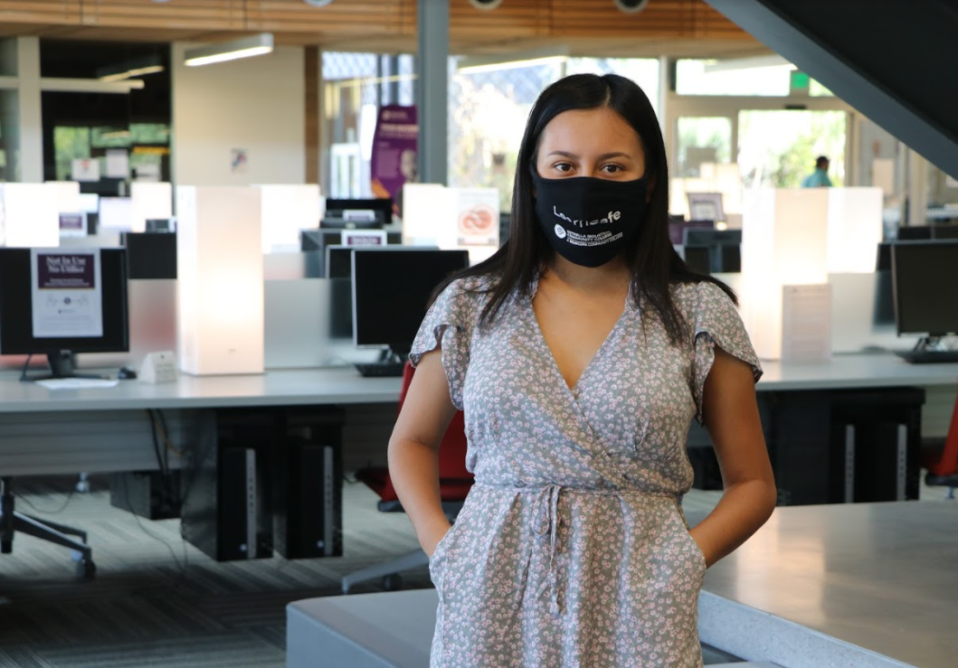
Student Experiences (Survey):
Room for growth:
Belonging in and out of the classroom was lower (but n.s.) for Black/African American students and Asian, Pacific Islander, and American Indian students
Males report higher belonging in the classroom than female and non-binary students (approaching marginally sig.)
W
Notes:
Break out differences of male/female/non-binary by discipline
Belong x Race, p=.28, so n.s.
Gender X Belong, p=.12, marginal

Slide 33
Student Experiences (Survey):
Encouraging takeaway and room for growth?
More diverse experiences, particularly diverse racial experiences, were reported by younger students (highest for the 21-25 age group) than older students (26+)
More family friendly programming especially during our cultural events
W
Notes:
Diverse exp x age, p=.002

Slide 34
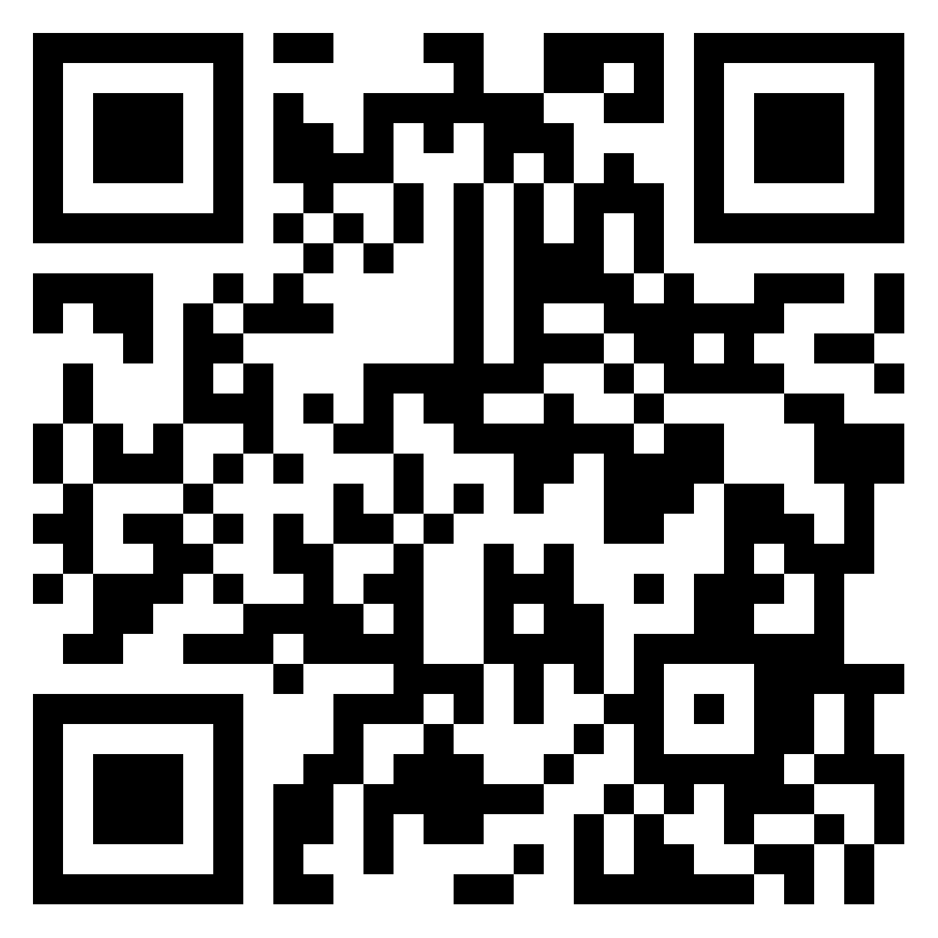
Post and collaborate!
https://padlet.com/eli2195827/clomkfkd296qci8l

