Slide 1
ECN Writing Assessment Results AY20/21 - 21/22
Erik Huntsinger (PI), Voxi Amavilah, Susan Azimi-Thomas, Kathy Archer, Steve Kazarian

Slide 2
Summary of Study
Fall 2020: EMCC economics faculty were asked to collect their students’ essay assignments in both ECN211 and ECN212. Essay were anonymized.
Spring 2021: Faculty engage in inter-rater reliability training with each other
Summer 2021: Faculty assess five new essays. Improvements were suggested and implemented.

Slide 3
Summary of Study (continued)
Fall 2021: EMCC economics faculty were asked (again) to collect their students’ essay assignments in both ECN211 and ECN212. Essay were anonymized.
Spring 2022: Faculty assess five new essays (each). Meet to discuss and summarize results

Slide 4
Participants
Faculty - Steve Kazarian, Kathy Archer, Voxi Amavilah, Erik Huntsinger, Susie Azimi-Thomas
Number of Essays assessed 25 (5 each)

Slide 5
Areas of Assessment
Essays were assessed using the EMCC Writing Rubric, including all areas:
Subject Matter | Focus/Main Idea/Thesis | Support/Development | Organization
Language Use | Format | Citation | Mechanics

Slide 6
Results (spring 2021)

Slide 7
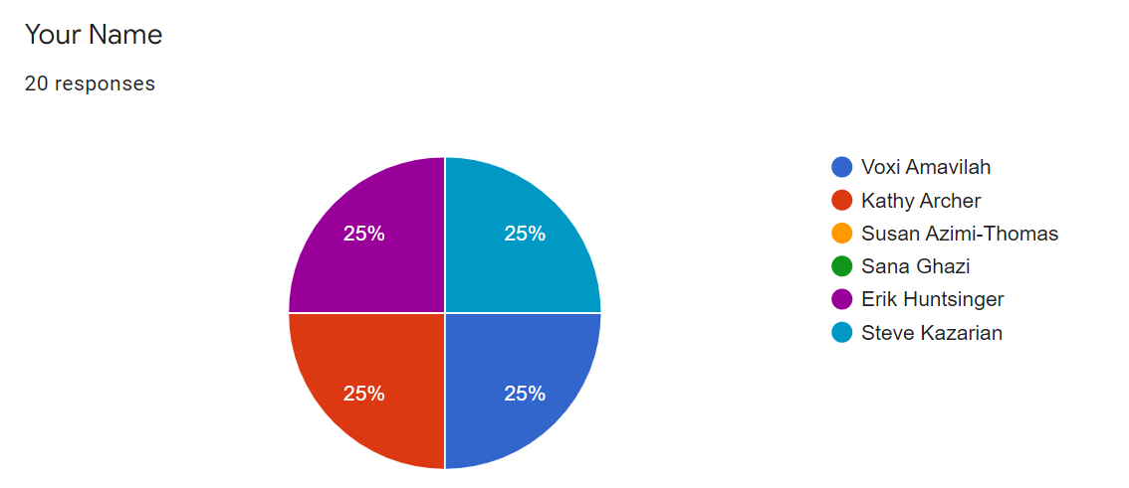
Assesors
Four (of six) ECN faculty members assessing in spring 2021: Voxi Amavilah, Kathy Archer, Erik Huntsinger, and Steve Kazarian

Slide 8
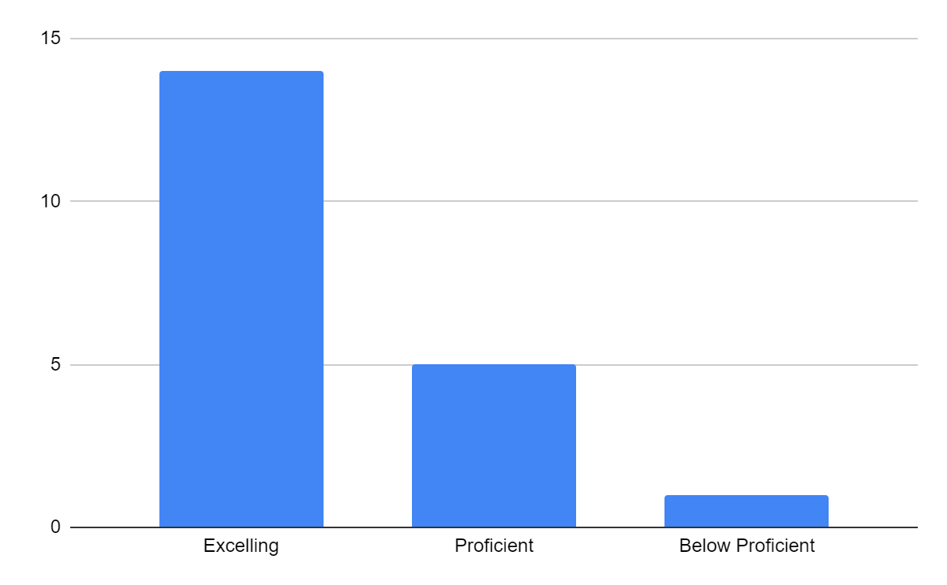
Subject Matter
Excelling | 14
Proficient | 5
Below Proficient | 1
Total | 20

Slide 9
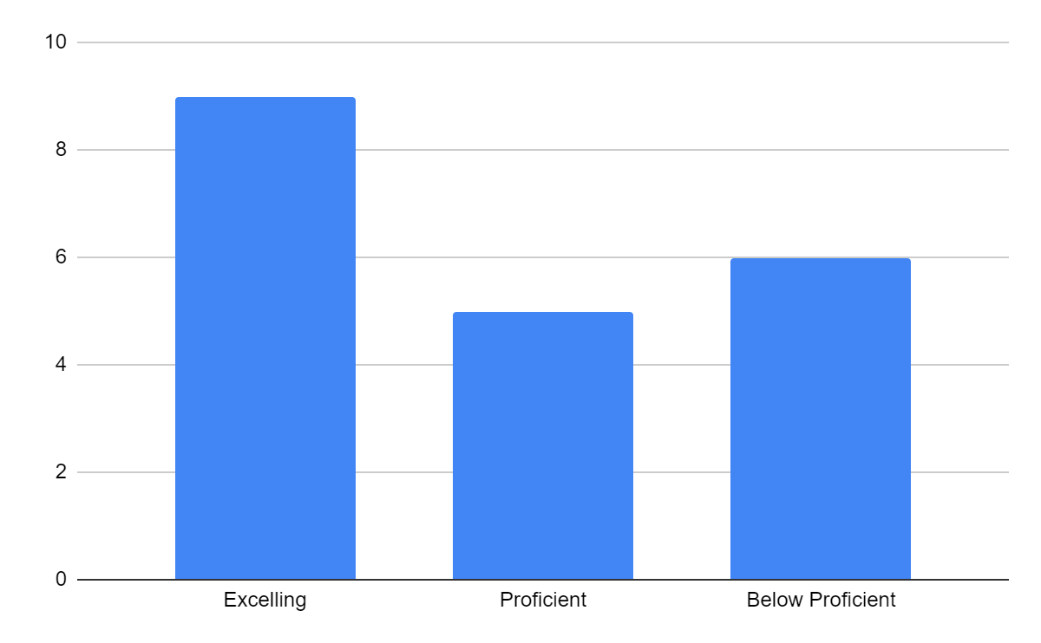
Focus/Main Idea/Thesis
Excelling | 9
Proficient | 5
Below Proficient | 6
Total | 20

Slide 10
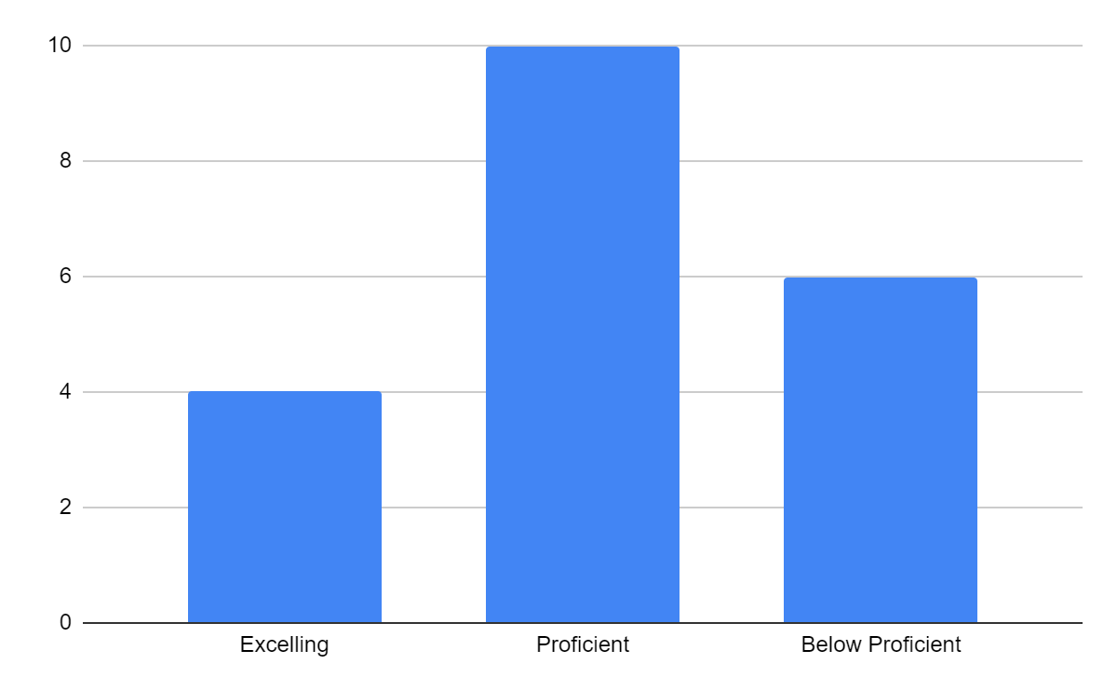
Support/Development
Excelling | 4
Proficient | 10
Below Proficient | 6
Total | 20

Slide 11
Organization
Excelling | 4
Proficient | 10
Below Proficient | 6
Total | 20

Slide 12
Language Use
Excelling | 4
Proficient | 10
Below Proficient | 6
Total | 20

Slide 13
Format
Excelling | 4
Proficient | 10
Approaching Proficient | 6
Total | 20

Slide 14
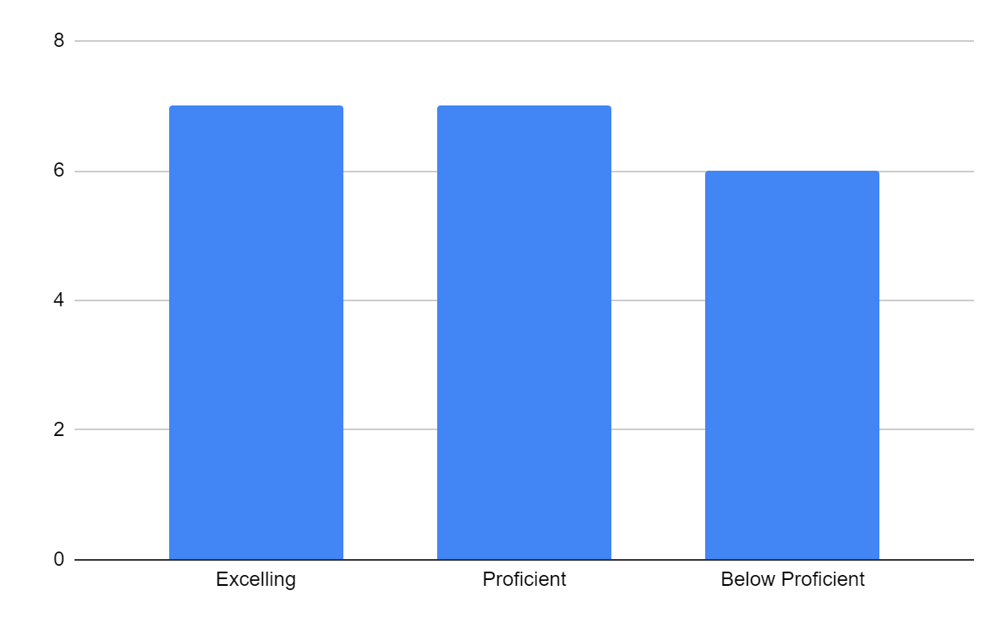
Citation
Excelling | 7
Proficient | 7
Below Proficient | 6
Total | 20

Slide 15
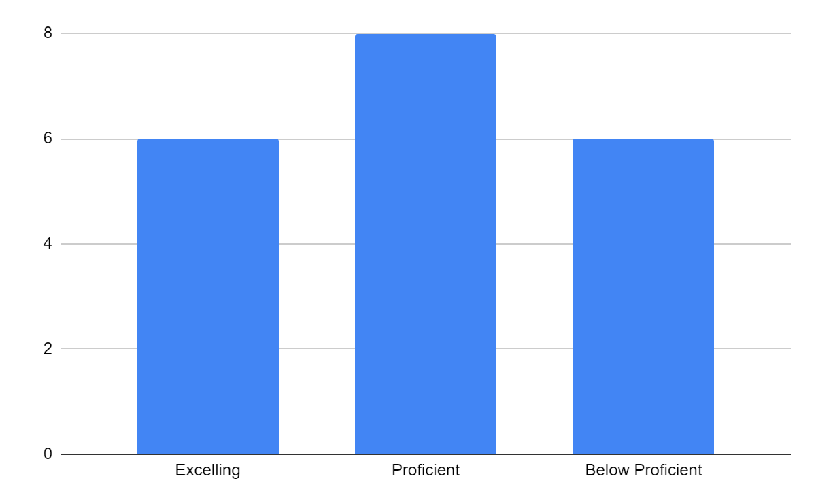
Mechanics
Excelling | 6
Proficient | 8
Below Proficient | 6
Total | 20

Slide 16
Summary
Except for Subject Matter (95%), all areas demonstrated a 70% proficiency rate or above
Subject Matter | 95%
Focus/Thesis | 70%
Support/Dev | 70%
Organization | 70%
Language Use | 70%
Format | 70%
Citation | 70%
Mechanics | 70%
Bold indicates “excelling” was greater than or equal to “proficiency”

Slide 17
Observations (Spring 2021)
It appears from this sample that most students are reaching proficiency or higher in their essays
Only one (1) student scored “not proficient” in any category, Citation)
Subject Matter was clearly most strongly met
Improving success could mean less “approaching proficiency” but also more “excelling”

Slide 18
Recommendation (Summer 2021)
Support/development: Help students determine credible sources vs others (e.g., opinion pieces)
Organization/format: Include a template in the assignment to help students organize their thoughts.
Language Use/Mechanics: Require students to submit essay through Grammarly?
Citations - Create a Canvas page with citation resources for students to use if they want to
Rough draft vs. final draft assignments - Have students submit their rough draft so that we can give them feedback before its due

Slide 19
Implemented Changes (Fall 2021)
Add “Scholarly Sources and Why They Matter” Page (courtesy of Kathy Archer, ECN instructor) (Support/development)
ECN Template Added to assignment (Organization)
Implement ECN Library Search Video Quiz (Support/development)
Integrate Citation Resources page (Citation)
Changed “Librarian Check-in” assignment to “Library Citation Check” (Support/development)
Added “rough draft” between “outline” and “final draft” (overall)

Slide 20
Results (Spring 2022)

Slide 21
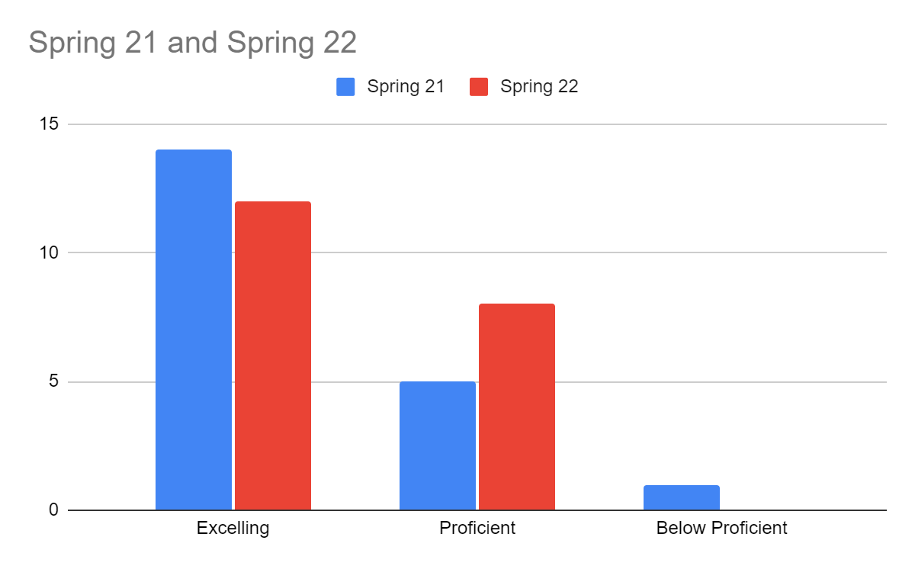
Subject Matter (Sp 21 vs. Sp 22)
 | Spring 21 | Spring 22
Excelling | 14 | 12
Proficient | 5 | 8
Below Proficient | 1 | 0
Total | 20 | 20
Nearly all students in both samples were proficient or above.

Slide 22
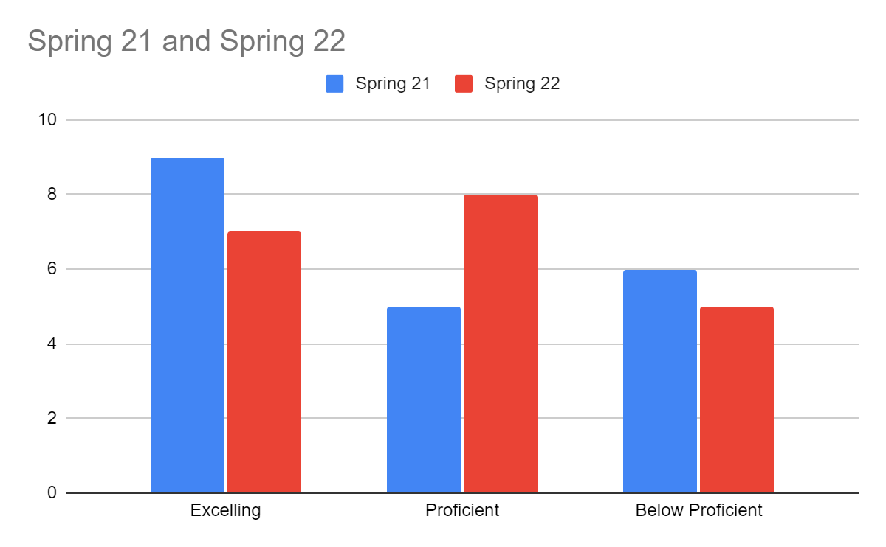
Focus/Main Idea/Thesis (Sp 21 vs. Sp 22)
 | Spring 21 | Spring 22
Excelling | 9 | 7
Proficient | 5 | 8
Below Proficient | 6 | 5
Total | 20 | 20
Nearly all students had the same level of proficiency or higher

Slide 23
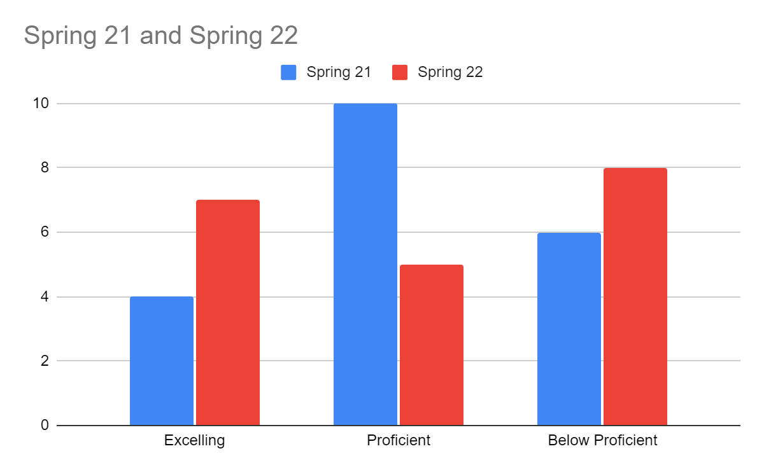
Support/Development (Sp 21 vs. Sp 22)
 | Spring 21 | Spring 22
Excelling | 4 | 7
Proficient | 10 | 5
Below Proficient | 6 | 8
Total | 20 | 20
Though more students were excelling in sp 22, more also scored below proficiency

Slide 24
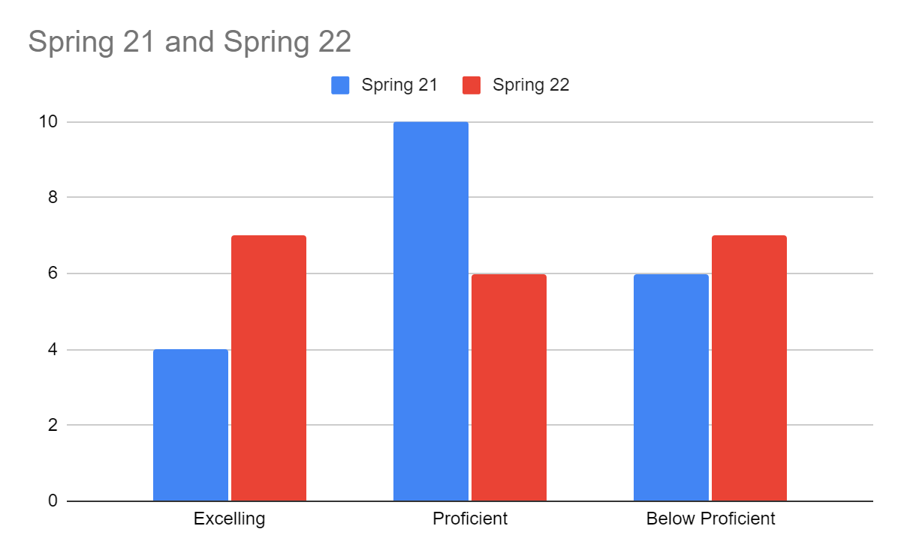
Organization (Sp 21 vs. Sp 22)
 | Spring 21 | Spring 22
Excelling | 4 | 7
Proficient | 10 | 6
Below Proficient | 6 | 7
Total | 20 | 20
Though more students demonstrated excelling in organization, the number scoring below proficiency was largely unchanged

Slide 25
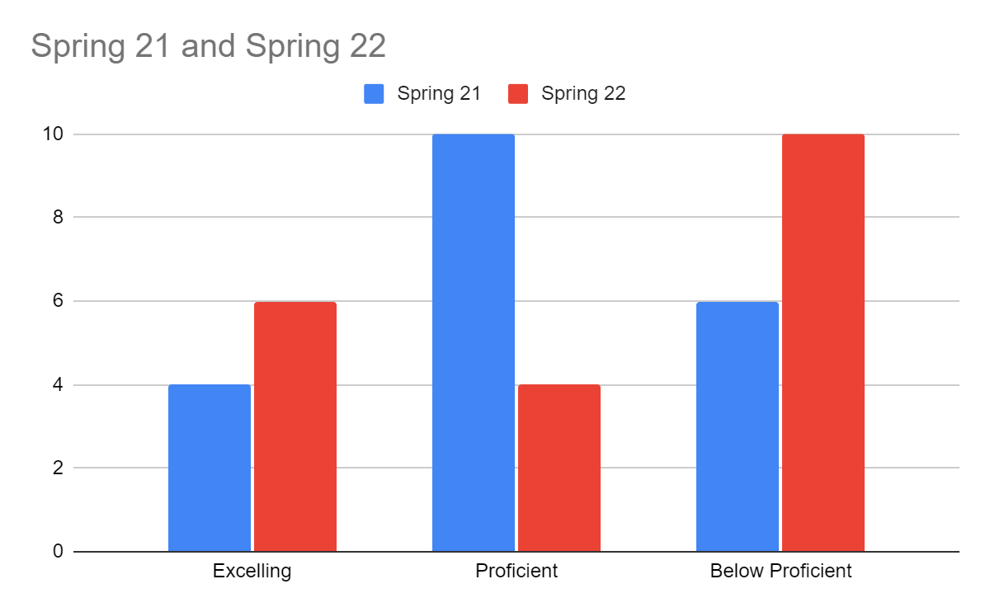
Language Use (Sp 21 vs. Sp 22)
 | Spring 21 | Spring 22
Excelling | 4 | 6
Proficient | 10 | 4
Below Proficient | 6 | 10
Total | 20 | 20
Though more students demonstrated excelling in language use, more students also demonstrated below proficiency

Slide 26
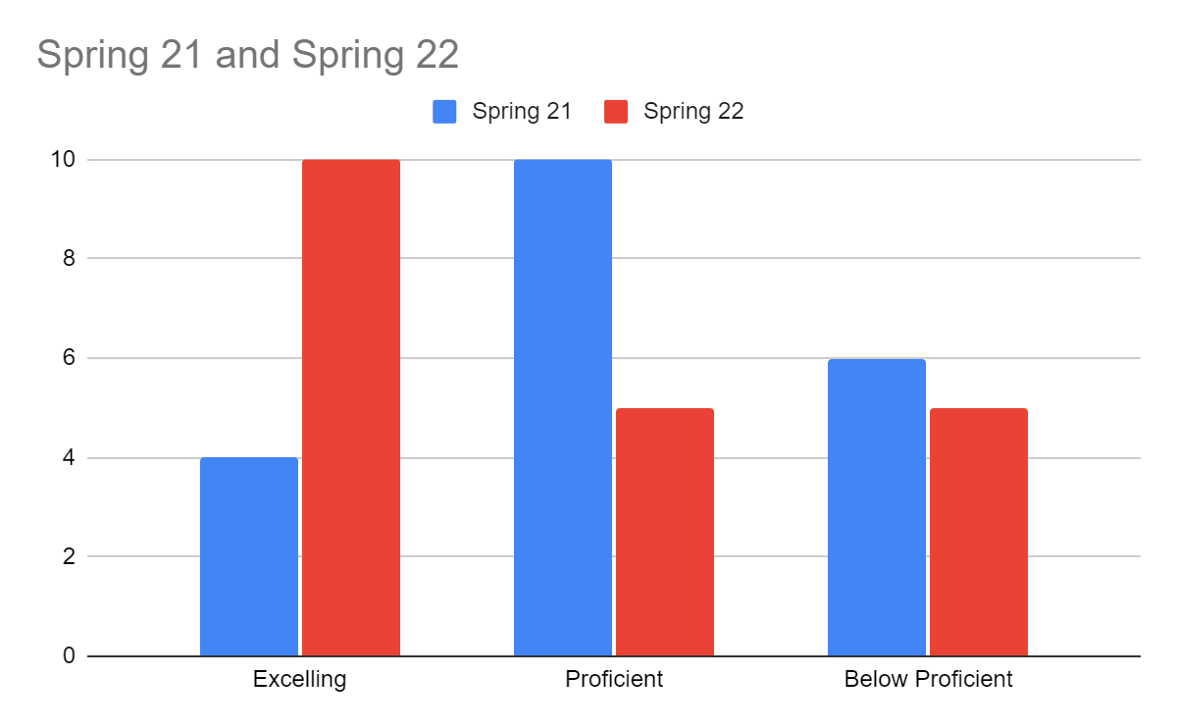
Format (Sp 21 vs. Sp 22)
 | Spring 21 | Spring 22
Excelling | 4 | 10
Proficient | 10 | 5
Below Proficient | 6 | 5
Total | 20 | 20
Many more students demonstrated excelling in format, with fewer “proficient” or “below proficient”

Slide 27
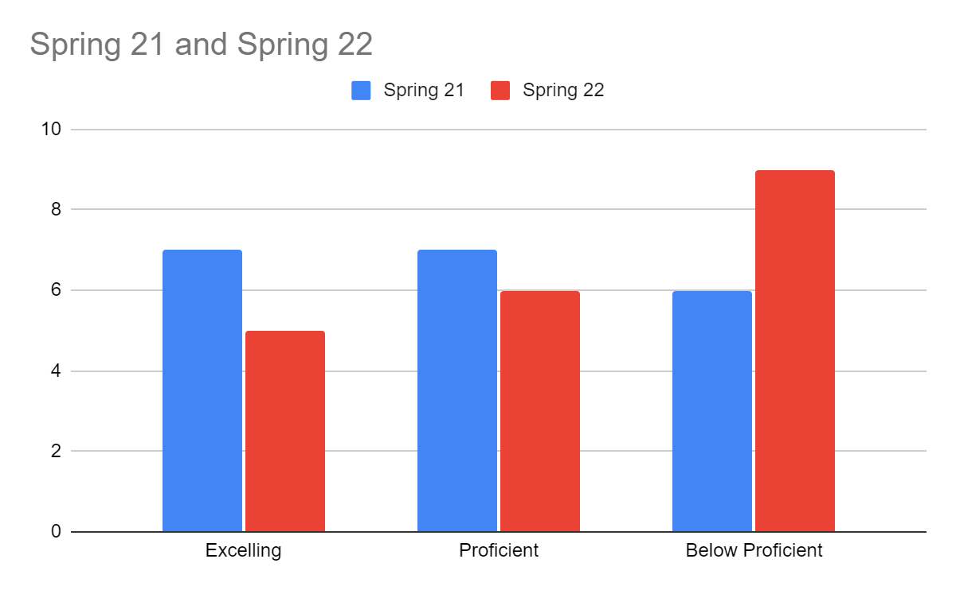
Citation (Sp 21 vs. Sp 22)
 | Spring 21 | Spring 22
Excelling | 7 | 5
Proficient | 7 | 6
Below Proficient | 6 | 9
Total | 20 | 20
More students demonstrated below proficiency, with fewer excelling or proficient

Slide 28
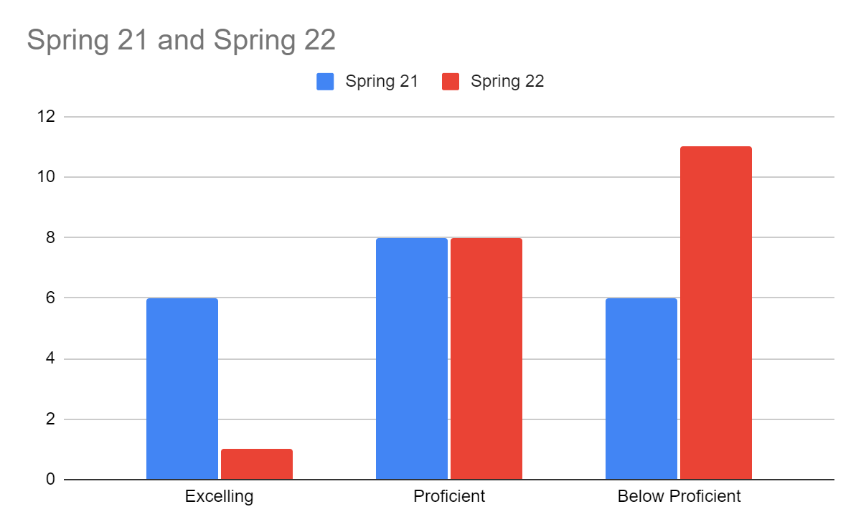
Mechanics (Sp 21 vs. Sp 22)
 | Spring 21 | Spring 22
Excelling | 6 | 1
Proficient | 8 | 8
Below Proficient | 6 | 11
Total | 20 | 20
Much fewer students demonstrated excelling, while an identical increase in below proficiency

Slide 29
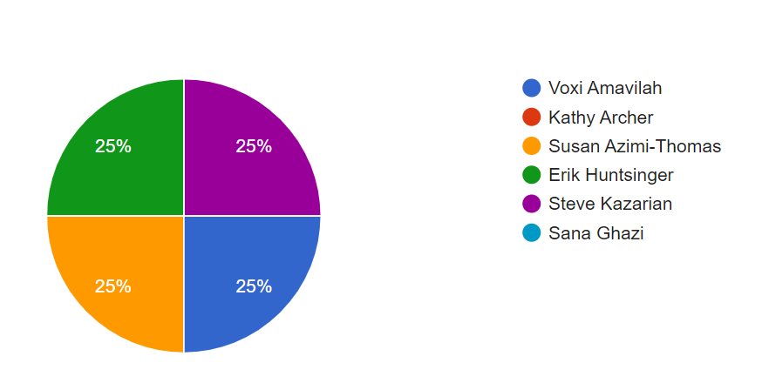
Observations (Sp21 vs. Sp22)
Though there were four (of six) ECN faculty members assessing in spring 2022, one assessor dropped out (Kathy Archer) and another came in (Susan Thomas)
With different assessors, this adds variability to the scores

Slide 30
Recommendation Outcomes (Sp 21 vs Sp22)
Support/development: Mixed. Spring 2022 showed more excelling but also more below proficient. There may have been some mixed signals in this criterion regarding the quality of sources vs. the quantity of sources used in the paper to justify the points
Organization/format: Mixed. Organization was roughly the same, but formatting was reported much higher.

Slide 31
Recommendation Outcomes (Sp 21 vs Sp22)
Language Use/Mechanics - Overall down. Language use was mixed but mechanics got worse. Perhaps use of Grammarly could help here.
Citations - Overall did not show much improvement, was generally down.
Rough draft vs. final draft assignments - Generally observed that there wasn’t much difference between these two for most students. Recommend an intermediate reflection assignment for them to consider instructor feedback and how they will address the issues in the final draft

Slide 32
Overall Evaluation (Sp 21 vs Sp22)
Discussed how this process has made us more sensitive to the criteria in the rubric, and this may explain why some of the results have decreased from one year to the next
Having a formatted template helped the students structure their papers and should be continued

Slide 33
Overall Evaluation (Sp 21 vs Sp22)
Talk with Academic Success Center tutors on areas where we’re seeing students struggle
Explore how to submit a mechanics/grammar check before final draft (e.g., Grammarly); add this to the bottom of the rough draft
Creation of a thesis statement with submission of credible sources

Slide 34
Appendix
Raw Data of Study (sp 21)
Data Collection Form (sp 21)
Data: Inter-rater Reliability Study
EMCC Writing Rubric
Raw Data of Study - Sp 22
Data Collection Form (sp 22)

