Slide 1
Virtual Microscope student slides showing different locations and a variety of images for the same tissue.

Slide 2
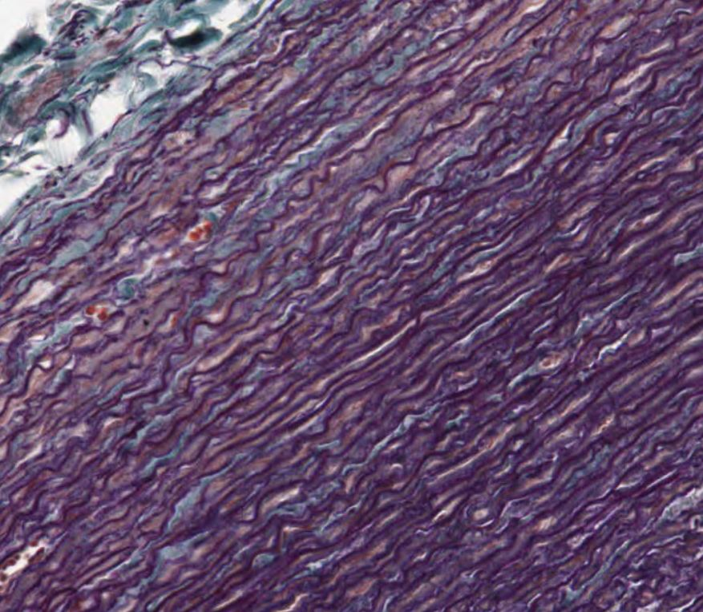
Student A
Elastic Connective Tissue
Notes:
Elastic CT

Slide 3
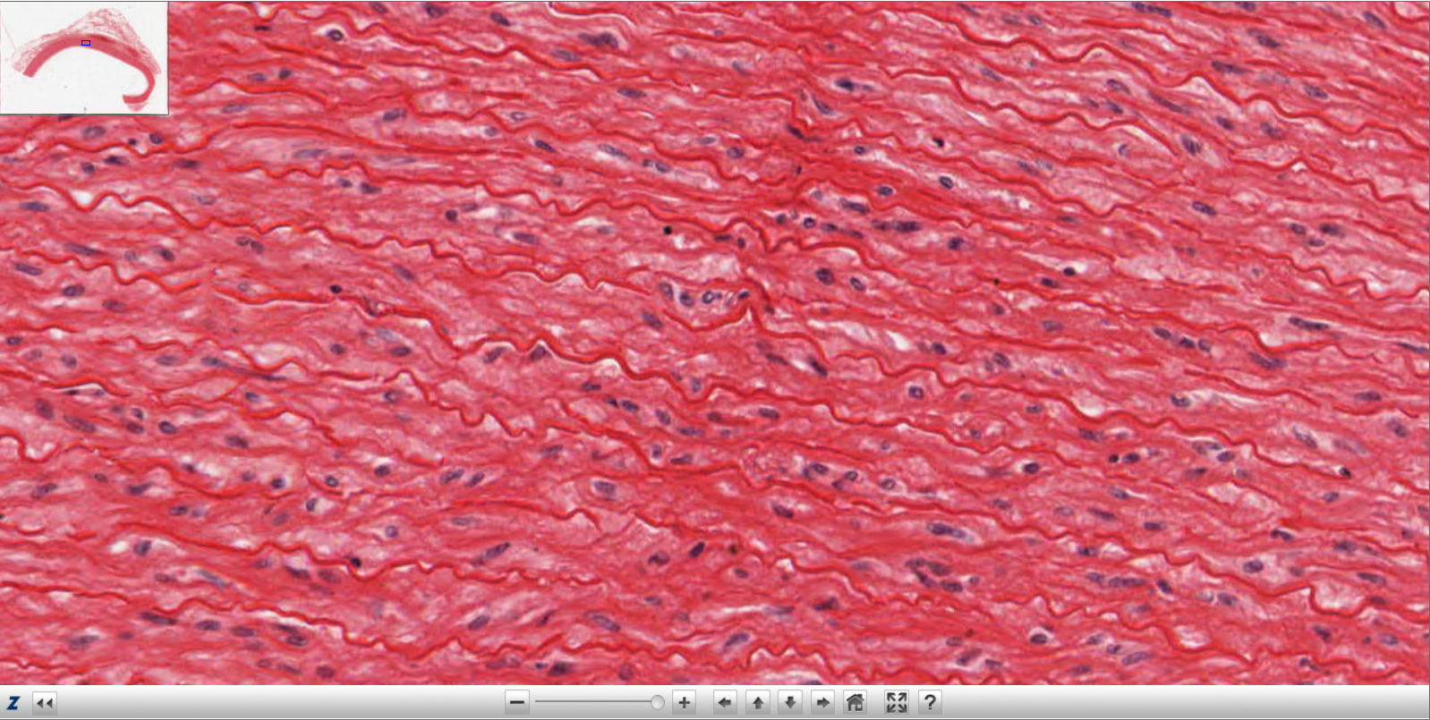
Student B
Elastic Connective Tissue

Slide 4
Text Slide for Elastic Connective Tissue
Name Of Tissue: Elastic CT
Magnification/Zoom: 40x
Name of the Outlined cell: Fibroblasts
Name of fiber (for CT only): Elastic
Location of Tissue: Walls of large blood vessels like the aorta.
Function: Allows stretching and recoiling after stretching; e.g., blood vessels can stretch and then go back (recoil) to unstretched position.

Slide 5
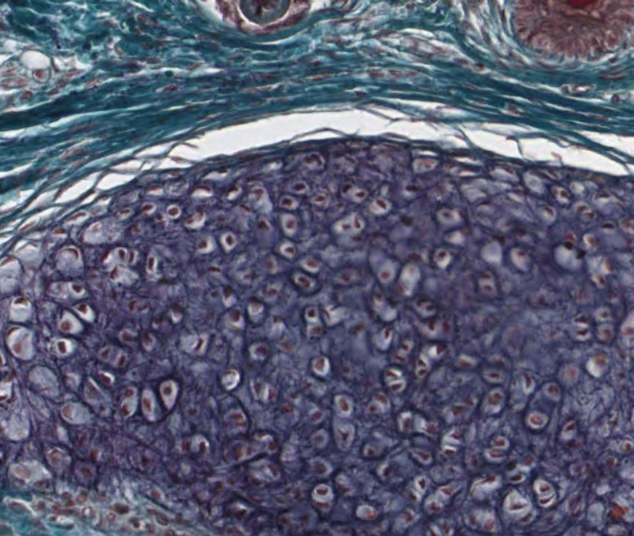
Notes:
Elastic Cartilage

Slide 6
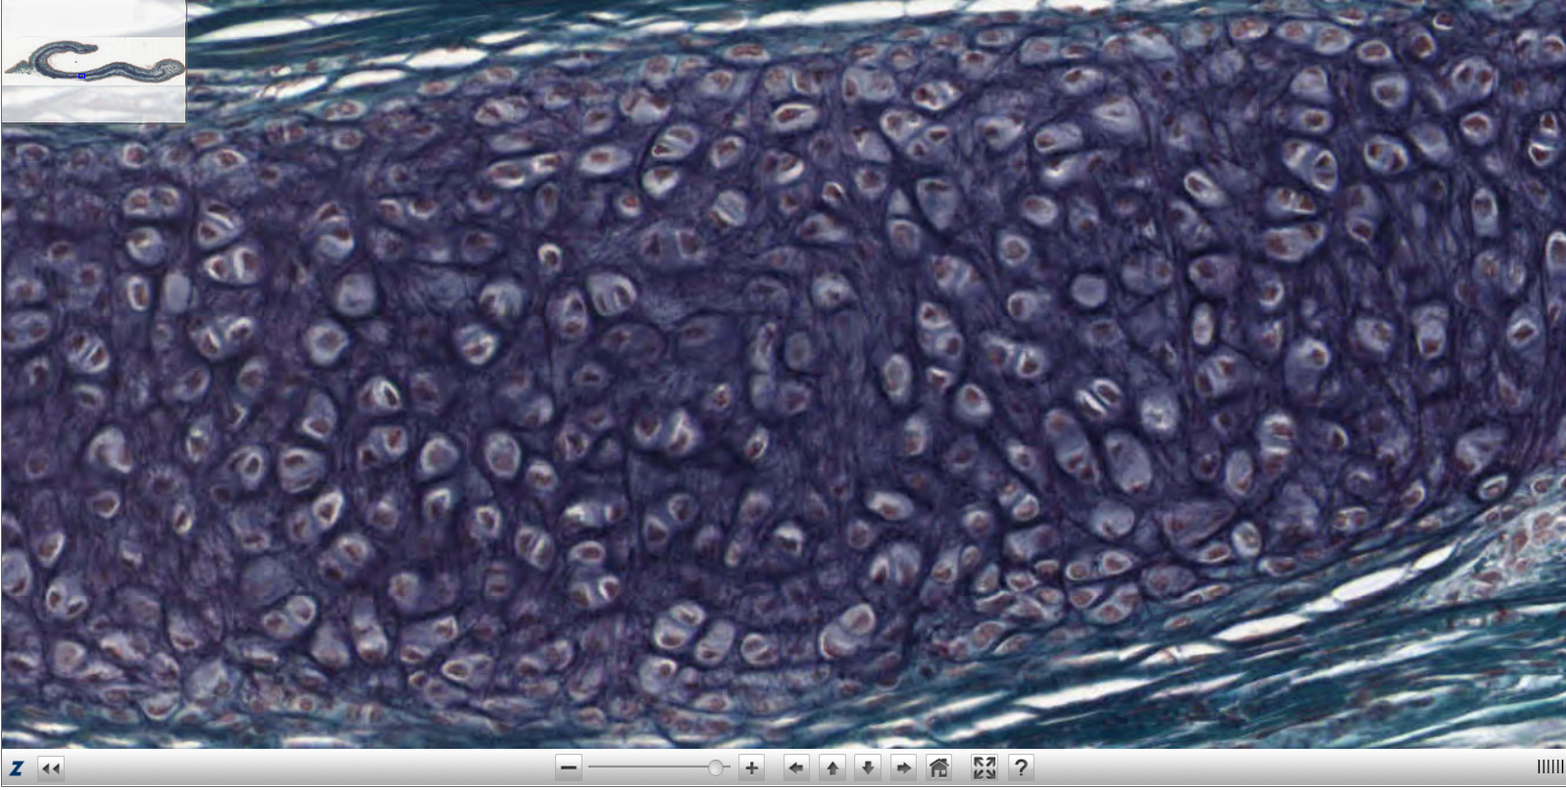

Slide 7
Text Slide for Simple Elastic Cartilage Connective Tissue
Name Of Tissue: Elastic Cartilage CT
Magnification/Zoom: 40X
Name of the Outlined cell: Chondrocyte
Name of fiber (for CT only): Elastic
Location of Tissue: Under skin of ear.
Function: Maintains the shape of a structure while allowing great flexibility.

Slide 8
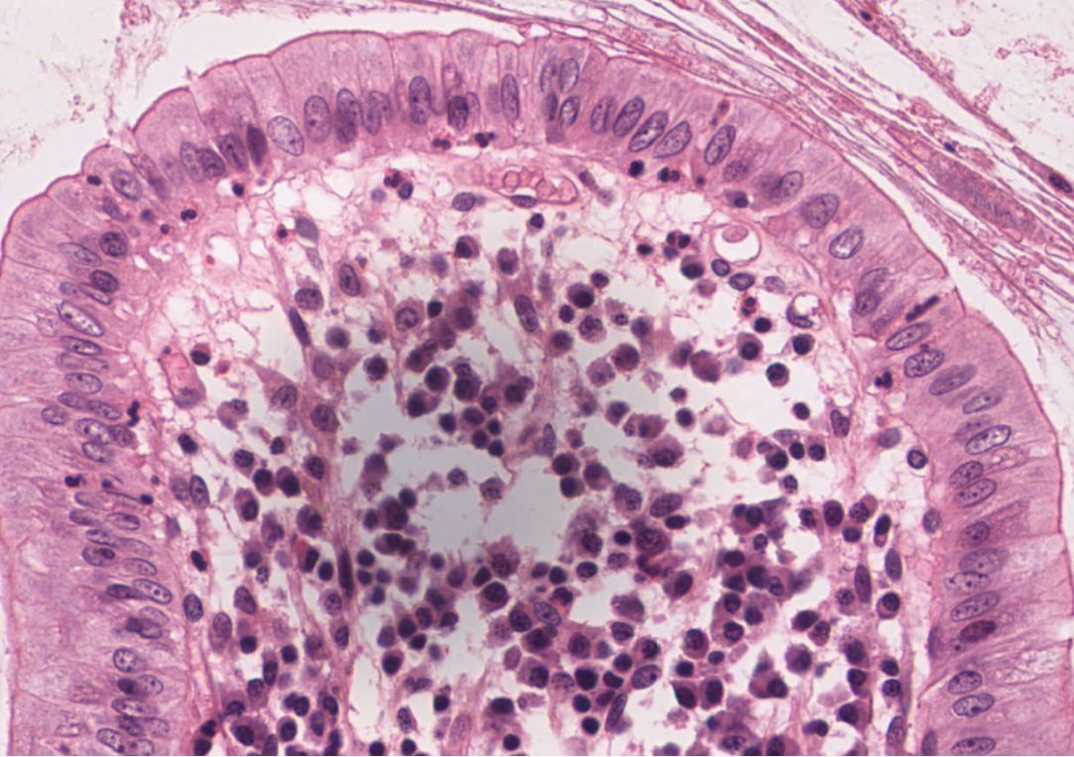
Student A
Simple Columnar Epithelial Tissue
Notes:
Simple Columnar ET

Slide 9
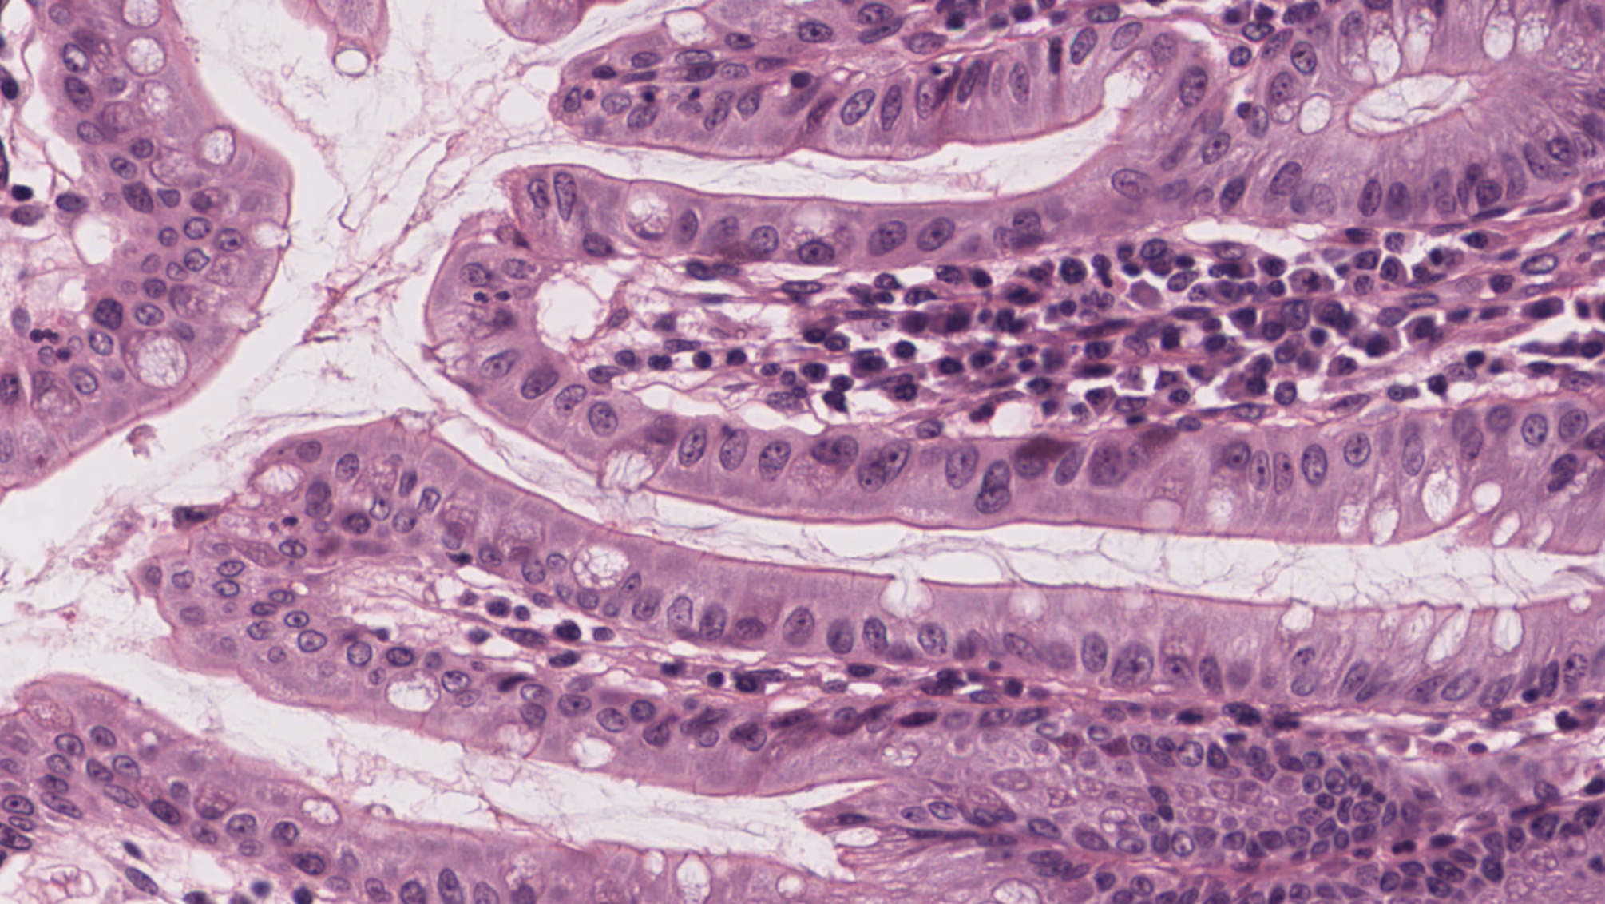
Student B
Simple Columnar Epithelial Tissue

Slide 10
Text Slide for Simple Columnar Epithelial Tissue
Name of Tissue: Simple Columnar ET
​​​​​​​
Magnification/ Zoom 40X​​​​​​​​​​​
​​​​​​​​​​​
Name of the outlined cell: ​Columnar Epithelial cells.​​​​​​​​​​​
List the fibers: ​none​
​​​​​​​​​​​
Location of tissue: ​Lining of intestine next to the food
​​​​​​​​​​​
Function: Absorption of nutrients, secretion of mucus & enzymes and other substances.
Notes:
Simple Columnar ET

