Slide 1
SAAC: Critical Inquiry Assessment 2014

Slide 2
Critical Inquiry Components
Observation / Question,
Identifying Hypothesis / Explanation,
Planning,
Analysis,
Conclusion / Solution.

Slide 3
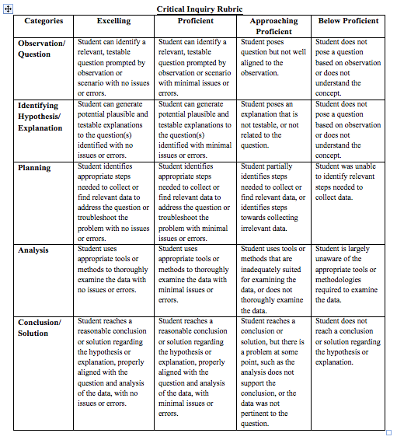

Slide 4
Background
In 2011:Instructors rated students for each of the five areas as
Proficient (scored as a 3)
Approaching Proficient (scored as a 2)
Below Proficient (scored as a 1) in 2011
In 2014: Instructors rated students for each of the five areas as
Excelling (scored as a 4)
Proficient (scored as a 3)
Approaching Proficient (scored as a 2)
Below Proficient (scored as a 1)
To compare 2011 and 2014 results, the 2014 results scored as either Excelling or Proficient were merged and scored as Proficient so the two years’ results could be compared

Slide 5
Classes Assessed
 | 2011 | 2014
Number of Faculty Participating (One participated both years) | 7 | 9
Number of Sections Assessed (CRE101 and EDU22 had two sections assessed) | 18 | 12
Number of Prefixes Assessed (CIS, MAT, SOC assessed both years) | 5 | 6
Course Level Assessed Dev Ed 100 Level 200 Level | 0% 77% 23% | 17% 28% 55%
Number of Courses Assessed (CIS120DF assessed both years) | 6 | 10

Slide 6
Participants Assessed
 | 2011 | 2014
Participants
 | 227 | 273
Student Level
New Freshman (<= 7 cumulative hours earned by prior term) Freshman / Sophomore (>7 and <30 cumulative hours earned by prior term) Sophomore (30+ cumulative hours earned by prior term) | 9% 39% 52% | 33% 30% 37%
Gender of Participants
Female Male Data Not Available | 60% 36% 4% | 55% 45% 1%

Slide 7
Classes Assessed
In 2011:
Prefixes: CIS, ECN, MAT, PSY, SOC
Classes: CIS120DF, ECN211, ECN212, MAT151, PSY230, and SOC140
In 2014:
Prefixes: CIS, CRE, EDU, MAT, RDG, SOC
Classes: CIS120DF, CRE101, EDU222, EDU230, MAT082, MAT221, MAT241, MAT276, RDG081, and SOC130

Slide 8
Overall Performance for 2014
The strongest area = Observation / Question: Student can identify a relevant, testable question prompted by observation or scenario with no issues or errors
The area with the greatest opportunity to improve = Analysis: Student uses appropriate tools or methods to thoroughly examine the data with no issues or errors.
Although there were minor differences between the averages for new freshmen and sophomores, NONE of these differences were statistically significant

Slide 9
Overall Performance for 2014
Statistically significant observations of 2014:
100 Level Courses had a higher mean than Dev Ed Courses in terms of Observation/Question, Analysis, and Conclusion/Solution
100 Level Courses had a higher mean than 200 Level Courses in terms of Observation/Question, Identifying Hypothesis/Explanation, Analysis, and Conclusion/Solution
200 Level Courses had a higher mean than Dev Ed courses in terms of Analysis
MAT prefix courses had a lower mean than non-MAT prefix courses
SOC prefix courses had a higher mean than non-SOC prefix courses

Slide 10
Overall Performance for 2014 Using 4 Point Scale
2014 Results | Excelling |  | Proficient |  | Approaching Proficient |  | Below Proficient |  | Mean
 | # | % | # | % | # | % | # | %
Observation / Question | 111 | 41% | 126 | 46% | 25 | 9% | 11 | 4% | 3.23
Identifying Hypothesis / Explanation | 98 | 36% | 131 | 48% | 29 | 11% | 15 | 5% | 3.14
Planning | 95 | 35% | 121 | 44% | 44 | 16% | 13 | 5% | 3.09
Analysis | 92 | 34% | 114 | 42% | 50 | 18% | 17 | 6% | 3.03
Conclusion / Solution | 87 | 32% | 133 | 49% | 38 | 14% | 15 | 5% | 3.07

Slide 11
DANGER!!! Comparing New Freshmen to Sophomores
There is variability within assessments, classes, class levels, et al
There were multiple graders
The Rubric is abstract and open to interpretation, more so than other Gen Ed Ability assessments

Slide 12
DANGER!!! Comparing 2011 to 2014 Results
The differences in samples of 2011 and 2014 may compromise the validity of comparisons The scoring of the rubric changed from 2011 to 2014. In spite of attempts to logically cluster the data, it may have affected the overall scores.
Course levels assessed: no Dev Ed sections were assessed in 2011 but Dev Ed represented 9.2% of all assessments in 2014. In 2011 100 Level courses represented over 3/4th of all assessments but slightly over 1/4th of all assessments in 2014.
Student Year Level: in 2011, new freshmen represented only 8.8% of all assessments but almost 1/3rd (32.6%) of all assessments in 2014. Sophomores represented over half (52.4%) of all assessments in 2011 but only 37.0% in 2014.
Prefixes assessed: in 2011, MAT represented 59.5% of all assessments but in 2014 it only represented 38.1%. EDU was not assessed in 2011 but represented an additional 26.0% of all assessments in 2014.
Courses assessed: in 2011, MAT151 represented 59.5% of all assessments while in 2014 no single course represented more than 15.4% of the total number of assessments

Slide 13
Comparing 2011 to 2014 Results Using 3 Point Scale
 |  | Proficient |  | Approaching Proficient |  | Below Proficient |  | Mean
 |  | # | % | # | % | # | %
Observation / Question | 2011 | 138 | 60.8% | 59 | 26.0% | 30 | 13.2% | 2.48
 | 2014 | 237 | 86.8% | 25 | 9.2% | 11 | 4.0% | 2.83
Identifying Hypothesis / Explanation | 2011 | 185 | 81.5% | 28 | 12.3% | 14 | 6.2% | 2.75
 | 2014 | 229 | 83.9% | 29 | 10.6% | 15 | 5.5% | 2.78
Planning | 2011 | 86 | 37.9% | 108 | 47.6% | 33 | 14.5% | 2.23
 | 2014 | 216 | 79.1% | 44 | 16.1% | 13 | 4.8% | 2.74
Analysis | 2011 | 79 | 34.8% | 100 | 44.1% | 48 | 21.1% | 2.14
 | 2014 | 206 | 75.5% | 50 | 18.3% | 17 | 6.2% | 2.69
Conclusion / Solution | 2011 | 153 | 67.4% | 37 | 16.3% | 37 | 16.3% | 2.51
 | 2014 | 220 | 80.6% | 38 | 13.9% | 15 | 5.5% | 2.75

Slide 14
Lessons Learned
Differences in the classes assessed may have compromised the ability to credibly report longitudinal results. The next Critical Inquiry assessment may benefit from a more homogenous sample in 2017.
What else may we have learned?????

