Slide 1
EDU221, 222, 230, 236 Field Experience
Make sure to click on the audio representation on each slide!

Slide 2
A Few Things to Note . . .
This is a mandatory component of EDU221, 222, 230, 236
You do not complete your hours of Field Experience . . .
You don’t pass the course!

Slide 3
But . . .
This will be your most important experience in the course!

Slide 4
Overview of Process
Apply for FCC
Determine if Self or EMCC does placing
When you get FCC, apply to be placed
Contact Mentor Teacher
Do Field Experience
Have Mentor sign log hours, do evalution
Turn log and evaluation in to teacher

Slide 5
1. Apply for Fingerprint Clearance Card (FCC)
You will need your FCC for any field experience placement in K-12 public (including charter) schools
You will need your FCC to be admitted to the colleges of education at:
ASU
U of A
NAU
GCU, Ottawa, etc.
You will need your FCC to teach!
The process will take from 3-8 weeks, so apply now!

Slide 6
1. Apply for Fingerprint Clearance Card (FCC)
Do it yourself at
Some UPS stores (call ahead)
Local Police Departments (call ahead)
Or . . .
Let us do it!

Slide 7
1. Apply for Fingerprint Clearance Card (FCC)
In certain career fields it is mandatory that you have your DPS Level 1 or IVP fingerprint cards. For your convenience Estrella Mountain Community College will have Results Testing Services on campus on Wednesday of Week 2 at 9AM in the Career and Transfer Center and at 4:00 PM in the CTL during the Teacher Education Institute Orientation.
EDU hybrid/F2Fclasses will sign up for fingerprinting through their instructor;
Online classes should call or email Landis Elliott to register: 623-935-8220 or landis.elliott@estrellamountain.edu.
You must register 1 week in advance in order to have your fingerprints taken.
Please bring the following:
Drivers License or an alternate form of picture ID
$67 Money Order made out to DPS
$18 payment (cash/debit/credit card)

Slide 8
2. Determine if EMCC or yourself are doing the placement
Self-placed (for those who have their FCC)
Already working in a K-12 setting
Have prior experience in a K-12 setting
Did a field experience in the past
EMCC-placed (for those who have their FCC)
Choose site that’s convenient to you
Decide grade level/subject area you want to teach at

Slide 9
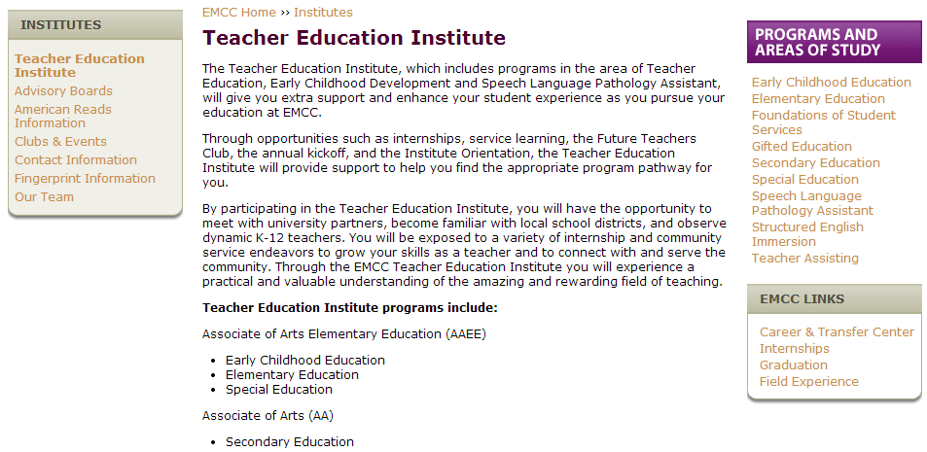
3. When you get your FCC, apply to be placed
Self-placed or EMCC-placed, apply through EMCC Education website at http://webapps.estrellamountain.edu/authenticate.php?redirect=/field-experience

Slide 10
3. Next steps in application process

Slide 11
4. Contact Mentor Teacher
If self-placed
Contact as soon as you fill in placement application
If EMCC placed
Contact when Landis emails you back with contact info
Then, for both self or EMCC placement:
Call/email mentor teacher to set up first meeting
At meeting, bring copy of FAQs, Field Experience Log, and Evaluation of Mentee form
Remember, this is an opportunity – be professional!!!!!
Do your Field Experience according to schedule you have set up

Slide 12
5. Do the Field Experience!
Remember to show your appreciation to your Mentor!
Be professional:
Dress
Timeliness
Introduce to principal
Investigate learning opportunities
When the experience is finished, write a thank you note!

Slide 13
5. Do the Field Experience!
Reminders:
Do not meet with students alone
Do not meet with students off campus
Do not make negative or disparaging comments
Do not bring tobacco to school
Do not socialize with students – be friendly, not their friend

Slide 14
6. Time Log and Evaluation
About the log during the experience:
Access through Canvas>Module 1> Field Experience Explanation and Documents
Fill in the log and have your mentor initial it after each visit
If you have other experiences that qualify, have the person responsible initial your log
About the evaluation form
Access through Canvas>Module 1> Field Experience Explanation and Documents
Have the mentor fill it out near the end of your experience
If they are uncomfortable with sharing with you, then they can scan/email to me at peter.turner@estrellamountain.edu

Slide 15
7. Submit Time Log and Evaluation to Dr. Turner
When finished, scan documents and submit as file upload assignment listed in final module
Remember – early work gets 10% Extra Credit!
Write a thank-you to your mentor

