Slide 1
Breaking New Ground – 1st Year Start-Up Processes and Accomplishments in Service-Learning Innovation
Center for
Service Learning
&Civic Engagement
Landis Elliott & Rachel Holmes, SL Coordinators

Slide 2
Objectives
Share the processes that EMCC Service Learning and Civic Engagement has established in the first year of this newly revived program

Slide 3
Rationale
Provide Helpful information to other colleges that may be interested in starting up their own SL program or revitalize an existing program

Slide 4
Preview of Session
History of SL at EMCC
Recruitment Efforts
Creating and Maintaining Community Partnerships
Training on integrating SL into the Curriculum
Effective Methods of Data Collection
Innovative Ideas for SL integration
Tips & Sample Ideas

Slide 5
What is Service Learning and Civic Engagement?
Service Learning- Meaningful community service, connecting to classroom ___________ and includes a ____________.
Civic Engagement- Serving the community to take action by working towards a long-term ________and spreading awareness of an issue facing _____________.

Slide 6
History of SL at EMCC
What we had
Faculty demand
Admin buy in

Slide 7
First Steps
Website
  Proposal form
  Agency Partner List
Marketing
  Handbooks
  Presentations- in class, day of learning, ctl
Advisory Board
Establishing Partnerships
Presidents Service Award- verified agency

Slide 8
First Steps
Website
  Proposal form
  Agency Partner List
Marketing
  Handbooks
  Presentations- in class, day of learning, ctl
Advisory Board
Establishing Partnerships
Presidents Service Award- verified agency

Slide 9
Overview of Outcomes after first year
1.) Increased the number of Agencies
2.) Alternative Spring Break
3.) Service Learning Celebration
4.) President’s Volunteer Service Award

Slide 10
14/15 AY
14,633 hours
21 instructors
                15/16 AY
                17,558 hours
                25 instructors
GOAL FOR THIS
ACADEMIC YEAR
20% INCREASE
2015-2016AY
17,445 hours
(to date)
=
Value of Volunteer time is $411,000*
Based on the Estimated Value of Volunteer Time ($23.36) from the 2015 Bureau of Labor Statistics
Notes:
At the beginning of the Fall semester the goal was set to increase service learning by 20%. To date- we have not only exceeded this goal and contributed 17,455 hours to the community but…when you take the estimated value of volunteer time for 2015 which is $23.56 EMCC can estimate the value of the volunteer hours provided at over $400,000.

Slide 11
2015-2016AY
20,003 hours
GOAL FOR THIS
ACADEMIC YEAR
20% INCREASE
=
Value of Volunteer time is $467,270*
25 Instructors
37% Gain in hours
Based on the Estimated Value of Volunteer Time ($23.36) from the 2015 Bureau of Labor Statistics
Notes:
At the beginning of the Fall semester the goal was set to increase service learning by 20%. To date- we have not only exceeded this goal and contributed 17,455 hours to the community but…when you take the estimated value of volunteer time for 2015 which is $23.56 EMCC can estimate the value of the volunteer hours provided at over $400,000.

Slide 12
Recognition of all Service Learning Students
754 EMCC students participated in Service Learning during the
2015/16 Academic Year
Notes:
Campus wide we have had over 754 students that participated in service learning during the academic year. We would like to honor all of the students that are present today and that truly impacted the community thru your work. you may pick up your certificate on the way out after the luncheon but at this time will you all stand and be recognized.
And now for our most prestigious award. The President’s Volunteer Service Award

Slide 13
Recruitment Efforts
Students, faculty and staff, getting buy in

Slide 14
Admin Buy-In

Slide 15
Faculty Recruitment

Slide 16



Student Recruitment
Clubs
Honors
Classes
Independent Projects

Slide 17
Staff Recruitment
E2
ACE
Ask Me
Day of Learning
CTL
Word of Mouth
Model the way

Slide 18
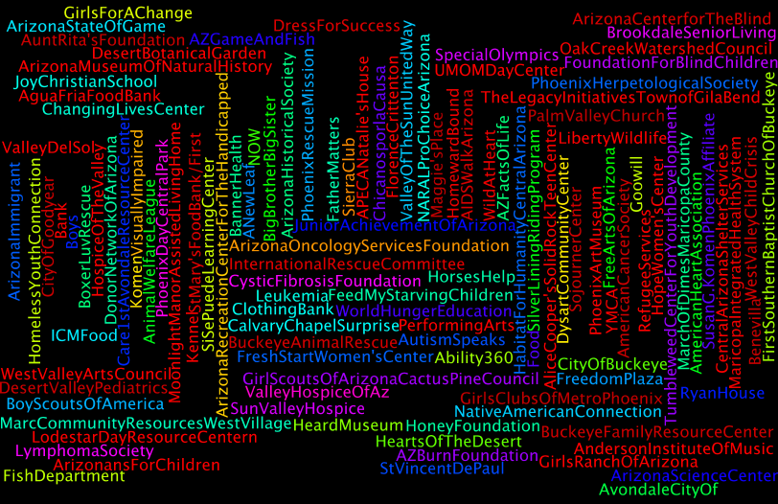
Creating and Maintaining Community Partnerships

Slide 19
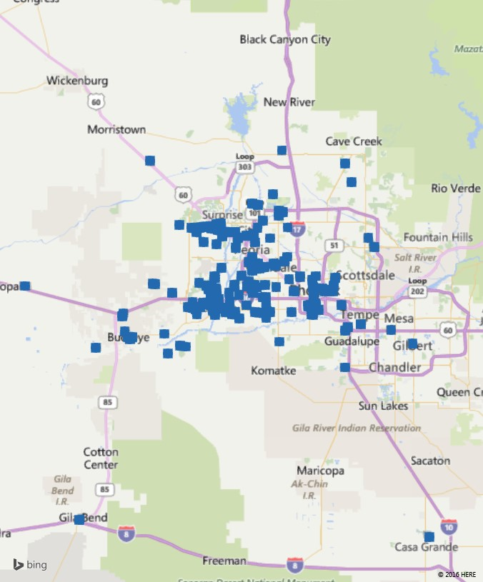
Oak Creek Canyon
The Reach
of EMCC Service Learning Students
EMCC
Mesa
Buckeye
Gila Bend
Casa Grande

Slide 20
Creating and Maintaining Community Partnerships
Speaking at local organizations
  Rotary
  Volunteer Groups
  Leadership groups on campus
Taking tours and volunteering at orgs
Creating personal relationships

Slide 21
Training on integrating SL into the Curriculum
Workshops
One on One meetings with instructors
Division Meetings
Adj Faculty Orientations
Training Ambassadors

Slide 22
Effective Methods of Data Collection
Time Logs
Online forms
Spreadhsheets

Slide 23
Effective Methods of Data Collection

Slide 24
What are your fears and concerns about integrating Service Learning?
t/p/s

Slide 25
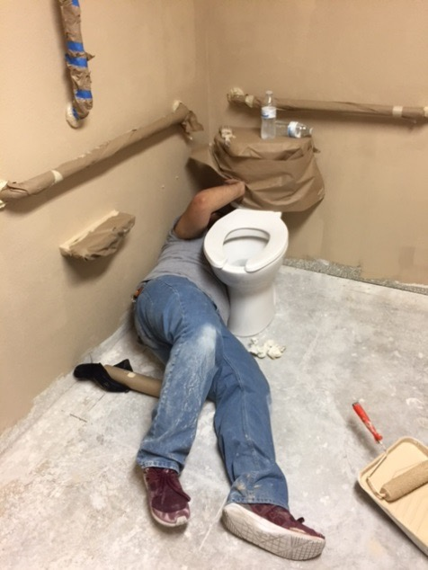
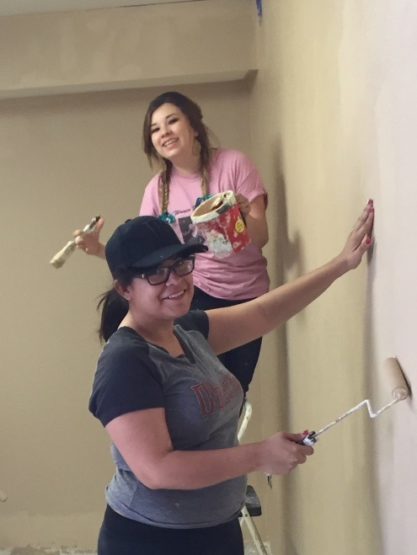
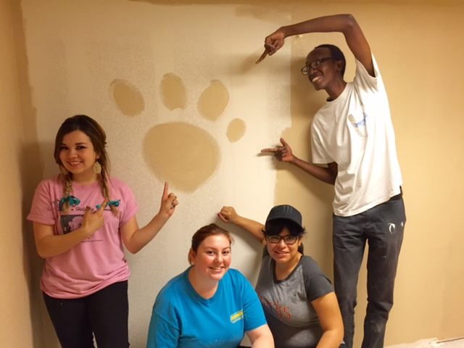
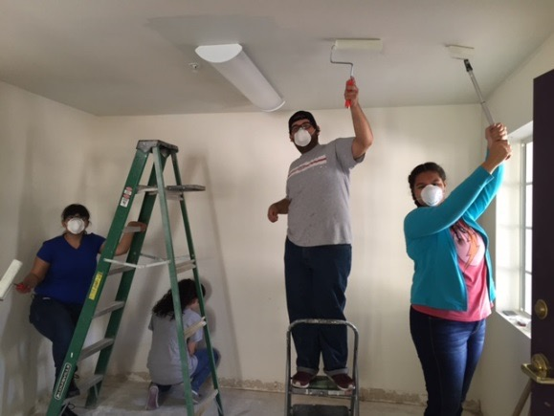
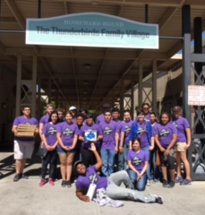
Alternative Spring Break 2016
Homeward Bound
30 Students (24
had no previous SL experience)
370 Hours

Slide 26
Tips & Sample Ideas
Refer to Handbook page 13-16 for sample ideas
Partner- come up with 2 innovative SL ideas that connect to the curriculum you teach or an academic area that interests you

Slide 27
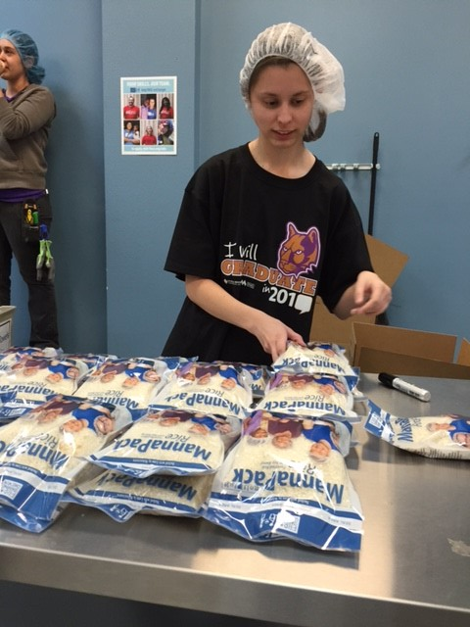
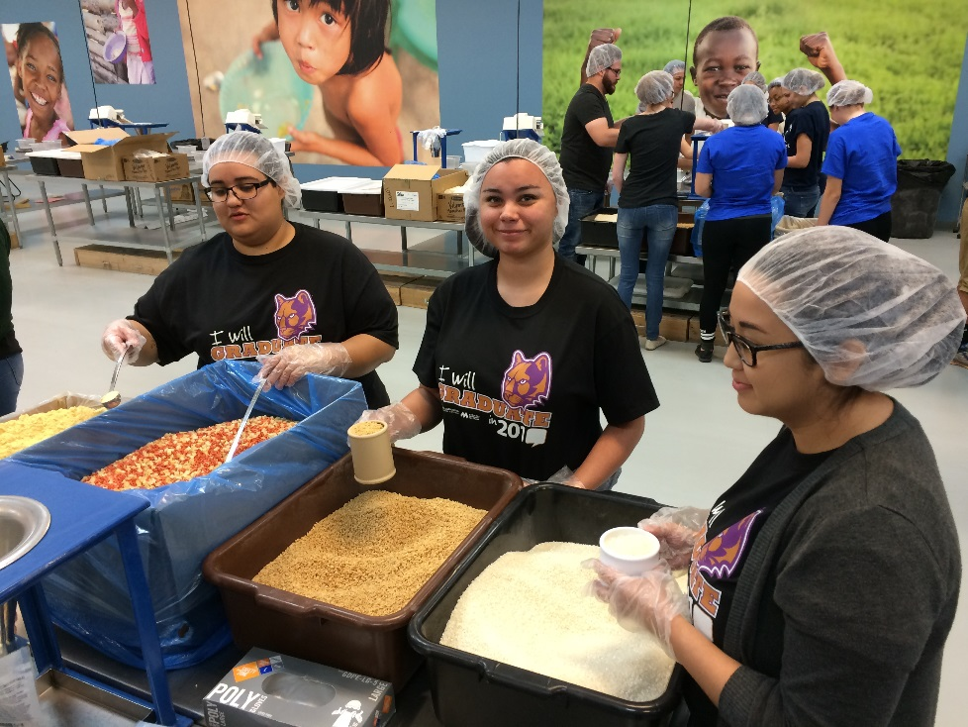
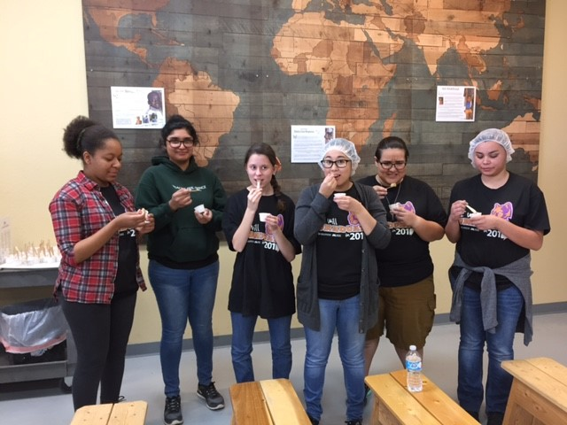
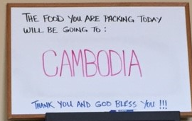
District-Wide Event
Feed My Starving
Children
Over 120 students participated

Slide 28
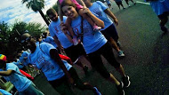
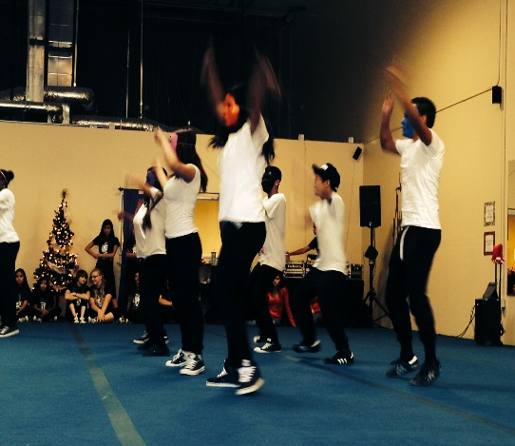
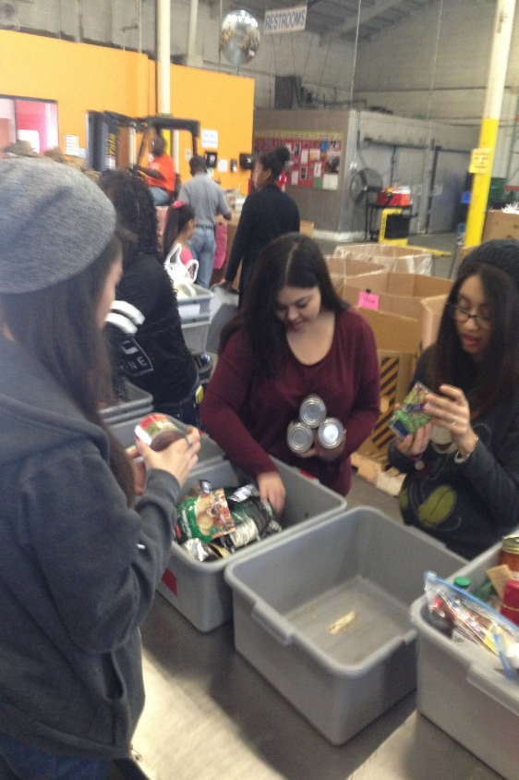
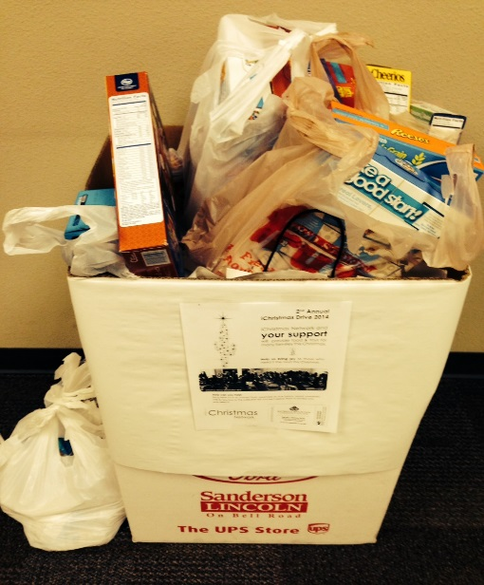
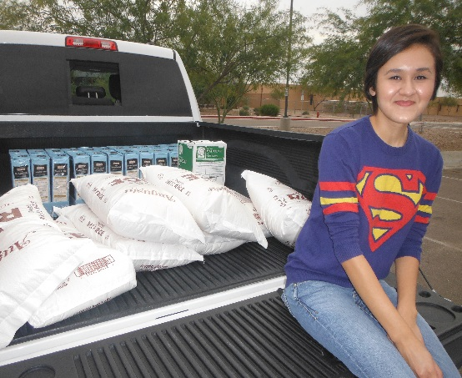
Service Learning Examples and Successes

Slide 29
Stay and Stray
Need chart paper/markers
1.) What is the 1st step you are going to take to implement service learning
2.) What type of recruitment efforts do you feel are most effective with your audience
3.) Service Learning Project List
4.) Civic Engagement Project List
5.)Benefits to the students, community, faculty/staff

Slide 30
Final Celebration
The importance of having a celebration
Showcasing EMCC Spring SL INCLUDE MORE PICTURES
  Awards
  Medallions
  Partner Recognition

Slide 31
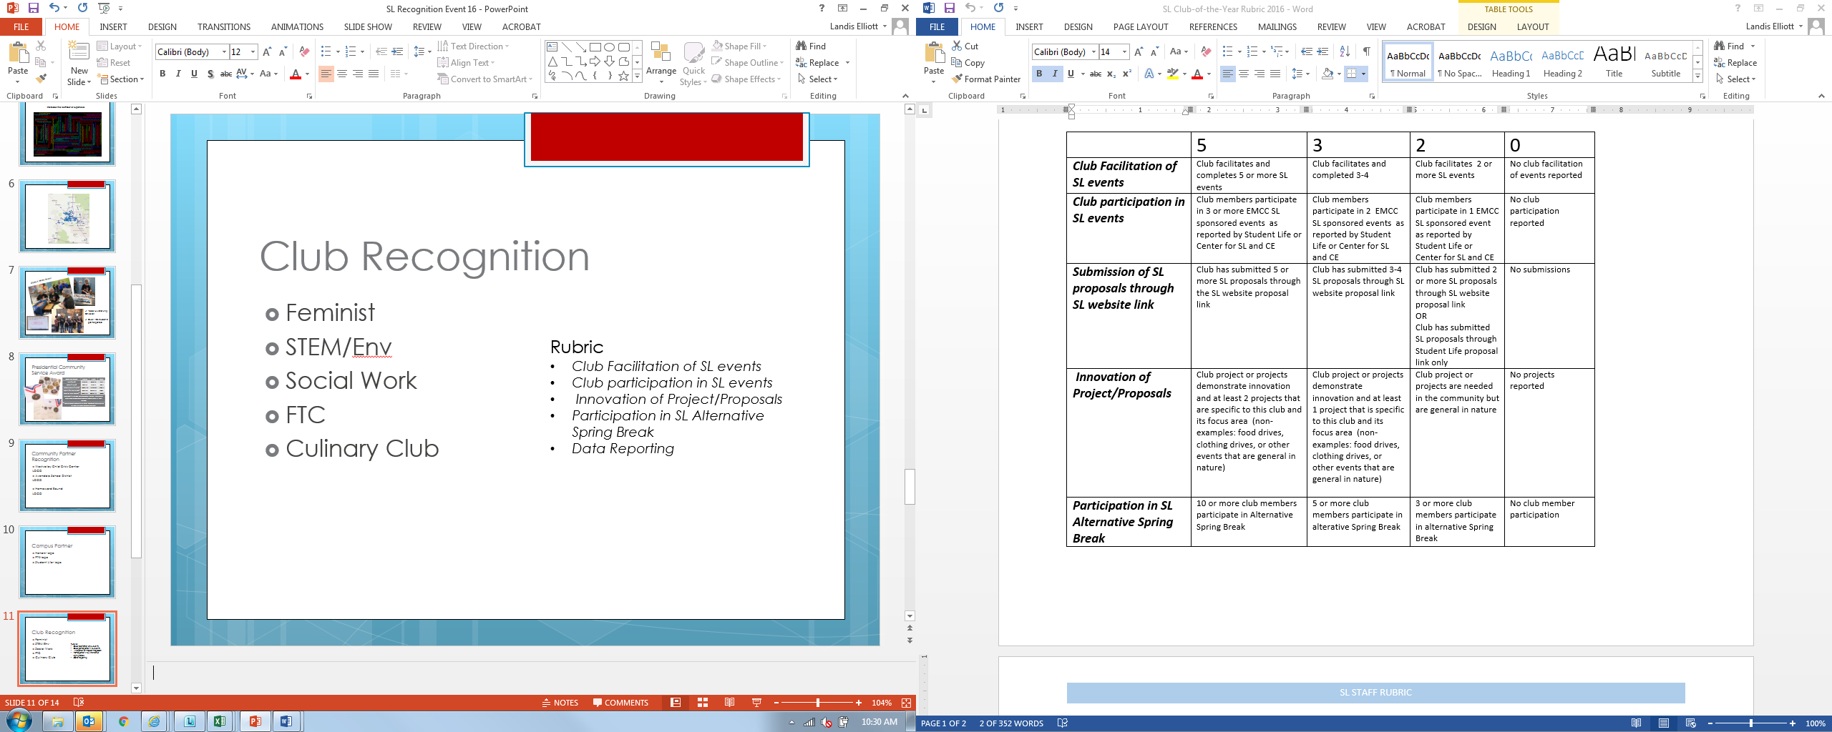
Club Recognition
Notes:
Add the data part of the rubrick, alpha order
Stand up and be recognized, over view of rubrick

Slide 32
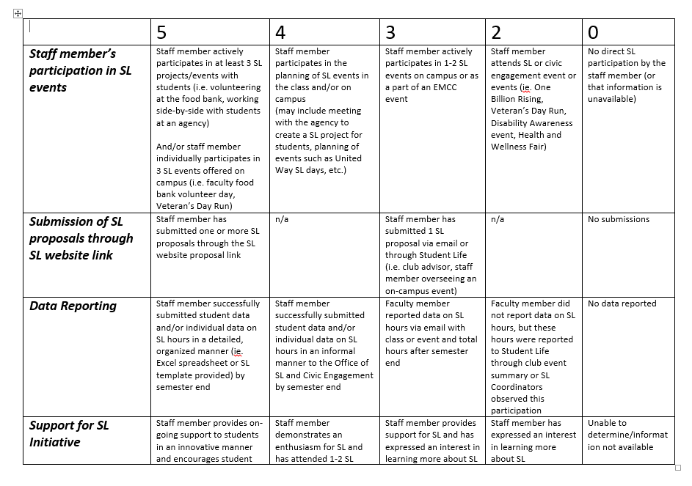
Staff Recognition
Notes:
Two Staff members that truly support students and SL on campus.
This first person has been an equal partner from the beginning in our drive to integrate SL outside of the classroom and woven into the fabric of clubs and orgs on campus. Not only does he encourage students to participate but he is always the first person in line to give up his own time in service learning events.
This person has been instrumental with brining service learning to our high school students enrolled at EMCC. Not only did she integrate this into the curriculum but she took time out of her own schedule to get her hands dirty and help out with the projects herself.
Please put your hands together in congradulating our first SL staff members of the year

Slide 33
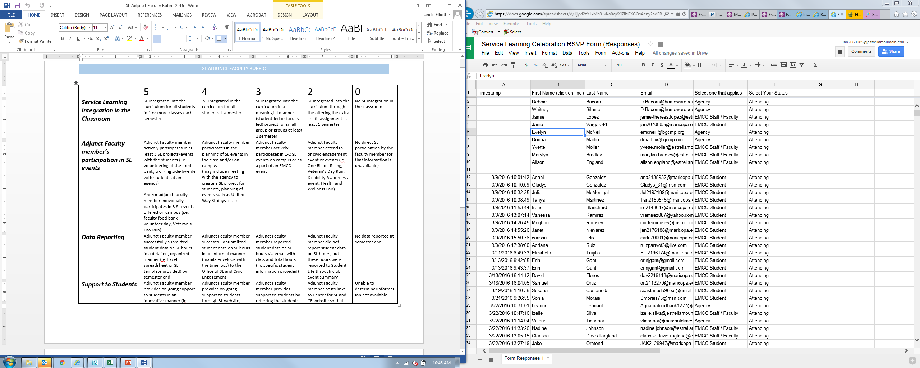
Adjunct Faculty Recognition
Notes:
The next two people we will be recognizing our Adjunct Faculty of the year.
This faculty member integrated SL directly into her classroom providing her psychology students with the opportunity to witness first hand the behavioral interactions with children in the foster care system. This faculty member created a strong partnership with the West Valley Child Crisis Center and we would like to congratulate Miss Alison England.
This next adjunct faculty member is part of EDU early childhood development team. She created a partnership with the City of Avondale and Care First location. She gives her own time while working with a group of EDU students implementing mom/tot playgroups in the community. Congratulations to Jaime Theresa Lopez

Slide 34
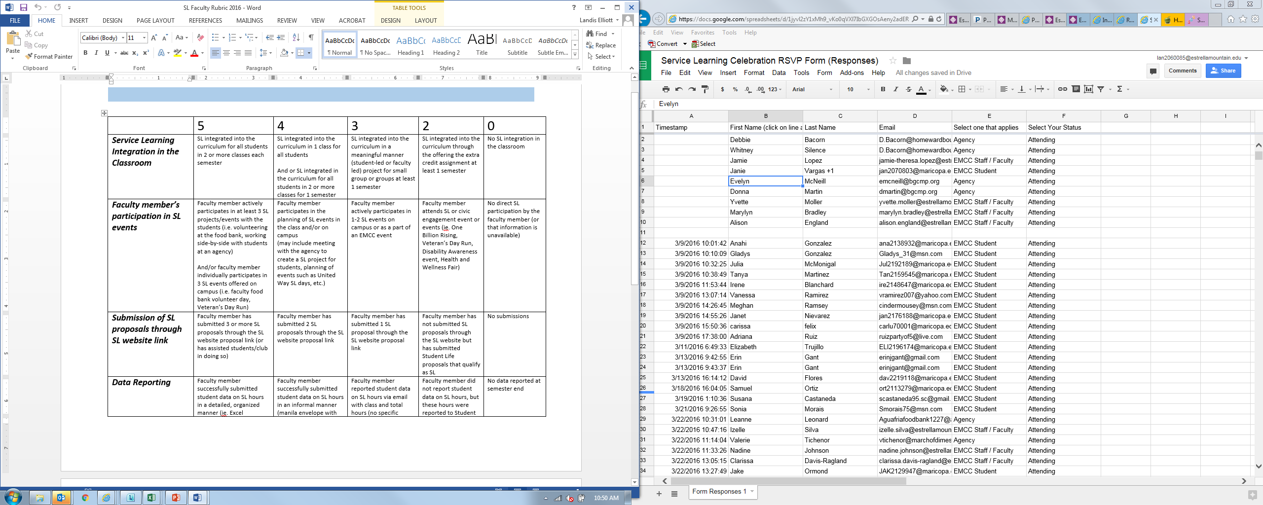
Faculty Recognition
Notes:
Discuss Rubric
This faculty member involved his students in the community throughout the year in events such as the pancake breakfast at the Veteran's Day Run and a variety of other local food festivals to provide his students with needed experience as they are giving back to the community. Unfortunately this person could not join us today but we would like to recognize Chef Steve Griggiths.
This first faculty member it is easier to say what this person doesn’t do on campus because she is constantly helping her students to engage in SL and organizing civic engagement events on campus. She is the model of selflessness, leads by example and was instrumental in bringing a SL program to EMCC. Let’s welcome the heart of S…Olga Tsoudis.

Slide 35
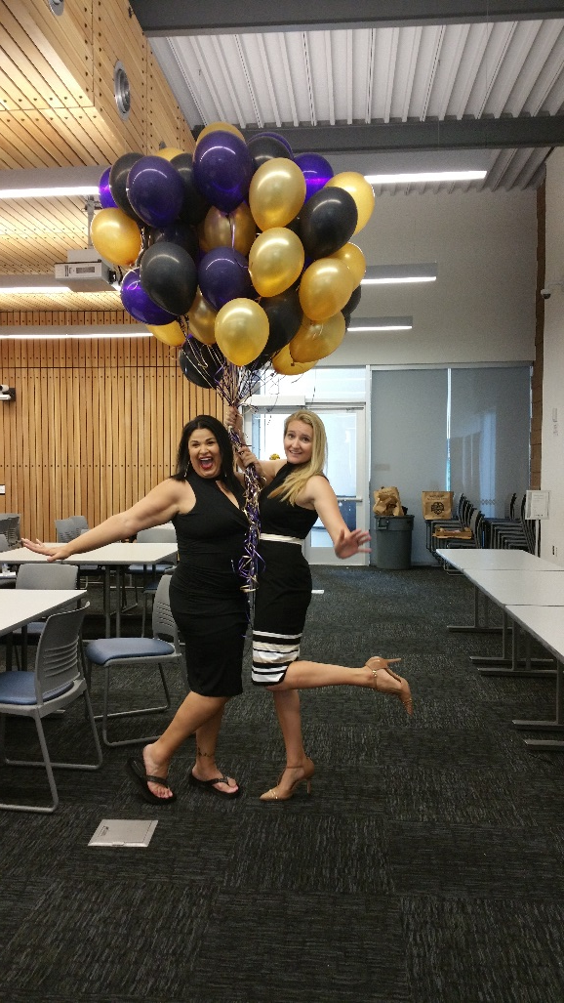
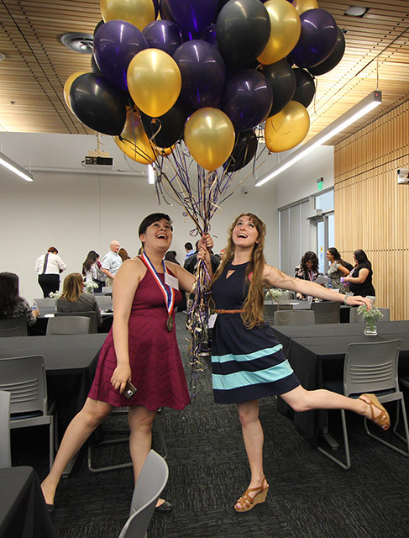
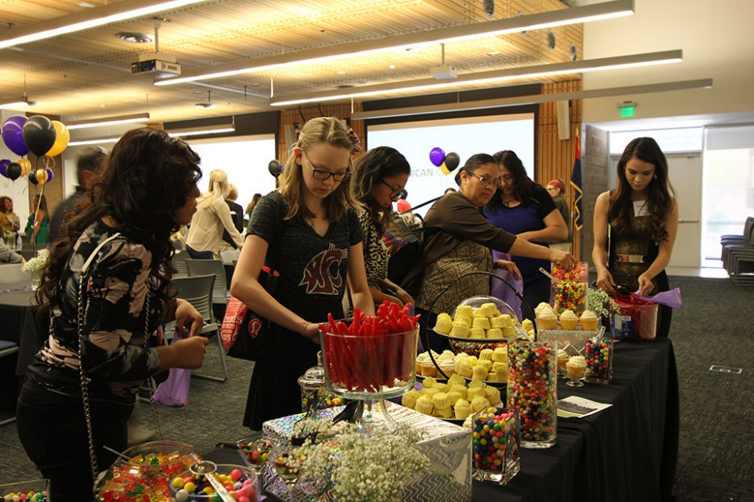

Slide 36
Ticket out the Door
On a post it note write down one question you still have on SL or one Ah-Ha Moment from the session

Slide 37
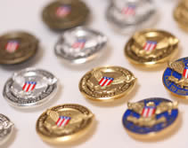
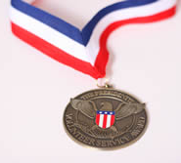
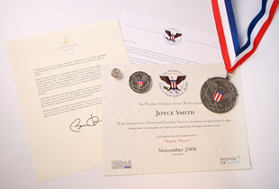
Presidential Community Service Award
Hours by Award | Bronze | Silver | Gold
Kids (5-10) | 26 – 49 | 50 – 74 | 75 +
Teens (11–15) | 50 – 74 | 75 – 99 | 100 +
Young Adults (16-25) | 100 – 174 | 175 – 249 | 250 +
Adults (26 and older) | 100 – 249 | 250 – 499 | 500+
Families and Groups* | 200 – 499 | 500 – 999 | 1,000+
President’s Lifetime Achievement Award: Individuals who have completed 4,000 or more hours in their lifetime
* Two or more people, with each member contributing at least 25 hours toward the total
60 students have received
this honor

Slide 38


President’s Community
Service Award
Notes:
At this time we would like to ask out VP of Dr Cardenas Adame would you please come up to the podium
Today our highest honor is being awarded to those students that have received 100 or more hours within the academic year. They are being honored thru this national award under President Obamas purvey. Students will receive a medallion they can wear to graduation and a signed certificate by president Obama. Students when we call your name, please make your way to the front. Although we have 60 students that received this award today we will be recognizing those that were able to attend. Please come up when your name is called.

Slide 39

Thank you
Landis Elliott
Landis.Elliott@estrellamountain.edu
(623)935-8220
Rachel Holmes
Rachel.Holmes@estrellamountain.edu
(623)935-8407

