Slide 1
Assessment Building in Service Learning
Rachel Holmes, M.Ed.

Slide 2
Ticket-in-the-door
What you already know about SL, and what do you hope to take away from today’s session?

Slide 3
Assessment Building in Service Learning Faculty-Focused
This workshop is specifically designed for Faculty, Staff, and Club Advisors and will provide a number of creative ideas for building the Final Reflection/Assignment that students are required to submit at the completion of SL projects.

Slide 4
Service Learning Overview
1. Students are either assigned a project or they create a project of their own and submit a proposal.
2. Students complete their required docs and begin the project.
3. Assessment/final reflection takes place…this is the key to SL!

Slide 5
The Role of Assessment
Critical for self-reflection to determine the value of the project to the student and to the beneficiary
Creates a final picture of the outcome, what went well, what didn’t
Connects the volunteer activity to student learning in a meaningful way to thereby enhance student knowledge/skills

Slide 7
Post It Notes
On your post it, write down at least 3 types of assessments that you feel could help students to reflect on their SL projects, the value of the project, their individual contribution and growth, etc.
Think/pair/share

Slide 8
Assessments

Slide 9
Assessment Ideas
3 options provided by Center for SL (as examples)
Written Assessments
Journals, essay, short answer
In-Class Presentations
Video and Online Canvas Presentations
Portfolio
Whole-group or Small-group Discussion
Large Poster (to be hung up, stay and stray, or presented)
Additional Ideas…
Notes:
Students can certainly submit a written assessment, but that requires a lot of grading. As an alternative, the teacher can designate one day for presentations (5-10 min each) for student to share with the class.
Another alternative is having students create a video, PP, prezy, etc and post to Canvas discussion board for peer review and peer feedback. This is a great time saver for hybrid and online courses.

Slide 10
Whole Class, Small group, or individual
Think in terms of time constraints.
If it’s a group project, do you want a group assessment or individual? Benefits of each? t/p/s
How do you ensure individual accountability?
Instructor’s personal preference
In terms of grading
In terms of how deep you want to see students reflect on the project
In terms of adding a rubric or doing a pass/fail

Slide 11
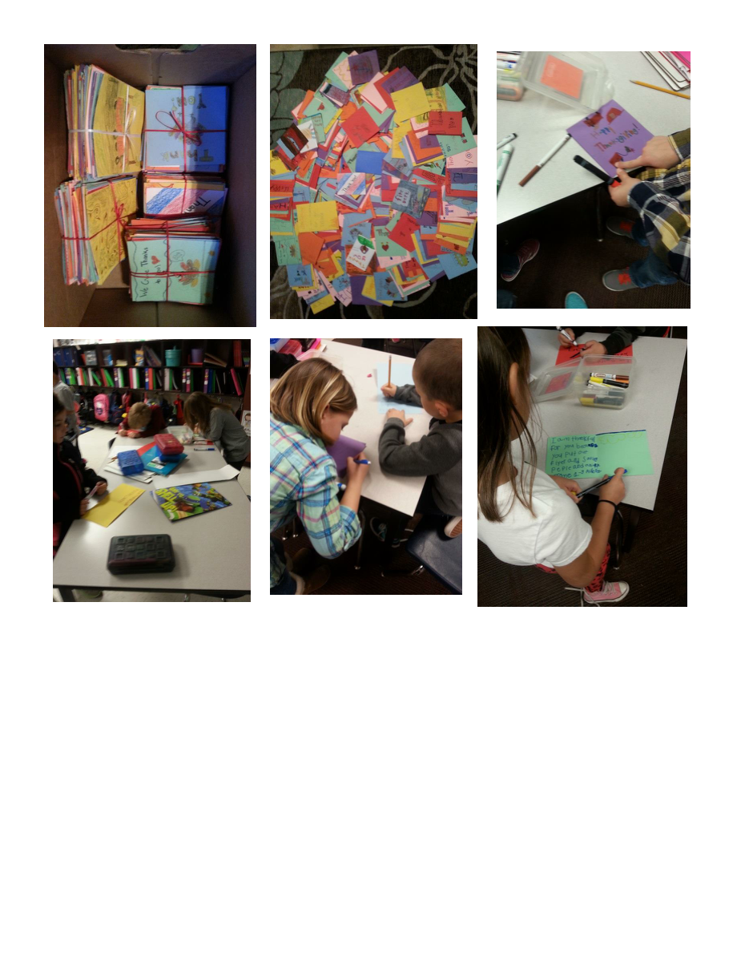
Examples of Assessments- Holmes
Written reflection with pictures
Scrapbook with pics, captions, interview snippets
Presentations to small groups, parallel teaching
Written reflections to Canvas, instructor graded
Whole-class potluck, discussion forum to present final outcomes

Slide 12
Christmas Gift Bags

Slide 13
Ronald McDonald House Project

Slide 14
Purpose of the Assessment
Qualitative vs. quantitative
To connect the project to the learning (skills, curricular ties, and personal growth)
To Grade or Not to Grade….
Notes:
To grade or not to grade-- I personally tie very view points to the assessment because I want students to gain intrinsic value rather that doing it just for the points
On the other hand, some students benefit more from a rubric and having to work for a grade--- instructor needs to determine what works best for his/her students

Slide 15
Final Assessment/Evaluation for Center for SL and CE
Required time log and supervisor evaluation
Instructors please keep track of the total hours for your class/see Faculty packet
Students submit their time log to instructor and the Center for SL and CE electronically
Notes:
Landis, how do we make sure that we have record of all SL hours? What’s easier…having every student and/or instructor do the required document and submit it to us electronically or in-person? I’m just afraid with all of the paperwork and different packets that it might get confusing.

Slide 16
Ticket-out-the-door
What is one assessment that you learned about today that you plan to implement with your students?
Or
What is one question you still have about assessment of SL?

Slide 17
For Additional Support
Contact
Center for SL and CE, EMCC
Rachel Holmes Rachel.holmes@estrellamountain.edu x58407 or
Landis Elliott Landis.Elliott@estrellamountain.edu x58220

