Slide 1
Service Learning and Civic Engagement
By Rachel Holmes and Landis Elliott
OFFICE OF SERVICE LEARNING AND CIVIC ENGAGEMENT, EMCC

Slide 3
Service Learning and Civic Engagement
4 Corners Activity
Please take a post-it and write a response for 2 of the 4 corners and place them on the respective posters you have chosen
1. What is Service Learning, and what is Civic Engagement?
2. How are Service Learning and Civic Engagement projects beneficial?
3. What concerns do you have about implementation of SL/CE projects into your curriculum?
4. What do you hope to learn today?

Slide 4
Definitions
Service Learning
The combination of community service and classroom instruction, with a focus on critical, reflective thinking as well as personal and civic responsibility
May be community service, one or more volunteer events, donations
Civic Engagement
Active participation in the public life of a community in an informed, committed, and constructive manner with a focus on the common good
Civic engagement provides students an opportunity to serve the community (the larger community or the college community) by working towards a long-term solution and/or awareness of an issue facing society
Working towards positive social change

Slide 5
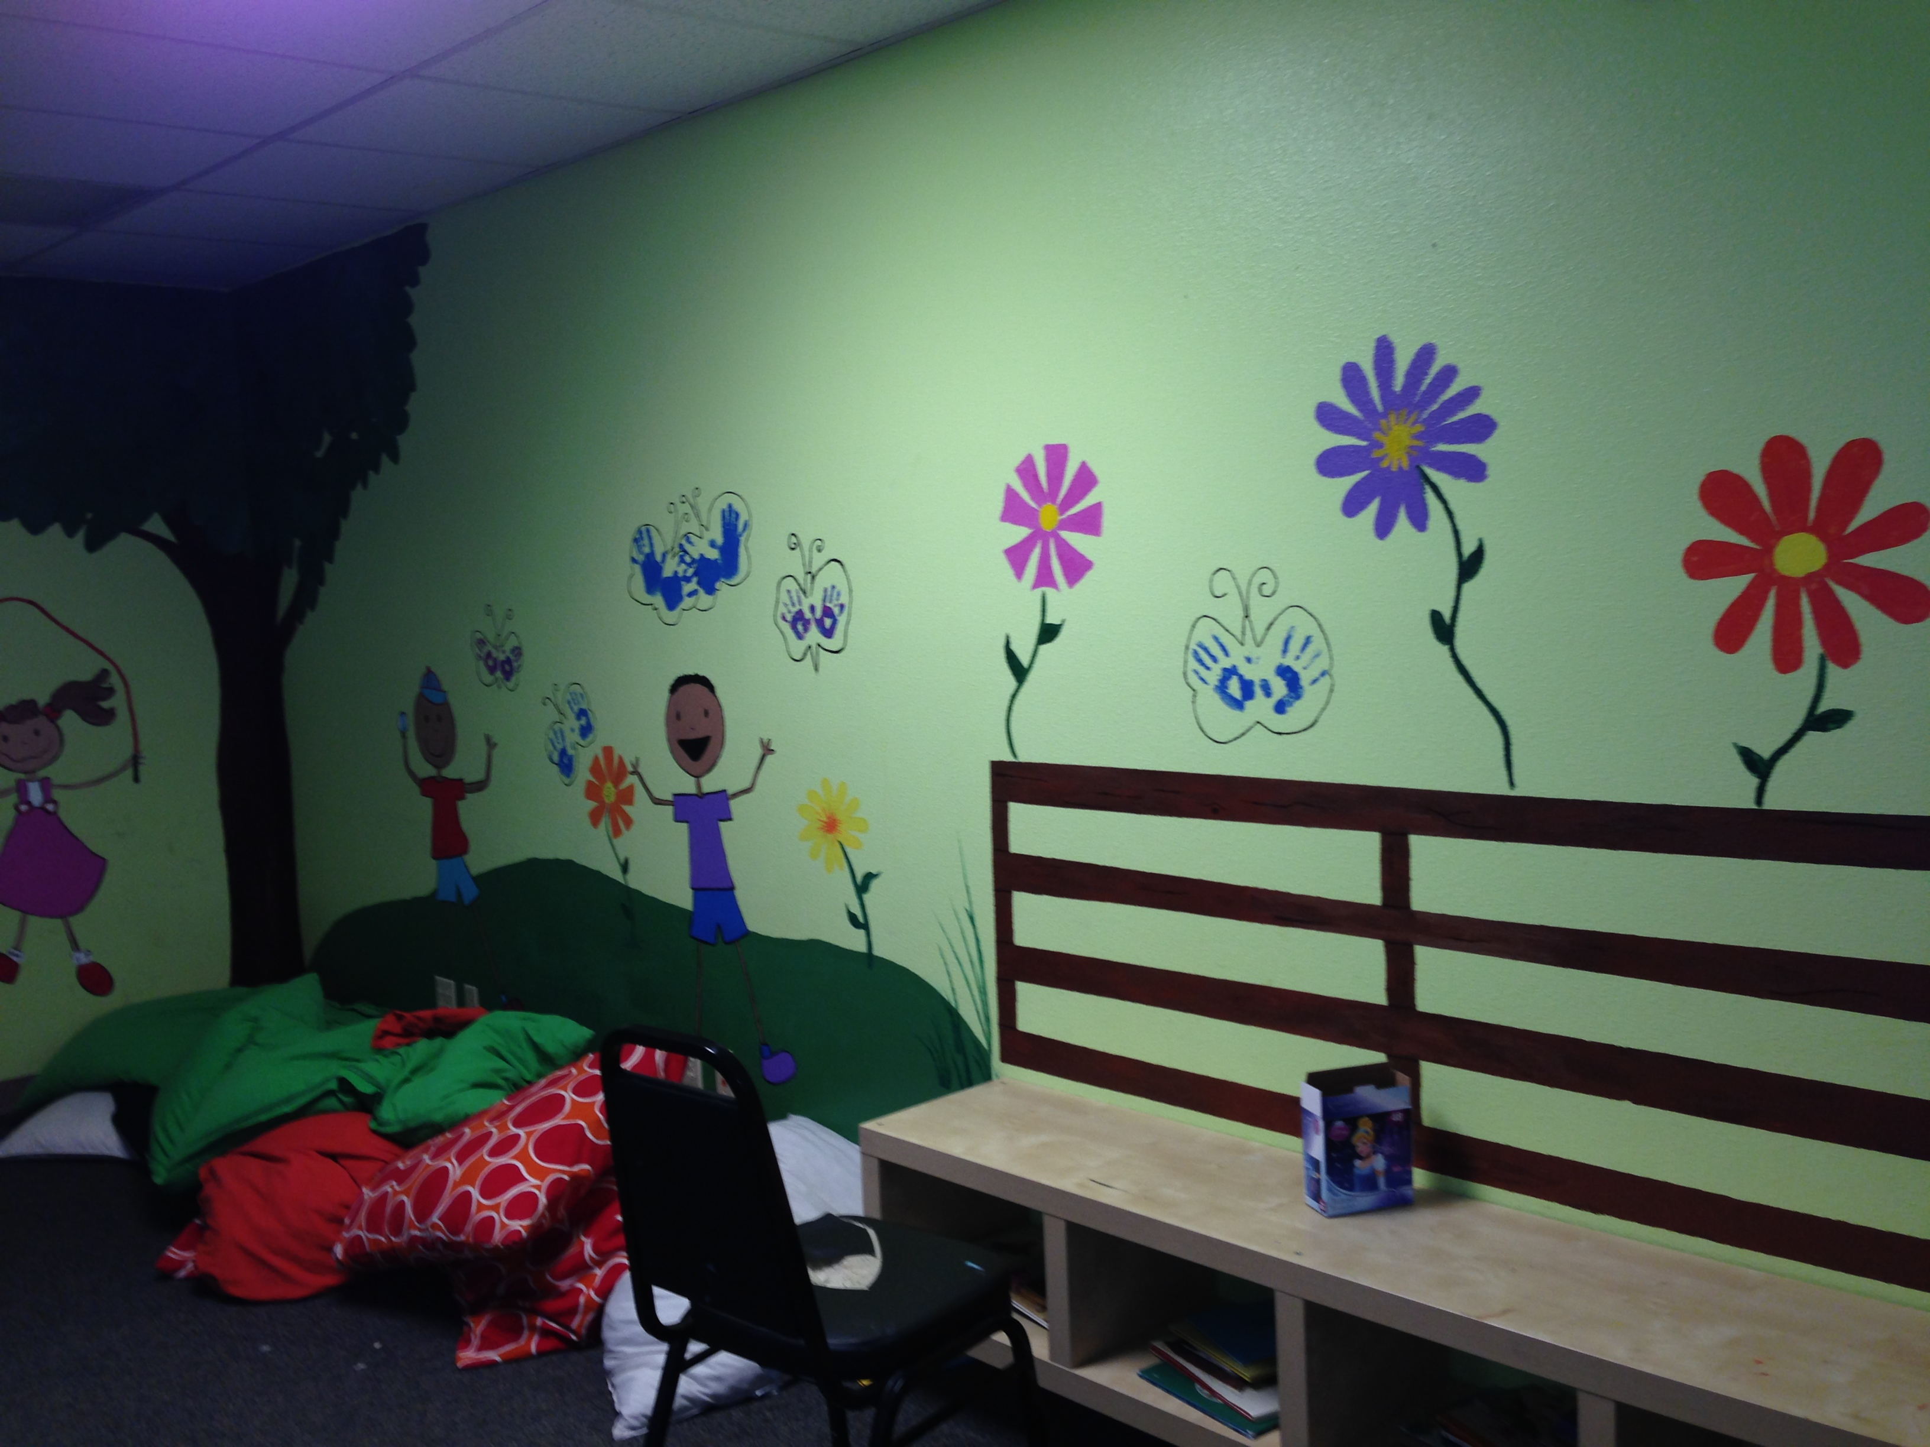
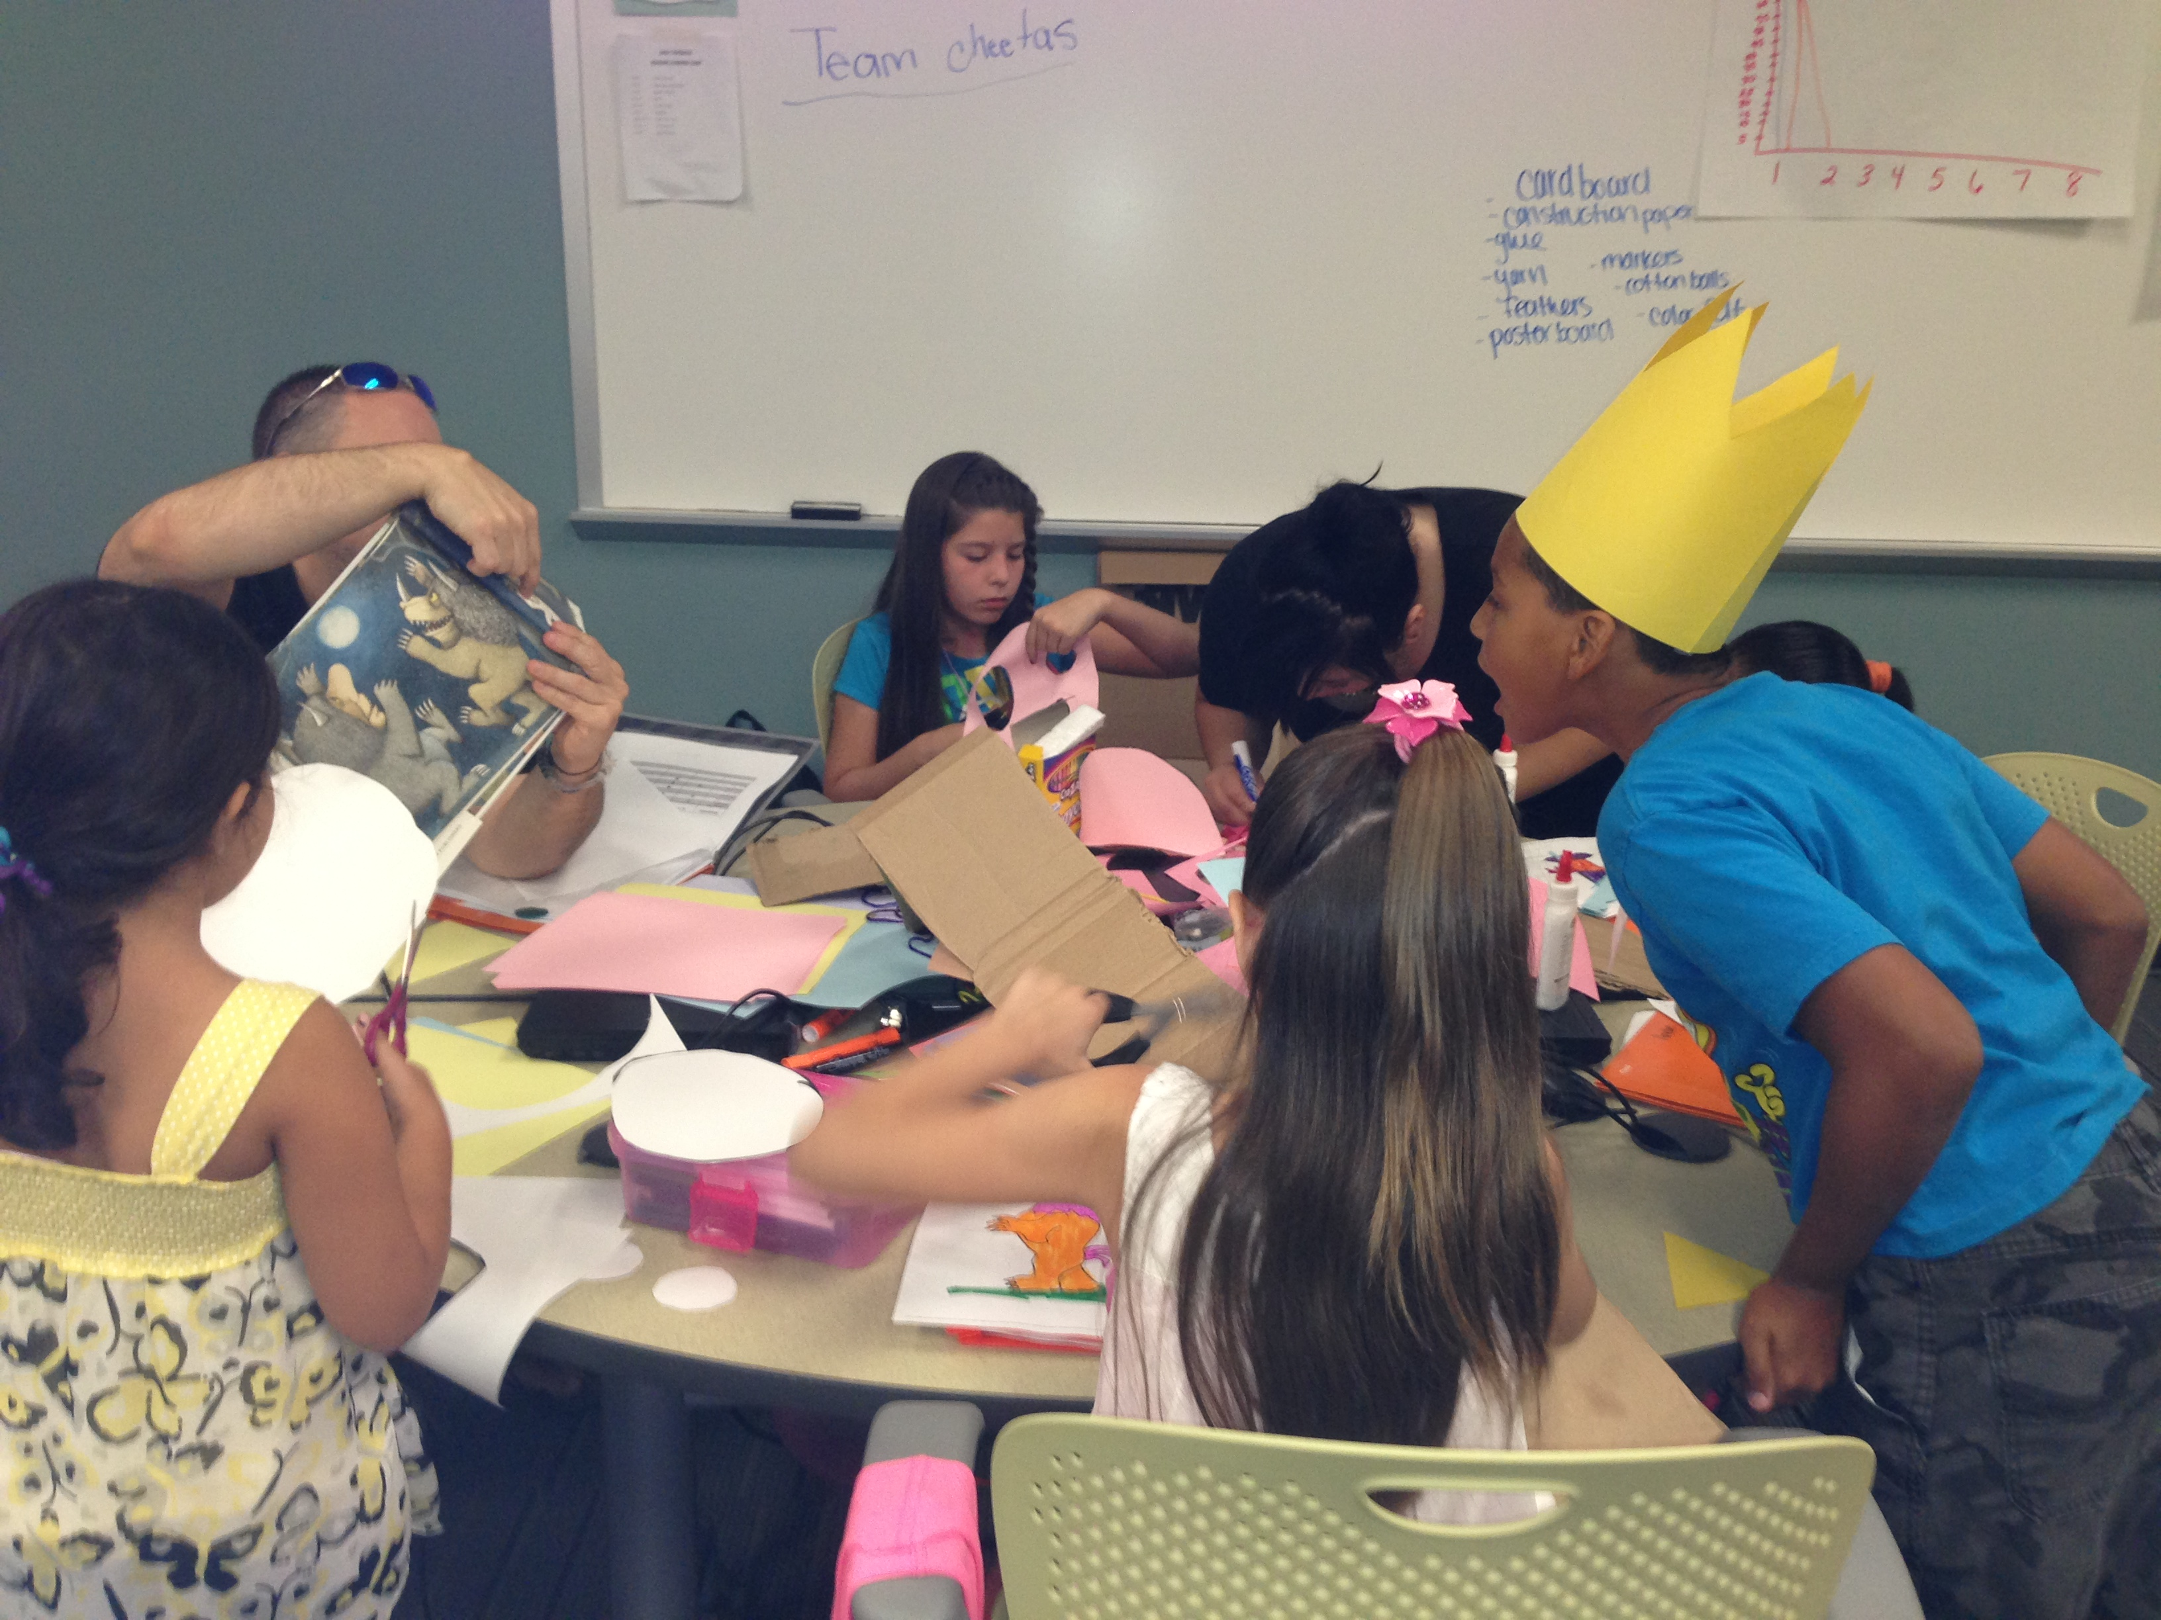

Slide 6
How does Service Learning Align to EMCC Vision, Mission, and Values
Vision
We provide exceptional and creative learning experiences that prepare all learners to achieve their dreams and transform their lives.
Mission
Estrella Mountain is an innovative higher learning organization responding to the diverse needs of West Valley communities
Workforce Development Responding to the community's dynamic workforce needs by establishing partnerships and creating relevant programs of study, training and services.
Community Education Providing learning experiences that enhance the knowledge, skills and abilities of life-long learners.
Civic Responsibility Creating opportunities and partnerships that provide a framework for learners to act responsibly in society.

Slide 7
The Center for Service Learning and Civic Engagement at EMCC
2015-2016 Goals:
- Increase SL/CE campus wide- begin with at least 25 instructors willing to implement
- Recognize the efforts of all students, faculty, staff, and community partners through a year-end recognition celebration in the Spring
Coordinators:
Landis Elliott, Manager of Internships and Coordinator of Center for SL/CE
Rachel Holmes, Faculty Coordinator of Center for SL/CE
F- 2014 6,189 hours
S- 2015 8,444 hours
21 instructors
GOAL FOR THIS ACADEMIC YEAR
20% INCREASE
F- 2015 7,426 hours
S- 2016 10,132 hours
25 instructors

Slide 8
Benefits of Service Learning and Civic Engagement
At your assigned table, you will work with your peers to determine the benefits/role of one of the following:
Students
The college as a whole
Community Partners
Community members receiving services

Slide 9
Benefits of Service Learning
Strengthen interpersonal skills
Builds community partnerships
Makes learning more useful and relevant
Promotes active learning
Provides real-life application of what students are learning in the classroom.
Provides an opportunity for students to learn about and give back to the community
Enhances sensitivity to diversity
Promotes personal and social growth

Slide 10
Benefits Continued
Stimulates intellectual and leadership development
Fosters a sense of civic responsibility
Helps prepare students for their future careers
Allows students to serve as involved citizens in their communities
Facilitates the development of a lifelong commitment to service
Heightens awareness of community needs
Develops critical thinking, communication, and problem-solving skills

Slide 11
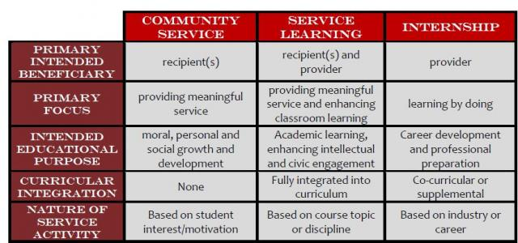
Overview of Service Learning/Civic Engagement

Slide 12
Examples of Past Projects
Down Syndrome Walk
Dance Festival for Special Needs Awareness
New Life Center Literacy Program
Maricopa Medical Center
iChristmas
Food Drives
Clothing and Hygiene Project Drives
Reader’s Theatre Performances
Tutoring Programs

Slide 13
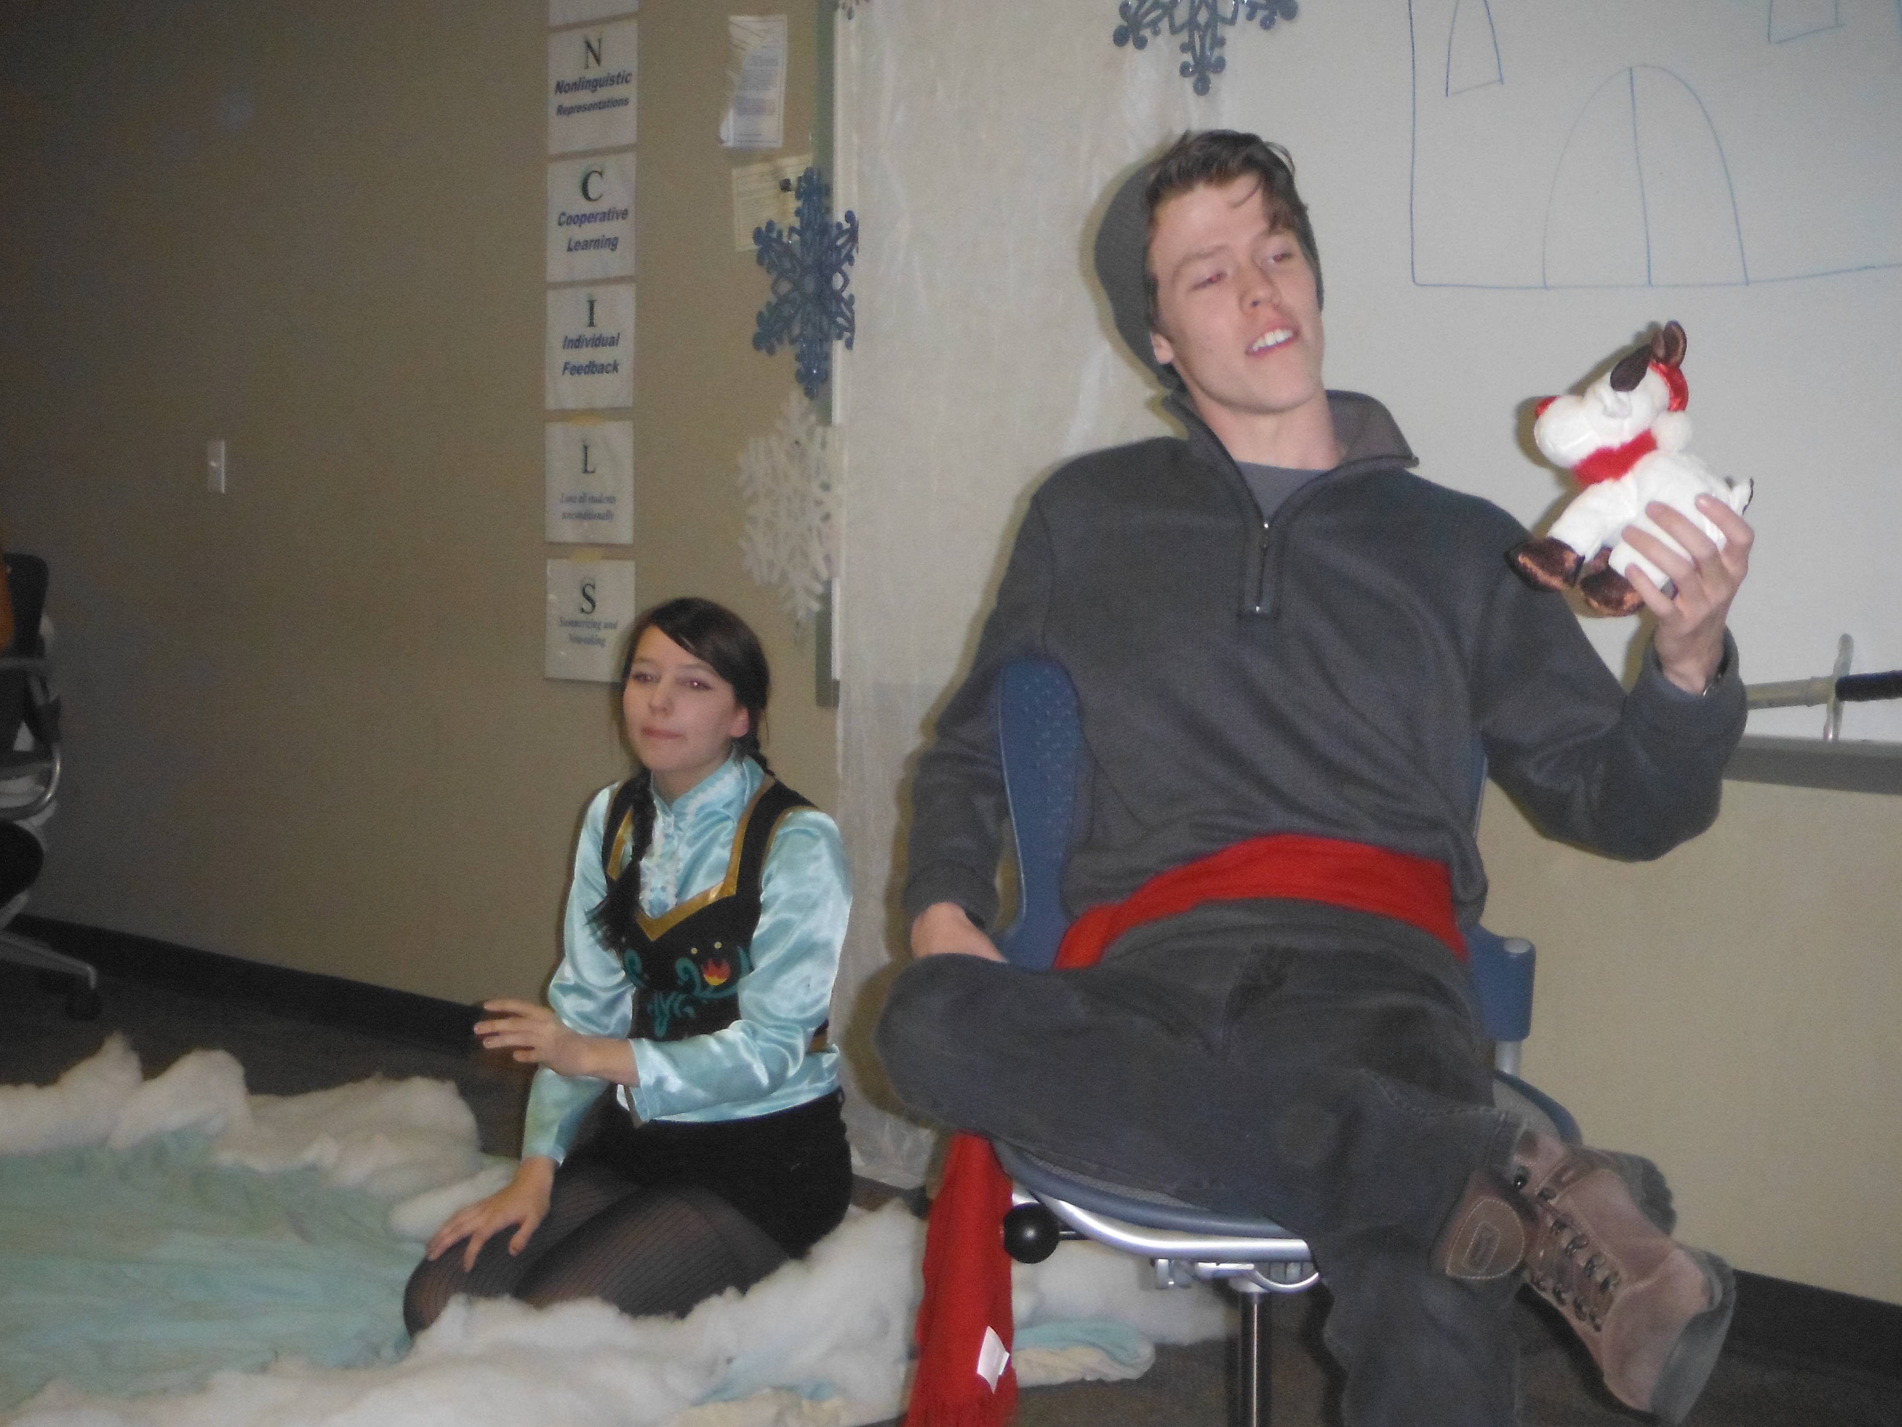
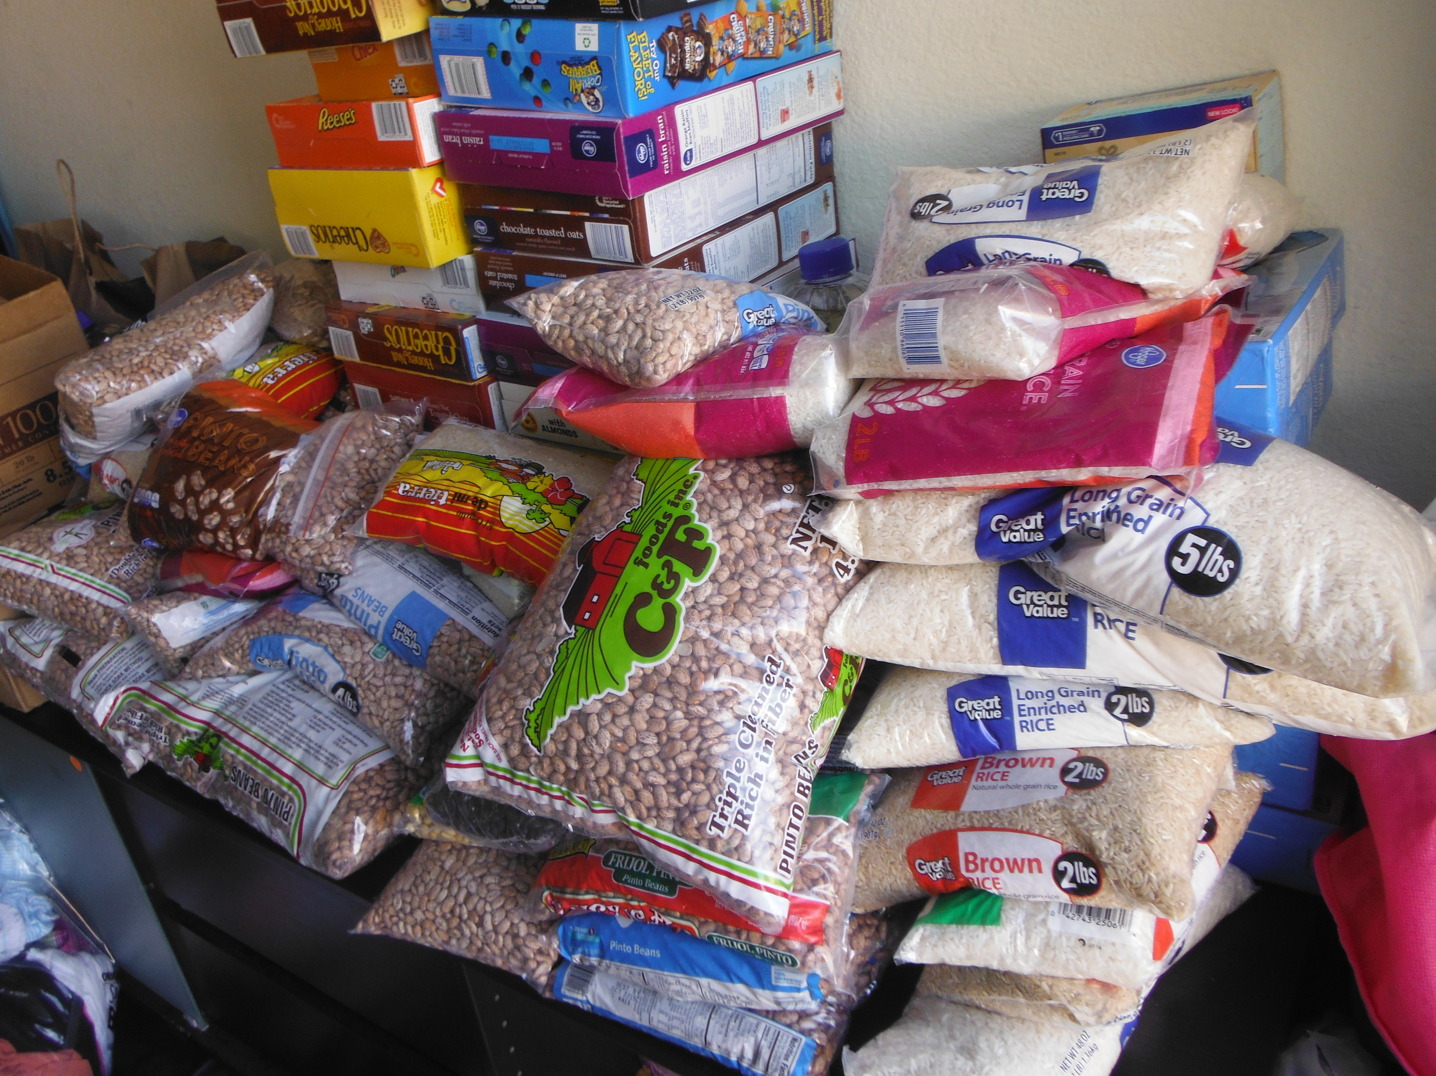

Slide 14
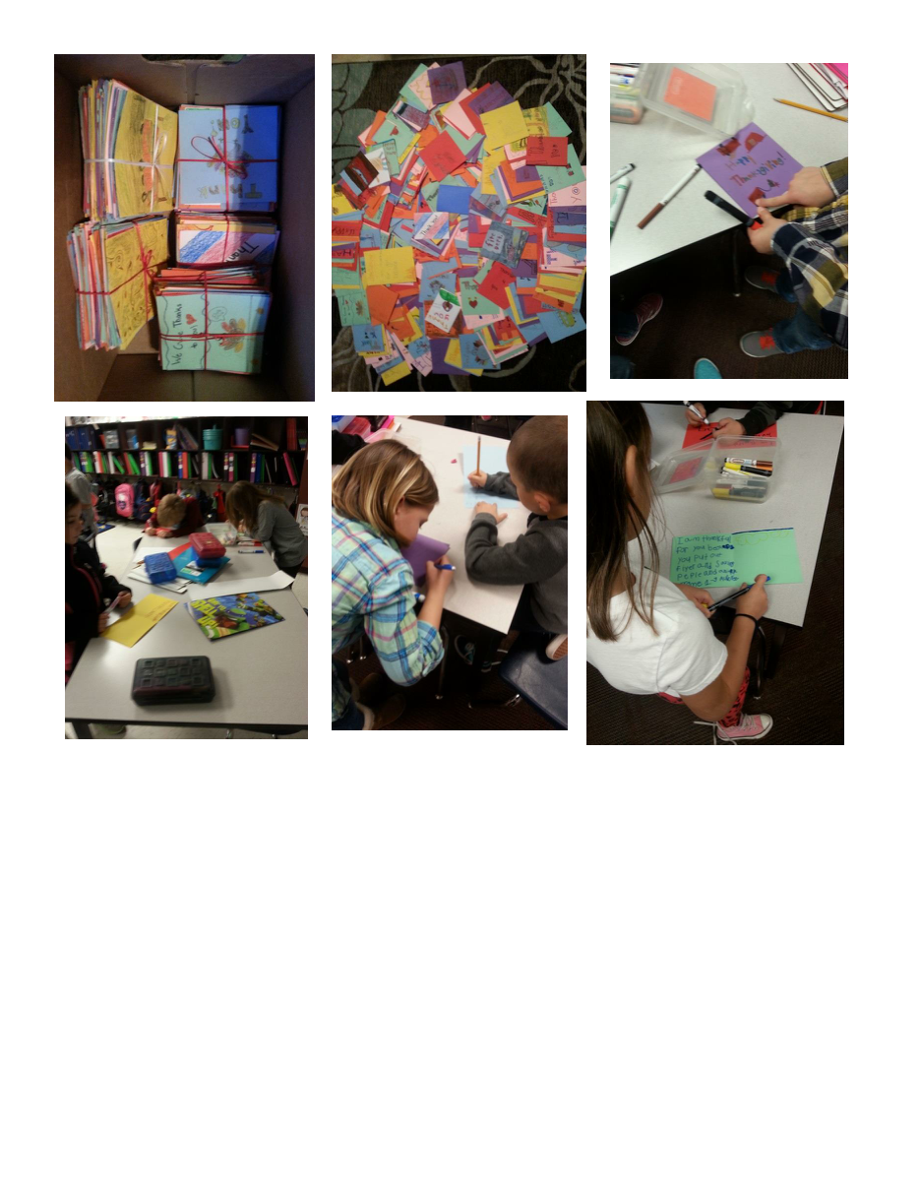
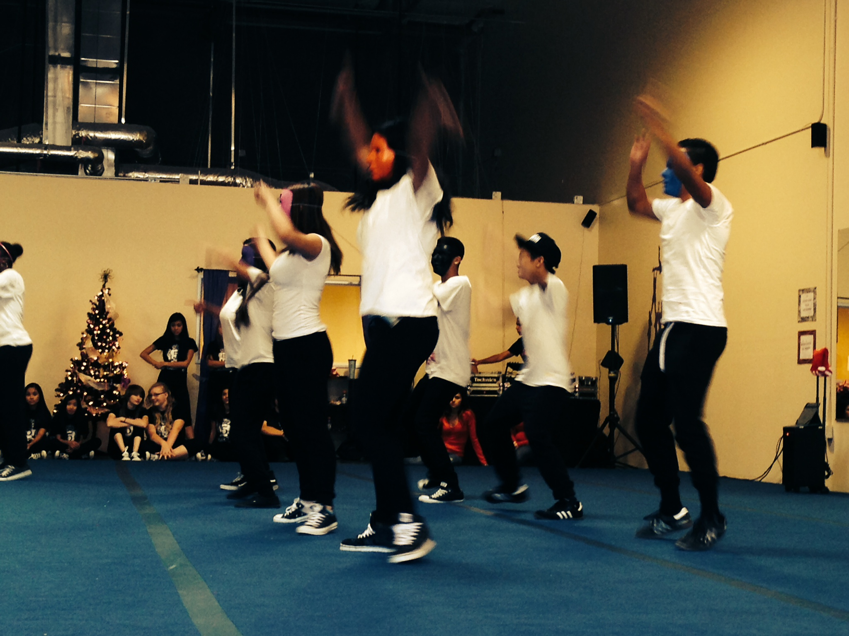

Slide 15
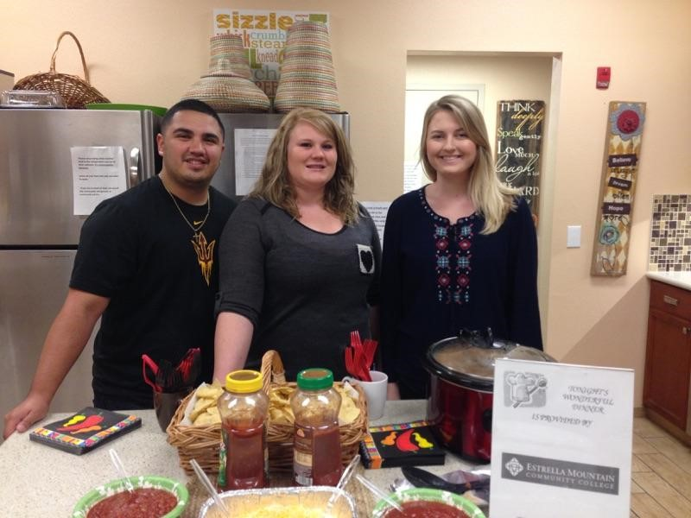

Slide 16
What is required of students?
1. Complete the proposal
Select a course competency
Determine the service to be performed
Select a community partnership/organization
Write a measurable goal:
Create a timeline
Determine how the project ties to the coursework and provide a written justification
2. Submit their request to Center of SL/CE via the website for data collection purposes, and to ensure that the partnership agreement is in place
3. Facilitate the project (seeking assistance from professor and/or Center of SL/CE)
4. Final Reflection Assignment
Can be a written reflection, whole-class discussion, PP presentation to the class, video presentation, speech, etc.
5. Complete Student Survey through the Center of SL/CE website

Slide 17
How do I Implement SL/CE?
1. Determine if the instructor will or if students will create the project. (and will it be SL, CE, a one-time event, or an ongoing project)
2. Determine if it will be Individual/Club Placement, Class Project, or One-Day Event
3. Provide students with the instructions/parameters of the assignment on Canvas and in-class complete with all requirements/rubric/etc.
Office of SL and CE will provide the student handouts (time log, supervisor evaluation, liability release)
4. If possible, provide one in-class workday for students to write up the proposal
5. Check in with students periodically either in-class or on Canvas to ensure progress
6. Create an assignment in Canvas where students submit the proposal and another assignment for the final reflection submission.
7. Include a SL/CE statement in your syllabi.

Slide 18
Sample Projects
Consider each of the following and whether it falls under SL or whether it falls under CE
Humannequins
One Billion Rising
EMCC Health Fair
Community Garden
Create and produce informational videos for non-profit organizations
Teach Senior Citizens basic computer skills
Create an after-school dance class for teens
Volunteering at the local food bank

Slide 19
Tips for Success
Include the requirement in your syllabus and on Canvas—be specific
Start small
You may want to select one whole-class project to begin with
Ask for help
Landis Elliott, can assist with the required documents, can suggest possible organizations in need of assistance, etc.
Rachel Holmes, can assist with facilitation of projects, Canvas help (setting up the assignments, requirements for students, etc.)

Slide 21
What Paperwork is Required
1.) Service Learning Proposal
2.) Student/Agency Agreement
3.) Service Learning Contact Log
Check out our NEW website:
http://www.estrellamountain.edu/students/service-learning

Slide 22
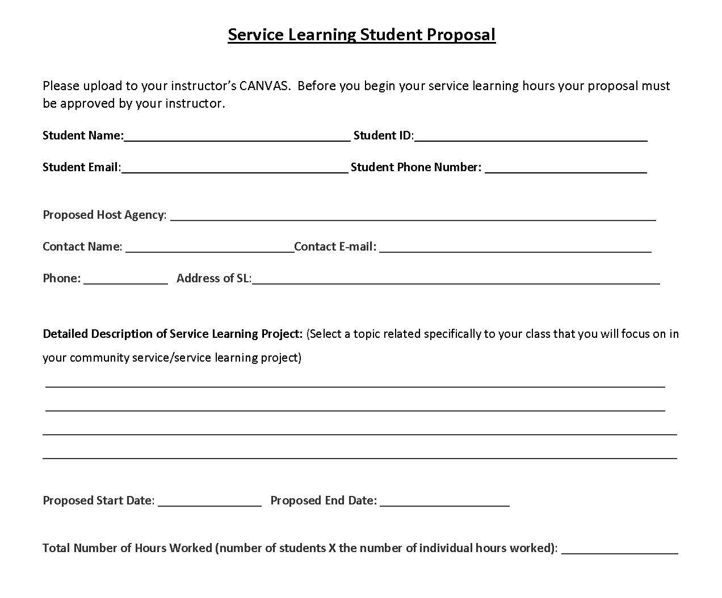
Service Learning Proposal
Who: Students
What: An overview of the SL
Project
Where (do I turn it in):
Webform- Honors, Clubs/Orgs, E2/3,
Independent projects
Class- Upload to CANVAS

Slide 23
Student/Agency Agreement
Who: Students/Agency
What: A contract between the Agency and student
Where (do I turn it in):
SL/CE Office or Email- Independent projects
Upload to CANVAS- Class, Honors

Slide 24
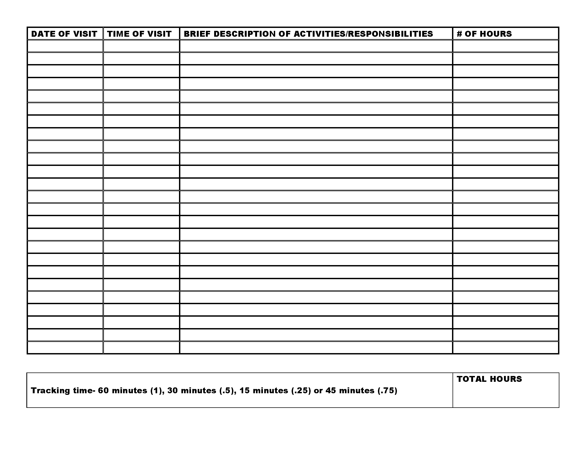
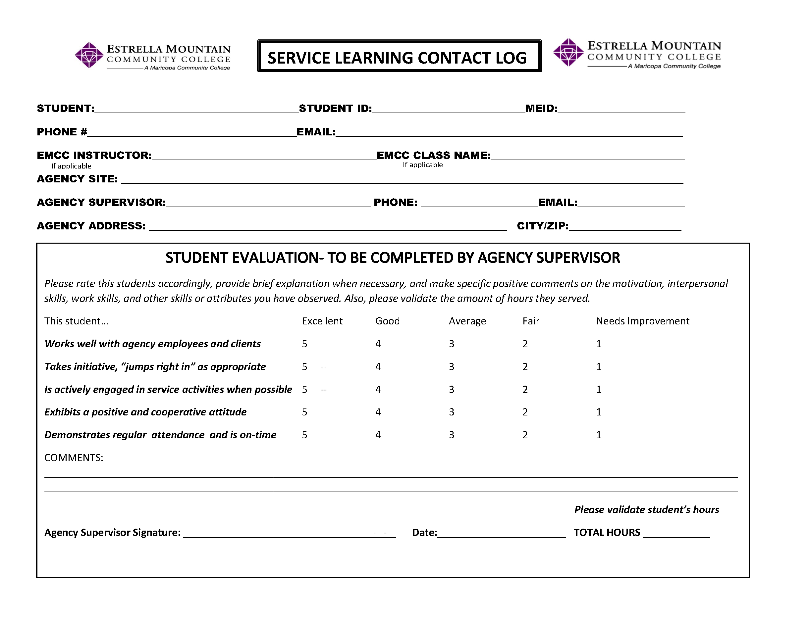
Service Learning Contact Log
Who: Students/Agency
What: Verification of Time
Where (do I turn it in):
SL/CE Office or Email-
Independent projects
Upload to CANVAS- Class, Honors

Slide 25
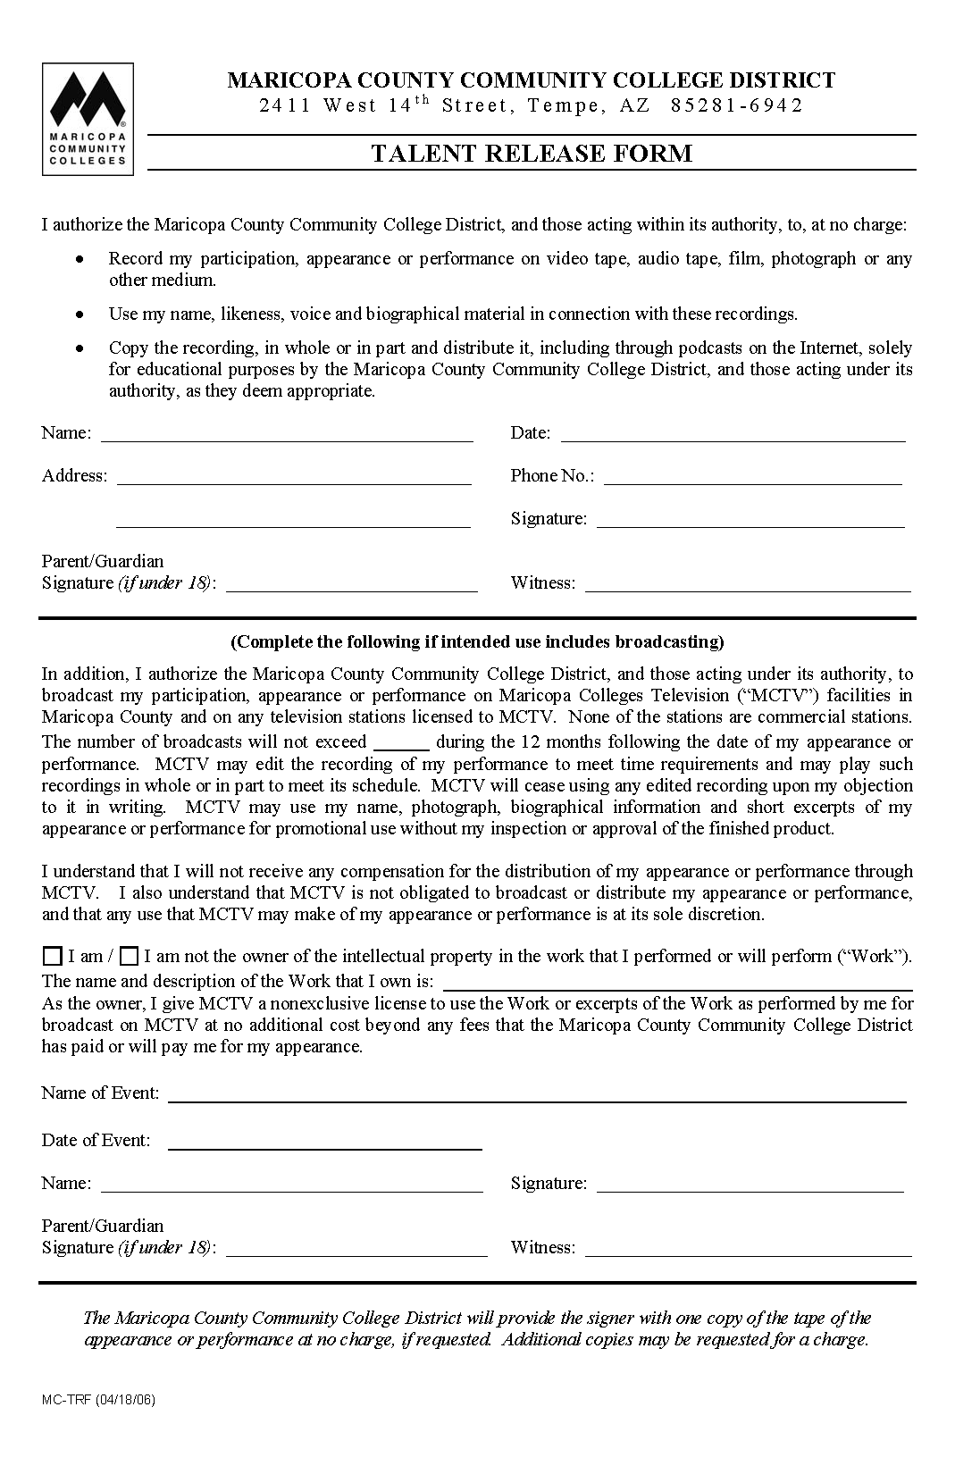
Risk/ Talent Release
Who: Student
What: Liability and use of pictures, quotes
Where (do I turn it in):
SL/CE Office or Email- Honors,
Independent projects
Upload to CANVAS- Class, Honors

Slide 26
4 Corners Review
Let’s take another look at two of the questions:
What concerns do you have about implementation of SL/CE projects into your curriculum?
What do you hope to learn today?
__________________________________________
On a post-it please provide us feedback on any continuing concerns you may have with your contact information so that we may assist you.
What is one take-away from today’s session, and did you learn what you had hoped to today?

Slide 27
Ticket-out-the-door
What is one new fact that you learned today that you found useful?
What is one way that you can integrate service learning into your own classroom (or individually), and what would be your first step?
Questions or comments?

Slide 28
For More Information
Landis Elliott
Landis.Elliott@estrellamountain.edu
(623)935-8220
Rachel Holmes
Rachel.Holmes@estrellamountain.edu
(623)935-8407

