Slide 1
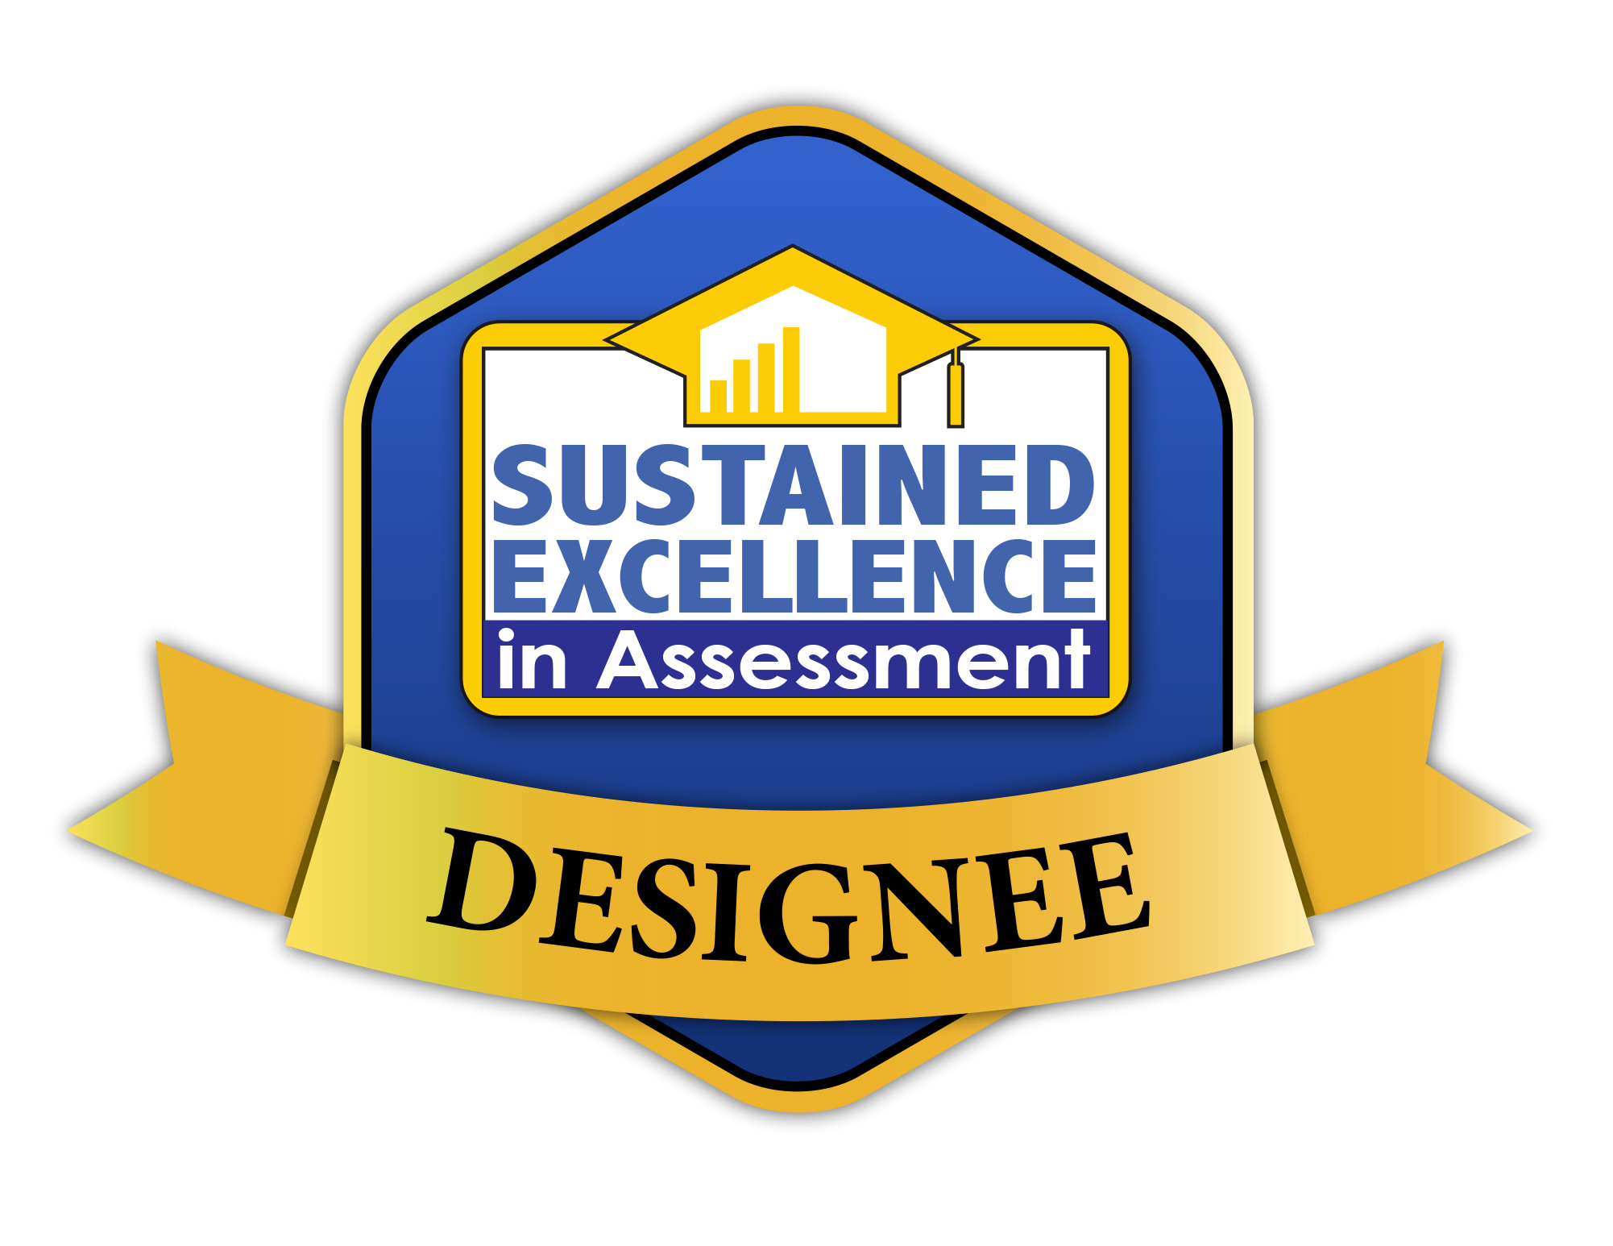
Assessment Practices at Kansas State University
What we do and why we do it?
Frederick Burrack, Ph.D.
Director of the Office of Assessment

Slide 2
A Culture Of Assessment
What is it and how do we achieve it?
Notes:
The first major challenge that we have in this responsibility is to develop across our campuses a culture of Assessment in which:
assessment of student learning is valued as mechanism to define academic success and not as a reporting expectations;
course grades do not clearly document learning;
course content and skills taught does not automatically mean course content and skills learned.
views the assessment process as an essential component of education.

Slide 3
Learning
What we teach does not define learning.
Notes:
We can easily come to agreement that the purpose of education is for students to learn.
We introduce what are new ideas and concepts through the teaching in our courses.
(click) But what we teach does not define learning.
Learning is defined by how they make sense of these new ideas, concepts, and skills, then transfer them to new situations.

Slide 4
Traditional Teaching / Learning Sequence
Notes:
Teaching has often been designed with
(click) the instructor identifying what they wish to teach, or what educational norms designate is important. Until the most recent past, this has been through published texts. The source of content comes increasingly from sources beyond published text books.
(click) The title ‘Professor’ came from the practice of presenting information and appropriate examples for students to attain.
(click) then the learning outcomes are defined by the exams evaluating what has been selected by the professor.
I share this construct because an assessment culture is founded on an alternative construct of teaching and learning.

Slide 5
Backward Design
Define Learning Outcome
Expected Demonstration
Instructional Planning
Teaching as Assessment
Identify Learning Needs
Notes:
The alternative teaching and learning construct is focused on a Backward Design. Instead of 1) choosing the content to teach; 2) teaching the content; 3) and testing the content taught to identify what was learned;
Instead of identifying the learning outcome as a result of teaching, backward design begins with
(click) deciding what is to be learned. These learning outcomes are the basis for all decisions in the instructional process;
(click) Additionally the assessment is defined before instruction and content is determined. In backward design, it is important to define how you expect students to demonstrate the learning outcomes. (assessments);
(click) plan instruction and content appropriate for the students so that they can develop the skills so to apply the learning as intended;
(click) then you teach and identify achievement through the planned activities. If designed to do so, student can demonstrate developmental learning as they participate in the instructional activities we call teaching.
(click) Resulting from assessment measurements, an important component of teaching is identifying successes, but more importantly, the primary purpose of assessments is to identify if there are deficiencies that need to be addressed to fully attain the desired outcome.
Then you go back to and either reteach deficiencies or progress to new or enhanced outcomes.

Slide 6
Academic uniqueness Value each programs’ mission
A “One-Size-Fits-All” assessment process will not work
Notes:
Another construct the leads toward an positive Culture of Assessment is a recognitions that there is no such thing as a ‘one-size-fits-all’ assessment system. Trying to create one will inhibit a culture of assessment. When documenting student achievement of university-wide learning goals, it is important that assessments authentically represent how learning is uniquely applied.

Slide 7
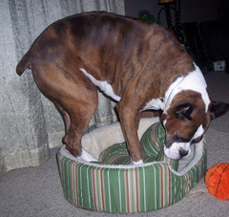
Academic uniqueness Value each programs’ mission
Notes:
If not, you will find the faculty very uncomfortable trying to comply with as assessment program that doesn’t authentically reflect the learning that occurs in their program.

Slide 8
Designed to provide information authentic to student learning, valued by the program and ties to university outcomes.
Knowledge
Critical Thinking
Communication
Diversity
Integrity
Assessment #1
Learning Outcome #1
Assessment #2
Assessment #1
Program
Unit
Learning Outcome #2
Assessment #2
Assessment #1
Learning Outcome #3
Assessment #2
Notes:
One of the processes that contribute to developing a culture of assessment across Kansas State University is in respecting autonomy of learning. The primary focus for assessment of student learning at K-State occurs within academic and non-academic programs, student life and support units. We are continually working on striving for higher levels of quality assessment that reflect the learning expected of students in and across their and across their discipline.
Each program/unit
(1) identifies appropriate student learning outcomes,
(2) develops direct/indirect assessments for each outcome, and
(3) establishes competency that defines expected achievement levels requisite for all students.
Assessments that document student achievement in any of the five university undergraduate outcomes are aligned from appropriate demonstrations of achievement. The process is designed to provide information authentic to student learning that is valued by the program and at the university level.
This is the one, most important element that leads to developing a culture of assessment within an educational system.

Slide 9
Assignment Grading
Knowledge
Skills
Beliefs
? Knowledge ?
? Skills ?
? Beliefs ?
Notes:
Another construct that promotes a Culture of Assessment is an understanding that traditional grading processes do not necessarily reflect effective data for outcomes assessment.
Traditionally (click) assignments often include a variety of disciplinary focused (click) knowledge, skills, and attitudes or beliefs. So it is important to recognize that nearly all assignments are designed for students to demonstrate learning of more than one learning outcome.
When deciding an assignment grade, we average the achievement in these learning areas into (click) one average score we call an assignment grade. (click) Summative assessment scores do not provide sufficient information to identify qualities of learning specific to each outcome.

Slide 10
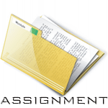
Course Grading
Course
Grade
Notes:
Then the tradition is to take the summary or averaged scores of the multiple learning outcomes from each assignment, and then average them into a summary score we call a course grade. This aggregates the multiple learning outcomes even more, making it nearly impossible to define the quality of learning for each outcome.

Slide 11
Paradigm of Outcomes Assessment
Course Outcome #1
Knowledge
Skills
Beliefs
Course Outcome #2
Course Outcome #3
Notes:
Now consider if the assessment that is assessing multiple learning outcomes identify qualities of learning for each outcome beyond the average used in a course grade. Then there will be more information that can guide improved learning. This is the intent of learning assessment.

Slide 12
Course-based Outcomes Assessment
Course Outcome #1
Course Outcome #2
Course Outcome #3
Notes:
The value of isolating achievement per outcome in assessment practice from individual assignments is the opportunity to identify the quality of learning specific to outcome outcomes.
.

Slide 13
Aligned Course & Program Outcomes
Outcome
Outcome
Outcome
Outcome
Outcome
Outcome
Outcome
Outcome
Outcome
Degree Completion Achievement:
Exceeds Program Expectation (Advanced)
Meets Program Expectations (Proficient)
Meets Minimum Program Expectations (Developing)
Does Not Meet Program Expectations (Unacceptable)
Program Outcome #1
Program Outcome #2
Program Outcome #3
Notes:
Then the outcomes collected from course-based assignments
are selectively aligned with programmatic outcomes.
Alignment of course-based assessments reflect student demonstration of learning
at the level of program completion reported by each program or unit.

Slide 14
Assessment Process
Assessment #1
Assessment #2
Courses
Assessment #1
Assessment #2
Assessment #1
Assessment #2
Knowledge
Critical Thinking
Degree Program
Learning Outcomes
(SLOs)
Communication
Diversity
Integrity
Notes:
This is the process implemented at Kansas State University to collect achievement data from (courses and campus-wide experiences), assessing how students authentically demonstrate learning that is applied to degree program learning expectations and aligned with university-wide student learning goals.

Slide 15
Support and Alignment
Knowledge
Critical Thinking
Communication
Diversity
Integrity
Notes:
Students demonstrate the expected learning through coursework and university experiences.
Achievement data is collected through coursework aligned with learning outcomes.
Student learning needs exposed from programmatic discussion are communicated to faculty through curricular and instructional adjustments.
Annual student learning data is reported to the Office of Assessment for programmatic outcomes, many of which align with the university learning goals.
The Office of Assessment respond back to the program with suggestions that feed back into the curriculum and assessment process.

Slide 16
Alignment at Each Stage
Planning, Outcomes,
& Curriculum
Data Collection and Choice of Measures
Data Analysis and
Discussion
Improvements and Documentation

Slide 17
Meeting External Expectations
Notes:
The Office of Assessment reports to the Higher Learning Commission through Accreditation and the Kansas Board of Regents through Program Review.
That is a typical process at most universities, but we do not feel this is sufficient.

Slide 18
Ongoing Assessment Projects
K-State 8 Survey
GTA Communication Survey
K-State Senior Survey
K-State Alumni Survey
National Survey of Student Engagement (NSSE)
Annual Progress Reports on Student Learning Assessment
K-State Accreditation Schedule
Institute for Student Learning Assessment

Slide 20
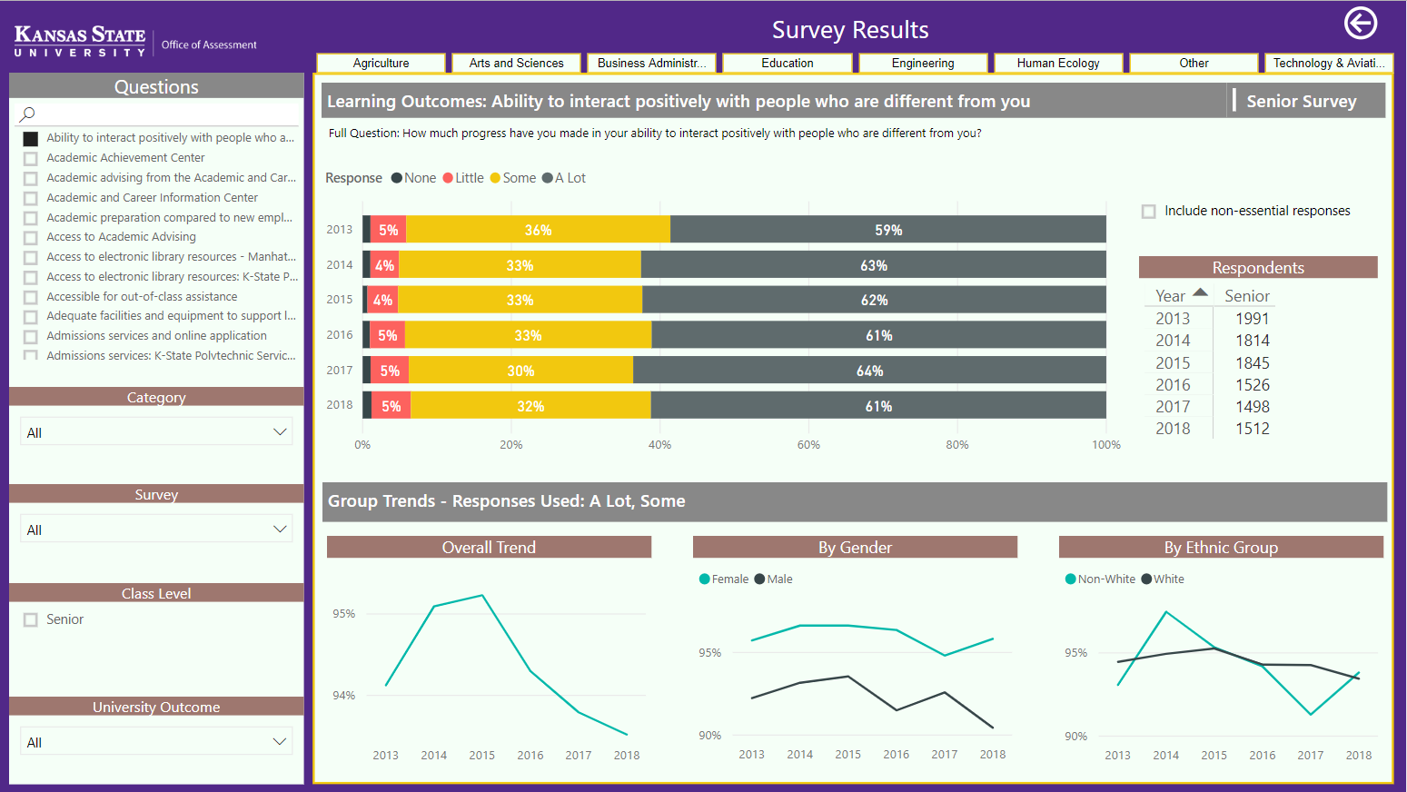

Slide 21
Assessment Practices at Kansas State University
What we do and why we do it?
Frederick Burrack, Ph.D.
Director of the Office of Assessment
Notes:
In another sessions I will be sharing how we are using our LMS (CANVAS) to automate data collection and use PowerBI to automate reporting. Now lets chat.

