Slide 1
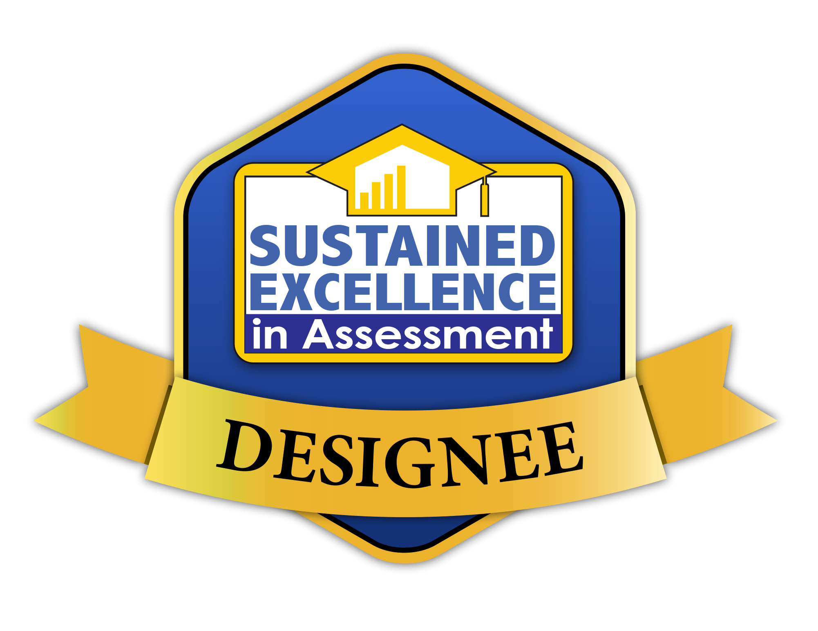
Addressing Criteria for the Higher Learning Commission
Criterion 4. Teaching and Learning: Evaluation and Improvement
Dr. Frederick Burrack

Slide 2
General Suggestions
Honest self-reflection is the goal.
Address each core and sub component.
Substantiate every claim. Policy is not sufficient.
Clarity and conciseness is essential.
Restate their words whenever possible.

Slide 3
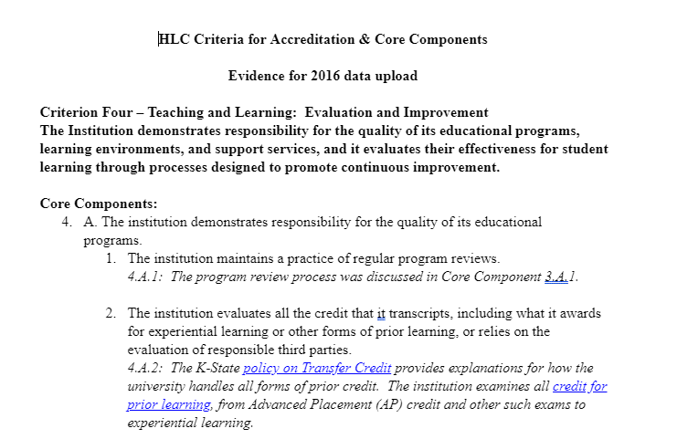
Repeat Wording
Make the assurance argument read easily without the need of other documents.
Begin each segment with the exact wording of the Criterion and/or section.
Do not make your reader search for the important information in attached documents.

Slide 4
Criterion 4. Teaching and Learning: Evaluation and Improvement
The institution demonstrates responsibility for the quality of its educational programs, learning environments and support services, and it evaluates their effectiveness for student learning through processes designed to promote continuous improvement.
Document what they are;
What quality means;
Proof that the above has been met or exceeded for each.
These are your Student Learning Assessment processes and reporting

Slide 5
Criterion 4. Teaching and Learning: Evaluation and Improvement
4.A. The institution ensures demonstrates responsibility for the quality of its educational programs offerings.
The institution maintains a practice of regular program reviews and acts upon its findings.
The institution evaluates all the credit that it transcripts, including what it awards for experiential learning or other forms of prior learning, or relies on the evaluation of responsible third parties.
The institution has policies that ensure assure the quality of the credit it accepts in transfer.

Slide 6
Criterion 4. Teaching and Learning: Evaluation and Improvement
4.A. The institution ensures the quality of its educational offerings.
The institution maintains a practice of regular program reviews and acts upon its findings.
The institution evaluates all the credit that it transcripts, including what it awards for experiential learning or other forms of prior learning, or relies on the evaluation of responsible third parties.
The institution has policies that ensure the quality of the credit it accepts in transfer.

Slide 7
Program Review
Complete eight-year cycle for all programs and educational units.
Step-by-step process of the comprehensive review.
Board of Regents Guidelines.
Several examples of review documents.
Positive/negative actions taken.

Slide 8
Criterion 4. Teaching and Learning: Evaluation and Improvement
4.A. The institution ensures the quality of its educational offerings.
The institution maintains a practice of regular program reviews and acts upon its findings.
The institution evaluates all the credit that it transcripts, including what it awards for experiential learning or other forms of prior learning, or relies on the evaluation of responsible third parties.
The institution has policies that ensure the quality of the credit it accepts in transfer.

Slide 9
Credit for Prior Learning
Credit Policies
# of students for each AP exam accepted or rejected
Credit for prior learning

Slide 10
Criterion 4. Teaching and Learning: Evaluation and Improvement
4.A. The institution ensures the quality of its educational offerings.
The institution maintains a practice of regular program reviews and acts upon its findings.
The institution evaluates all the credit that it transcripts, including what it awards for experiential learning or other forms of prior learning, or relies on the evaluation of responsible third parties.
The institution has policies that ensure the quality of the credit it accepts in transfer.

Slide 11
Transfer Credit
Transfer Policies
Put important wording in the argument.
Remember, policy must have documentation it is followed.
# of students per year for transfer granted.
Processes for confirming student achievement

Slide 12
Criterion 4. Teaching and Learning: Evaluation and Improvement
The institution maintains and exercises authority over the prerequisites for courses, rigor of courses, expectations for student learning, access to learning resources and faculty qualifications for all its programs, including dual credit programs. It ensures that its dual credit courses or programs for high school students are equivalent in learning outcomes and levels of achievement to its higher education curriculum.
The institution maintains specialized accreditation for its programs as appropriate to its educational purposes.
The institution evaluates the success of its graduates. The institution ensures assures that the credentials it represents as preparation for advanced study or employment accomplish these purposes. For all programs, the institution looks to indicators it deems appropriate to its mission.

Slide 13
Rigor, Expectations, Access, Faculty Qualifications, Dual Credit

Slide 14
Criterion 4. Teaching and Learning: Evaluation and Improvement
The institution maintains and exercises authority over the prerequisites for courses, rigor of courses, expectations for student learning, access to learning resources and faculty qualifications for all its programs, including dual credit programs. It ensures that its dual credit courses or programs for high school students are equivalent in learning outcomes and levels of achievement to its higher education curriculum.
The institution maintains specialized accreditation for its programs as appropriate to its educational purposes.
The institution evaluates the success of its graduates. The institution ensures assures that the credentials it represents as preparation for advanced study or employment accomplish these purposes. For all programs, the institution looks to indicators it deems appropriate to its mission.

Slide 15
Accredited Program
We maintain all this information on a website, but for the argument, we created .pdfs of every website for linking.

Slide 16
Criterion 4. Teaching and Learning: Evaluation and Improvement
The institution maintains and exercises authority over the prerequisites for courses, rigor of courses, expectations for student learning, access to learning resources and faculty qualifications for all its programs, including dual credit programs. It ensures that its dual credit courses or programs for high school students are equivalent in learning outcomes and levels of achievement to its higher education curriculum.
The institution maintains specialized accreditation for its programs as appropriate to its educational purposes.
The institution evaluates the success of its graduates. The institution ensures assures that the credentials it represents as preparation for advanced study or employment accomplish these purposes. For all programs, the institution looks to indicators it deems appropriate to its mission.

Slide 17
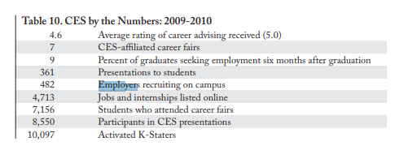
Graduate Credentials
Linked .pdf versions of relevant documents.
If you use survey numbers, explain in the narrative with document providing thorough documentation.
Indicators of success for completing 4-year degree.
Employment success in numbers, alumni feedback, employer feedback.

Slide 18
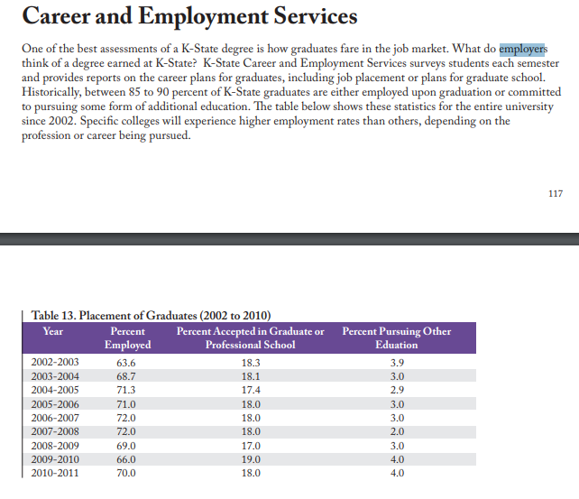
Graduate Credentials
Linked .pdf versions of relevant documents.
If you use survey numbers, explain in the narrative with document providing thorough documentation.
Indicators of success for completing 4-year degree.
Employment success in numbers, alumni feedback, employer feedback.

Slide 19
Criterion 4. Teaching and Learning: Evaluation and Improvement
4.B. The institution demonstrates a commitment to educational achievement and improvement through ongoing assessment of student learning. The institution engages in ongoing assessment of student learning as part of its commitment to the educational outcomes of its students.
The institution has clearly stated goals for student learning and effective processes for assessment of student learning and achievement of learning goals in academic and cocurricular programs. The institution assesses achievement of the learning outcomes that it claims for its curricular and cocurricular programs.
The institution uses the information gained from assessment to improve student learning.
The institution’s processes and methodologies to assess student learning reflect good practice, including the substantial participation of faculty and other instructional staff members.

Slide 20
Criterion 4. Teaching and Learning: Evaluation and Improvement
4.B. The institution maintains a practice of regular program reviews and acts upon its findings.
The institution has effective processes for assessment of student learning and achievement of learning goals in academic and cocurricular programs.
The institution uses the information gained from assessment to improve student learning.
The institution’s processes and methodologies to assess student learning reflect good practice, including the substantial participation of faculty and other instructional staff members.

Slide 21
Program Review
Linked .pdf versions of relevant documents.
Some are policy, but policy music be supported with evidence.

Slide 22
Criterion 4. Teaching and Learning: Evaluation and Improvement
4.B. The institution maintains a practice of regular program reviews and acts upon its findings.
The institution has effective processes for assessment of student learning and achievement of learning goals in academic and cocurricular programs.
The institution uses the information gained from assessment to improve student learning.
The institution’s processes and methodologies to assess student learning reflect good practice, including the substantial participation of faculty and other instructional staff members.

Slide 23
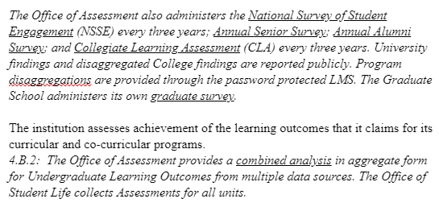
Institutional Learning Outcomes
Assessment Cycle
Protocols for reporting ASL
SLOs and Processes from each program/Unit
Institutional Assessments
Co-Curricular Units

Slide 24
Criterion 4. Teaching and Learning: Evaluation and Improvement
4.B. The institution maintains a practice of regular program reviews and acts upon its findings.
The institution has effective processes for assessment of student learning and achievement of learning goals in academic and cocurricular programs.
The institution uses the information gained from assessment to improve student learning.
The institution’s processes and methodologies to assess student learning reflect good practice, including the substantial participation of faculty and other instructional staff members.

Slide 25
Using Assessment Information
Example of program improvements
Professional Development Workshops
Institutional Initiatives

Slide 26
Criterion 4. Teaching and Learning: Evaluation and Improvement
4.B. The institution maintains a practice of regular program reviews and acts upon its findings.
The institution has effective processes for assessment of student learning and achievement of learning goals in academic and cocurricular programs.
The institution uses the information gained from assessment to improve student learning.
The institution’s processes and methodologies to assess student learning reflect good practice, including the substantial participation of faculty and other instructional staff members.

Slide 27
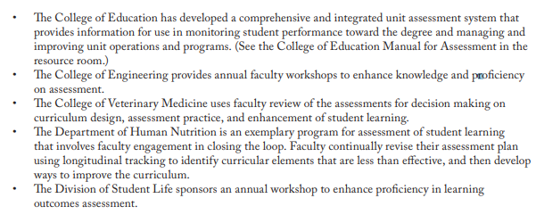
Faculty Involvement
Examples of faculty meeting and discussing assessment results.
Program improvements made.
Faculty attending workshops
Assessment showcase of faculty achievement in assessment

Slide 28
Criterion 4. Teaching and Learning: Evaluation and Improvement
4.C. The institution demonstrates a commitment to pursues educational improvement through ongoing attention to through goals that seek to increase retention, persistence and completion rates in its degree and certificate programs.
The institution has defined goals for student retention, persistence and completion that are ambitious but attainable and appropriate to its mission, student populations and educational offerings.
The institution collects and analyzes information on student retention, persistence and completion of its programs.
The institution uses information on student retention, persistence and completion of programs to make improvements as warranted by the data.
The institution’s processes and methodologies for collecting and analyzing information on student retention, persistence and completion of programs reflect good practice. (Institutions are not required to use IPEDS definitions in their determination of persistence or completion rates. Institutions are encouraged to choose measures that are suitable to their student populations, but institutions are accountable for the validity of their measures.)

Slide 29
Criterion 4. Teaching and Learning: Evaluation and Improvement
4.C. The institution demonstrates a commitment to pursues educational improvement through ongoing attention to through goals that seek to increase retention, persistence and completion rates in its degree and certificate programs.
The institution has defined goals for student retention, persistence and completion that are ambitious but attainable and appropriate to its mission, student populations and educational offerings.
The institution collects and analyzes information on student retention, persistence and completion of its programs.
The institution uses information on student retention, persistence and completion of programs to make improvements as warranted by the data.
The institution’s processes and methodologies for collecting and analyzing information on student retention, persistence and completion of programs reflect good practice. (Institutions are not required to use IPEDS definitions in their determination of persistence or completion rates. Institutions are encouraged to choose measures that are suitable to their student populations, but institutions are accountable for the validity of their measures.)

Slide 30
Retention
Institutional goals
Institutional metrics and data
Expose important data
Current initiatives

Slide 31
Criterion 4. Teaching and Learning: Evaluation and Improvement
4.C. The institution demonstrates a commitment to pursues educational improvement through ongoing attention to through goals that seek to increase retention, persistence and completion rates in its degree and certificate programs.
The institution has defined goals for student retention, persistence and completion that are ambitious but attainable and appropriate to its mission, student populations and educational offerings.
The institution collects and analyzes information on student retention, persistence and completion of its programs.
The institution uses information on student retention, persistence and completion of programs to make improvements as warranted by the data.
The institution’s processes and methodologies for collecting and analyzing information on student retention, persistence and completion of programs reflect good practice. (Institutions are not required to use IPEDS definitions in their determination of persistence or completion rates. Institutions are encouraged to choose measures that are suitable to their student populations, but institutions are accountable for the validity of their measures.)

Slide 32
Analysis
Reports of data
Reports of analysis and directives
Comparative analysis

Slide 33
Criterion 4. Teaching and Learning: Evaluation and Improvement
4.C. The institution demonstrates a commitment to pursues educational improvement through ongoing attention to through goals that seek to increase retention, persistence and completion rates in its degree and certificate programs.
The institution has defined goals for student retention, persistence and completion that are ambitious but attainable and appropriate to its mission, student populations and educational offerings.
The institution collects and analyzes information on student retention, persistence and completion of its programs.
The institution uses information on student retention, persistence and completion of programs to make improvements as warranted by the data.
The institution’s processes and methodologies for collecting and analyzing information on student retention, persistence and completion of programs reflect good practice. (Institutions are not required to use IPEDS definitions in their determination of persistence or completion rates. Institutions are encouraged to choose measures that are suitable to their student populations, but institutions are accountable for the validity of their measures.)

Slide 34
Uses Findings
Provide Direct Evidence of Using the Information and Discoveries from Analysis

Slide 35
Criterion 4. Teaching and Learning: Evaluation and Improvement
4.C. The institution demonstrates a commitment to pursues educational improvement through ongoing attention to through goals that seek to increase retention, persistence and completion rates in its degree and certificate programs.
The institution has defined goals for student retention, persistence and completion that are ambitious but attainable and appropriate to its mission, student populations and educational offerings.
The institution collects and analyzes information on student retention, persistence and completion of its programs.
The institution uses information on student retention, persistence and completion of programs to make improvements as warranted by the data.
The institution’s processes and methodologies for collecting and analyzing information on student retention, persistence and completion of programs reflect good practice. (Institutions are not required to use IPEDS definitions in their determination of persistence or completion rates. Institutions are encouraged to choose measures that are suitable to their student populations, but institutions are accountable for the validity of their measures.)

Slide 36
IPEDS (or whatever is appropriate)
We use the IPEDS definitions.

Slide 37
Criterion 3. Teaching and Learning: Quality, Resources, and Support
Core Component 3.A. The institution’s degree programs are academic offering is appropriate to higher education.
Courses and programs are current and require levels of student performance by students appropriate to the credential degree or certificate awarded.
The institution articulates and differentiates learning goals for its undergraduate, graduate, post-baccalaureate, post-graduate, and certificate programs.
The institution’s program quality and learning goals are consistent across all modes of delivery and all locations (on the main campus, at additional locations, by distance delivery, as dual credit, through contractual or consortial arrangements, or any other modality).

Slide 38
Criterion 3. Teaching and Learning: Quality, Resources, and Support
3.B. The institution demonstrates that the exercise of intellectual inquiry and the acquisition, application, and integration of broad learning and skills are integral to its educational programs.
3.B. The institution offers programs that engage students in collecting, analyzing and communicating information; in mastering modes of intellectual inquiry or creative work; and in developing skills adaptable to changing environments. (Moved from 3.B.3, clarification of language)

Slide 39
Criterion 3. Teaching and Learning: Quality, Resources, and Support
3.B. The institution offers programs that engage students in collecting, analyzing and communicating information; in mastering modes of intellectual inquiry or creative work; and in developing skills adaptable to changing environments. (Moved from 3.B.3, clarification of language)
The general education program is appropriate to the mission, educational offerings and degree levels of the institution. The institution articulates the purposes, content and intended learning outcomes of its undergraduate general education requirements. (Moved from 3.B.2)
The institution articulates the purposes, content, and intended learning outcomes of its undergraduate general education requirements. The program of general education is grounded in a philosophy or framework developed by the institution or adopted from an established framework. It imparts broad knowledge and intellectual concepts to students and develops skills and attitudes that the institution believes every college-educated person should possess. (Moved to 3.B.1)
The education offered by the institution recognizes the human and cultural diversity of the world in which students live and work.
The faculty and students contribute to scholarship, creative work and the discovery of knowledge to the extent appropriate to their programs offerings and the institution’s mission.

Slide 40
Criterion 3. Teaching and Learning: Quality, Resources, and Support
3.C. The institution has the faculty and staff needed for effective, high-quality programs and student services.
The institution ensures that the overall composition of its faculty and staff reflects human diversity as appropriate within its mission and for the constituencies it serves.
The institution has sufficient numbers and continuity of faculty members to carry out both the classroom and the non-classroom roles of faculty, including oversight of the curriculum, expectations for student performance, assessment of student learning; and establishment of academic credentials for instructional staffing.
All instructors are appropriately qualified, including those in dual credit, contractual and consortial offerings.
Instructors are evaluated regularly in accordance with established institutional policies and procedures.

Slide 41
Criterion 3. Teaching and Learning: Quality, Resources, and Support
3.C. The institution has the faculty and staff needed for effective, high-quality programs and student services.
The institution has processes and resources for assuring that instructors are current in their disciplines and adept in their teaching roles; it supports their professional development.
Instructors are accessible for student inquiry.
Staff members providing student support services, such as tutoring, financial aid advising, academic advising and cocurricular activities, are appropriately qualified, trained and supported in their professional development.

Slide 42
Criterion 3. Teaching and Learning: Quality, Resources, and Support
3.D. The institution provides support for student learning and effective teaching.
The institution provides student support services suited to the needs of its student populations.
The institution provides for learning support and preparatory instruction to address the academic needs of its students. It has a process for directing entering students to courses and programs for which the students are adequately prepared.
The institution provides academic advising suited to its programs offerings and the needs of its students.
The institution provides to students and instructors the infrastructure and resources necessary to support effective teaching and learning (technological infrastructure, scientific laboratories, libraries, performance spaces, clinical practice sites, museum collections, as appropriate to the institution’s offerings).

Slide 43
Move out of Teaching and Learning
3.D.5 The institution provides to students guidance in the effective use of research and information resources. (Moved to 2.E)
3.E. The institution fulfills the claims it makes for an enriched educational environment. (Concept moved to 2.B)
Co-curricular programs are suited to the institution’s mission and contribute to the educational experience of its students.
The institution demonstrates any claims it makes about contributions to its students’ educational experience by virtue of aspects of its mission, such as research, community engagement, service learning, religious or spiritual purpose, and economic development. (Concept moved to 2.B)

