Slide 1
Automating Assessment Data Collection with
Dr. Frederick Burrack
Director of Assessment
Kansas State University
fburrack@ksu.edu
Notes:
Dr. Frederick Burrack, Director of Assessment at Kansas State University in the United States of America.
This session will focus on ways to assess desired learning outcomes from coursework.

Slide 2
Aligning
With Outcomes
Outcome
Outcome
Outcome
Outcome
Outcome
Outcome
Outcome
Outcome
Outcome
Degree Completion Achievement:
Exceeds Program Expectation (Advanced)
Meets Program Expectations (Proficient)
Meets Minimum Program Expectations (Developing)
Does Not Meet Program Expectations (Unacceptable)
ISLO #1
ISLO #2
ISLO #3

Slide 3
Canvas Direct Assessment Process
Set Up Program Outcomes
SLO 1
SLO 2
SLO 3
Program Level
Course Level
Import & Align Outcomes
SLO 1
SLO 2
SLO 3
Notes:
CANVAS is designed in a hierarchy of levels administratively. There is the Institutional level, then a College level, the a Program level, and then what faculty work in is the Course level.
Where ever an outcome is created, it can be used or brought down to any level below with the data automatically being collected at both the assessment and the origination levels. We have placed all outcomes for programs on the program level, as each program has access to only their own program’s outcomes. (Although our process does not collect data in this way, we could have put institutional outcomes on that level where everyone would have access. I can explain why we chose not to do that later if you are interested, but it might be the appropriate place for your outcomes).
Then the faculty pull the appropriate outcome into their courses for assessment.

Slide 4
Outcomes in CANVAS
In the administrative portal
Notes:
In the administrative portal (in the appropriate program, college, or on the general institution level)
After selecting outcome, the best strategy would be to create a folder for each of the program outcomes. This is done by the add group button. It is important to note that what most of us call Outcomes are actually folders of criteria created using a group button.
Inside of each folder are the components of out outcomes, which we consider as criteria but in CANVAS are outcome. In CANVAS, we can be a granular in our assessments as you want, but the end point is called the OUTCOME in CANVAS.
These are created with the add Outcome button.
Notice the interconnection of the numbering. This is important for organization at a later point.
It is also useful to note the shorter title used for the outcome and the longer description used inside of the outcome. I can explain the usefulness of this later when we discuss visualization.

Slide 5
Outcomes in CANVAS
Wording must be:
Clear
Applicable
Useful across multiple assignments
Notes:
When creating an outcome, determining the levels of differentiated achieved is important. Since this outcome (remember that we are really speaking about each criterion that makes up an assessed component of the outcome category), the differentiation must be sufficiently clear so that multiple professors can find usefulness and applicability across assignments used for assessment.
You will need to set a Mastery score. Note that this does not mean perfectly mastered as we typically think. It means the level that fully meets the rigor of your program expectation.
There will probably be a level beyond master where a student can exceed the level that meets your expectation.

Slide 6
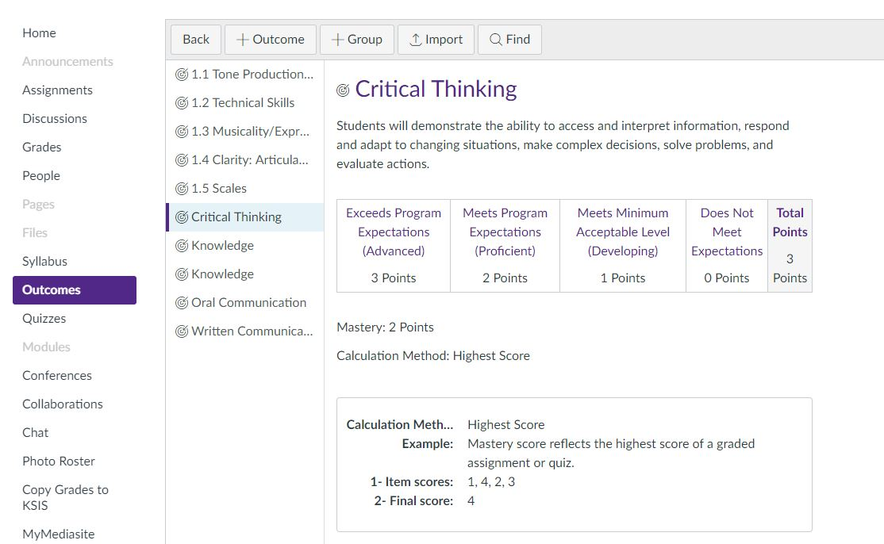
On the course level
Notes:
In a course:
The faculty has an outcomes button. They can create their own outcome in their course, but the student data will not leave the course. To collect data by the program or institution, they must
Find the outcome that has been created on the program, college, or institution level.

Slide 7
On the course level
Notes:
A box will appear and they can navigate to the outcome they wish to bring into their course to use in assessing students on an assignment.
Once they select the outcome they import it into their course.

Slide 8
On the course level
Notes:
Then this outcome is ready to be aligned with an assignment:
Faculty can bring in as many outcomes as are intended to be assessed for programmatic or institutional data collection process.
Then they will align the outcome with a scoring device used in an assignment.

Slide 9
Types of Assessments in Canvas
ASSIGNMENT
Task with single grade assigned
QUESTION BANK
(Quizzes)
Exams
Reviews
Open book/Take home
RUBRIC
Essays/Open Response
Presentations
Projects
Papers
Notes:
Fred

Slide 10
Selected Response in Canvas
Notes:
Fred

Slide 11
Knowledge-based Exams
1.
2.
3.
4.
5.
6.
7.
8.
9.
10.
Course Outcome #1
Course Outcome #2
Course Outcome #3
Notes:
inherent in course work are multiple learning expectations (or outcomes). Techniques to disaggregate and report learning per outcome can be useful to guide instructional improvement.
For many assessments, retention of knowledge provides important evidence of learning. (click) A common task through which we ask students to demonstrate retention is through selected choice questions. It requires multiple questions to identify sufficient levels of knowledge retention to confirm proficiency.
(click) An effective strategy to identify learning for specific outcomes from selected choice assessments is disaggregating per outcome.
This can be accomplished in a variety of ways.

Slide 12
On the course level
Manage Questions Banks
Notes:
Then this outcome is ready to be aligned with an assignment:
Faculty can bring in as many outcomes as are intended to be assessed for programmatic or institutional data collection process.
Then they will align the outcome with a scoring device used in an assignment.

Slide 13
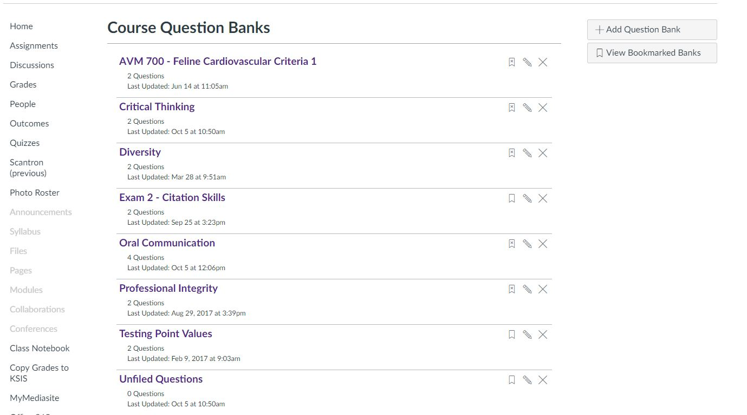
Notes:
When a quiz, or test is made, all of the questions automatically get filed
In an Unfiled Questions folder. To align questions to an outcome,
A Question Banks will have to be created for each outcome assessed.
For example, Critical thinking. Once there are folders for each outcome.

Slide 14
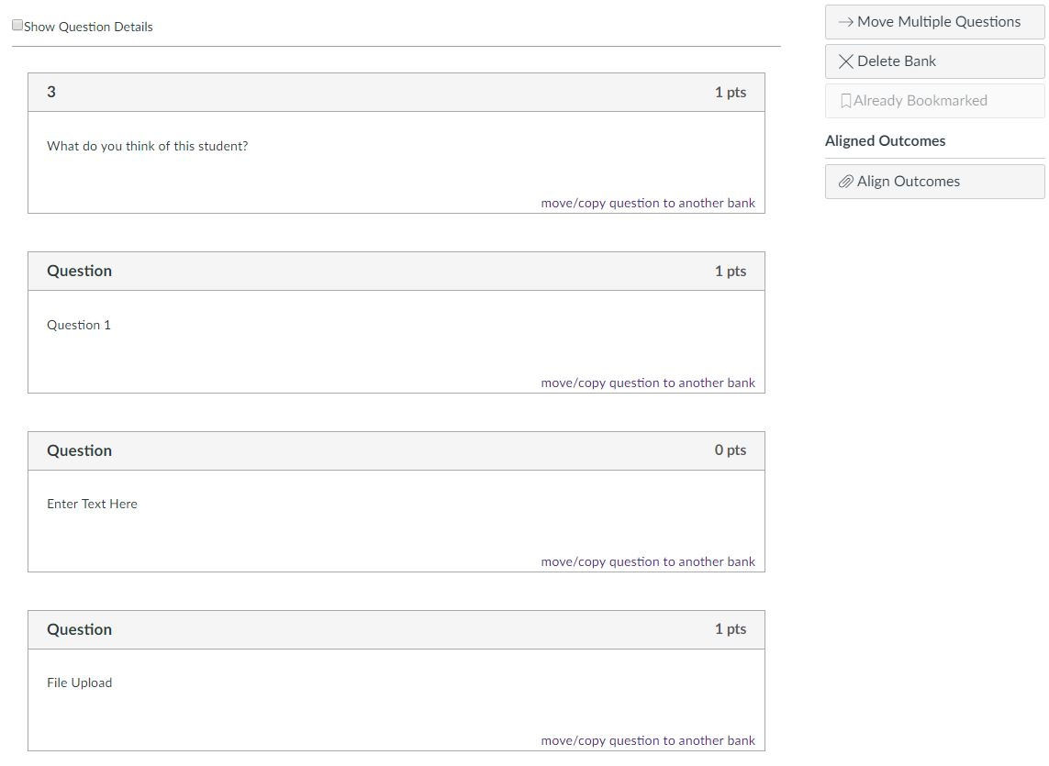
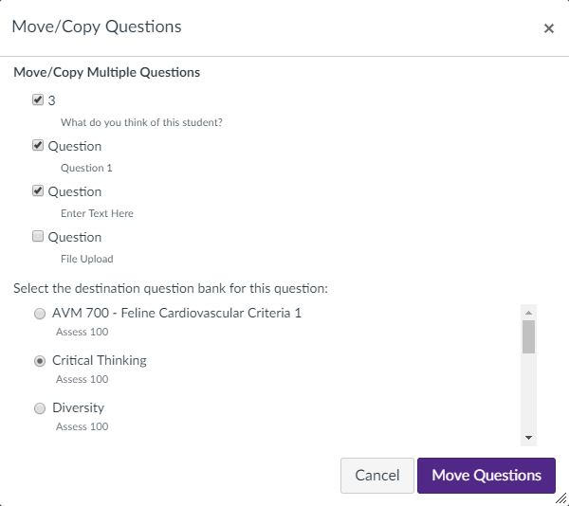
Notes:
You would go into the unfiled question bank
And select move questions into the appropriate outcome folder. By doing this you are not moving the question out of the exam, but simply aligning the questions to an outcome group.
You would select the outcome folder in which the question needs to be aligned
Then Move the questions

Slide 15
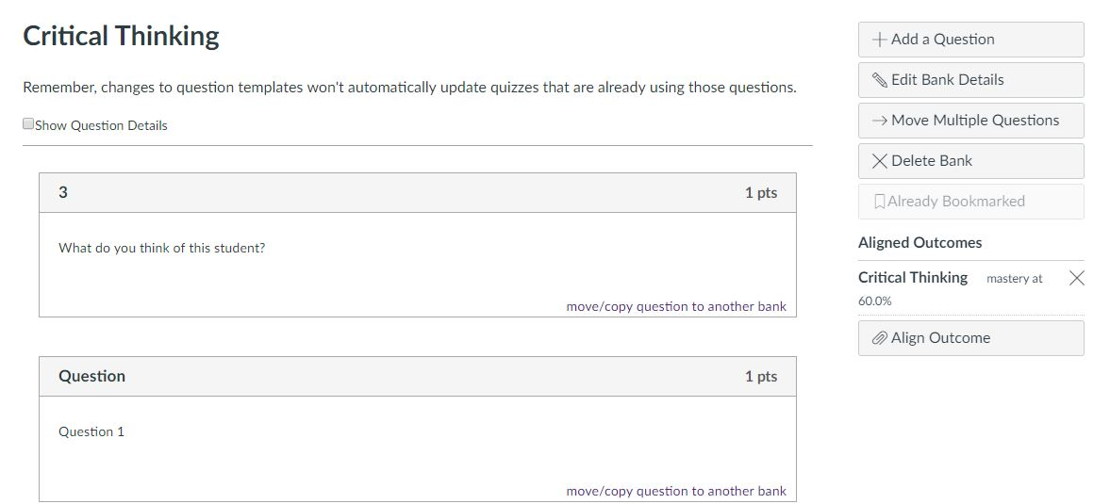
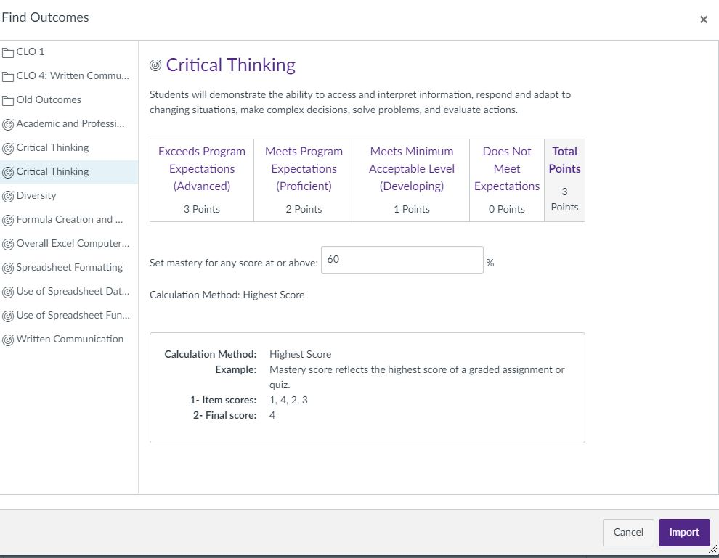
Notes:
In the Outcome Folder
You select Align outcome,
In the window that appears, select the outcome for which the entire folder of questions are to be aligned, then select import.
Now whenever any questions in that folder are answered, the scores will go to the program.

Slide 16
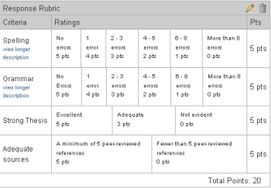
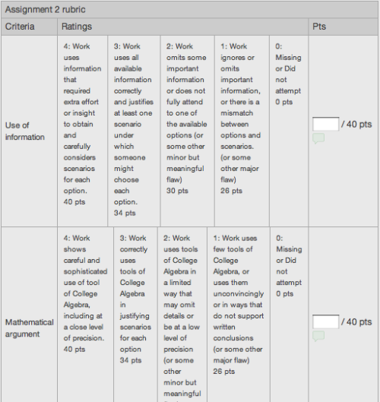
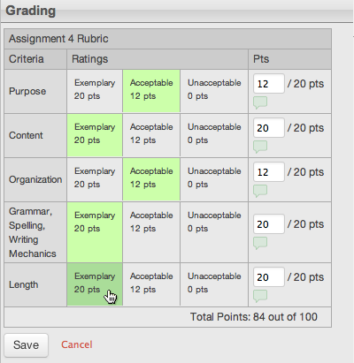
Rubrics in Canvas
Speed Grading
Application of knowledge
Notes:
With rubrics, which are an objective way of assessing
application of knowledge,
They can be very simple
Or thoroughly define the qualities of achievement differentiation.
In CANVAS, scoring become very easy and efficient.

Slide 17
Competency-based Assessments
Criteria | Unacceptable | Developing | Met Expectations | Exceeded Expectations
Content Develop
Critical Analysis
Use of Citations
Use of Evidence
Clarity
Course Outcome #1
Course Outcome #2
Course Outcome #3
Notes:
But in consideration of learning beyond retention, is it very important to assess how students understand the knowledge that they retain through application and transfer. If it nearly impossible to identify transfer through selected choice questions. We must observe the choices students make through decisions in action.
A typical measurement instrument is a scoring rubric. This device allows you to select
the specific learning to be demonstrated, which are the criteria that CANVAS calls outcomes.
The levels of achievement are the levels of differentiation.
each criterion is aligned with particular outcomes to identify specific learning achievements or deficiencies.

Slide 18
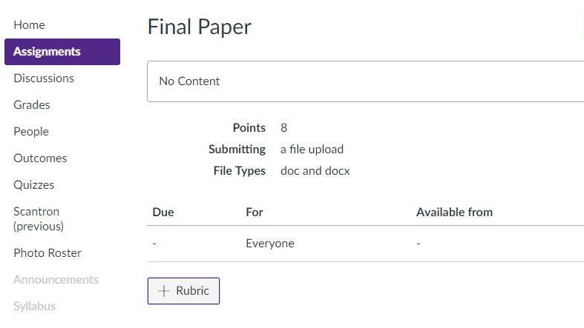
Notes:
If you recall, you first bring your outcomes into the course, then you create your assignment, in this case being a final paper. But the assignment is anything for which you might use a rubric scoring device.
When you select “Add Rubric”

Slide 19
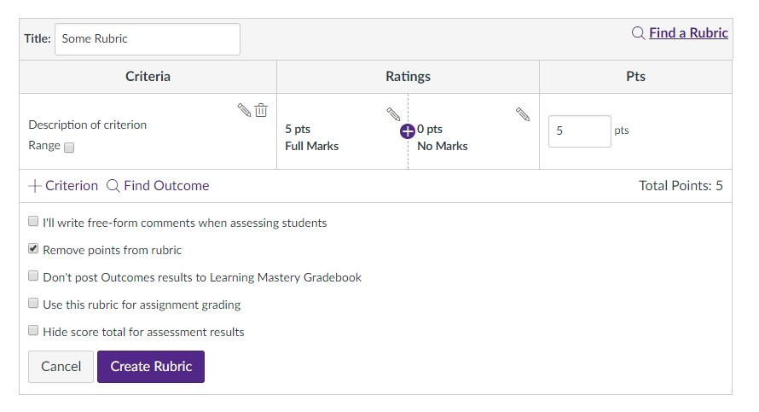
Notes:
When the Rubric Creator comes up
Title the rubric
Below this is where the faculty member would create any part of the scoring device that is not specifically assessing the outcome.
To add a the outcome scoring line, the faculty member would click Find Outcome.
The list of outcomes brought into the course will come up, so select the outcome desired. Once imported it become a part of the rubric.

Slide 20
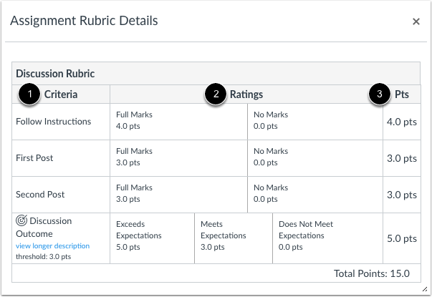
Notes:
The criteria line with the little target is the score that is sent to the program.

Slide 21
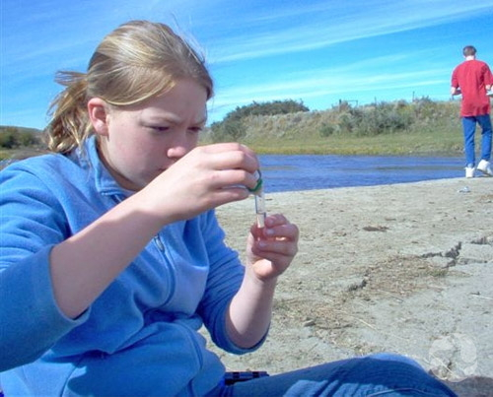
Notes:
Our professors use scoring devices in may classroom and internship demonstrations of learning.
They are used extensively in teacher education
In scientific field work
Observing students in laboratory learning
And in assessing oral communication such as classroom speeches.

Slide 22
Canvas Direct Assessment Process
Set Up Program Outcomes
Program Reporting
SLO 1
SLO 2
SLO 3
Program Level
Course Level
Import & Align Outcomes
Assess Outcomes
SLO 1
SLO 2
SLO 3
Notes:
The faculty score the work in the course and component scores from selected assignments are automatically forwarded to the program.
Our university further automates the process through visualizations using PowerBI.

Slide 23
Combining Assessment Data
Survey Results
Data Visualization Tool
Embedded Results
Other Assessment Data
Participation Data
Test Scores
Etc.
Combined, interactive dashboards and reports
Data Warehouse
Demographics
Other outcomes

Slide 24
Automating Direct Assessment Data Analysis
Data at the student-level enables enhanced analysis.
Demographic
Gender
Transfer
Online
Etc.
Survey results
Outcome data
Other
Retention
Graduation
Etc.

Slide 25
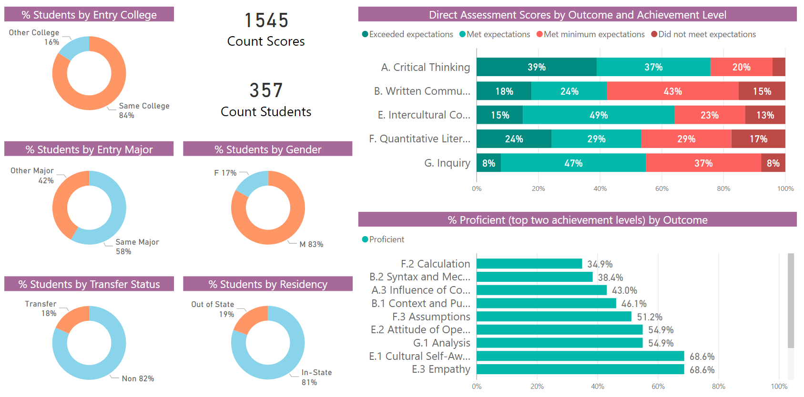
Direct Assessment Sample Report

Slide 26
Assessment Reporting in CANVAS & Power BI
Frederick Burrack – Director

Slide 27
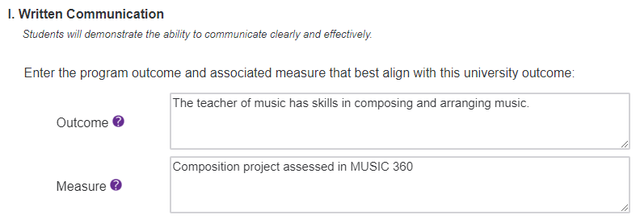
The Annual Progress Report (APR)
Knowledge
Critical Thinking
Communication
Diversity
Academic & Professional Integrity
Notes:
But there is a set of data that we must report in aggregate form to the HLC and the Kansas Board of Regents, which is the extent to which students are meeting institutional expectations for our Undergraduate Student Learning Outcome.
One of the points of emphasis I would like to point out is that the institutional definitions for the Undergraduate Learning Outcomes states: “Upon completion of their degree and regardless of disciplinary major, undergraduates are expected to demonstrate ability in at least five essential areas.”, which means that all students, no matter the program, are to be assessed in these outcomes. Here is the caveat, each program determines the appropriate ways students demonstrate learning in the discipline for each area, as well as the rigor of expectation.
You will see the outcomes and measures your program has designated from your assessment plan through which students demonstrate competency of each Undergraduate Learning Outcome. This auto-populates the form so you only need to make changes if what appears is incorrect.

Slide 28
The Annual Progress Report (APR)
Knowledge
Critical Thinking
Communication
Diversity
Academic & Professional Integrity
Notes:
Then, for each Undergraduate Learning Outcome, you transfer the number of students that
“Meet or exceed”,
“Met the minimum but did not meet the program expectations”, and
“Did not meet the minimum expectations” appropriate for the credentialing level for graduation, as per the rigor of your program.
The total will automatically be added.

Slide 29
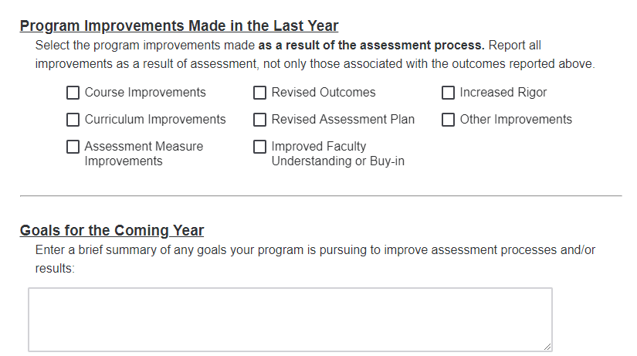
The Annual Progress Report (APR)
Notes:
And the last section are program improvement made in the past year as a response to your program’s student learning assessment.
These can be copied out of the report that you uploaded for review.

Slide 30
Learning Mastery Gradebook
Notes:
Chris

Slide 31
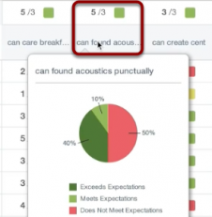
Learning Mastery Gradebook
Notes:
Chris

Slide 32
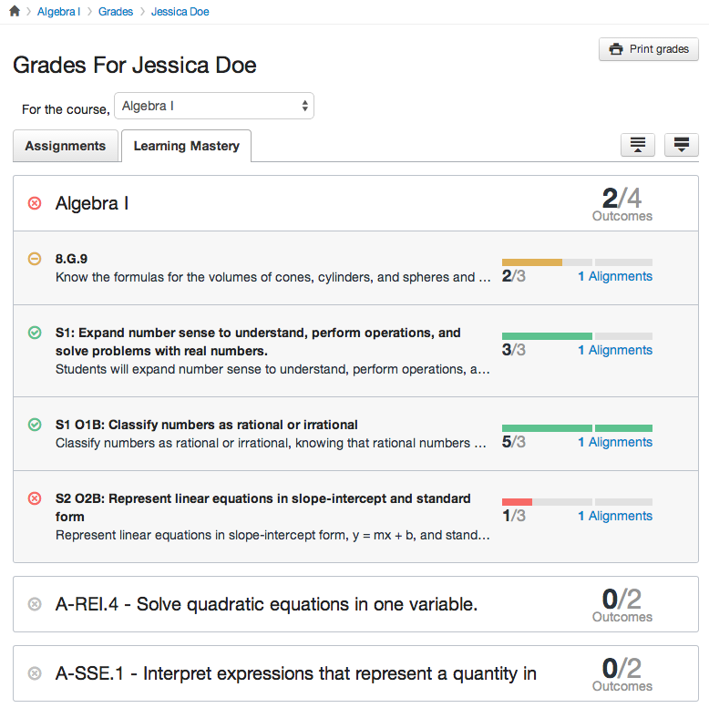
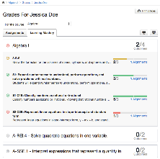
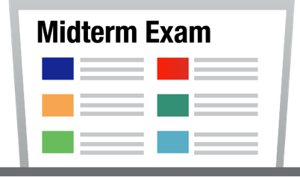
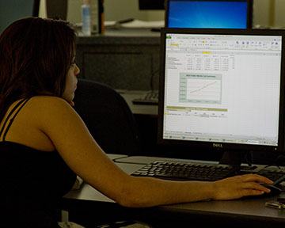
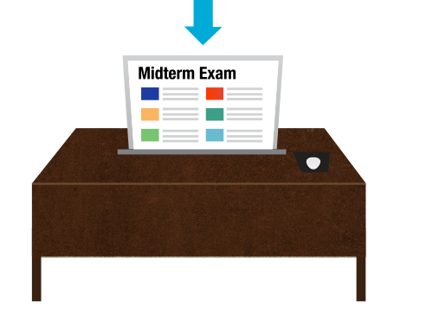
Faculty
Student
Notes:
Chris

Slide 33
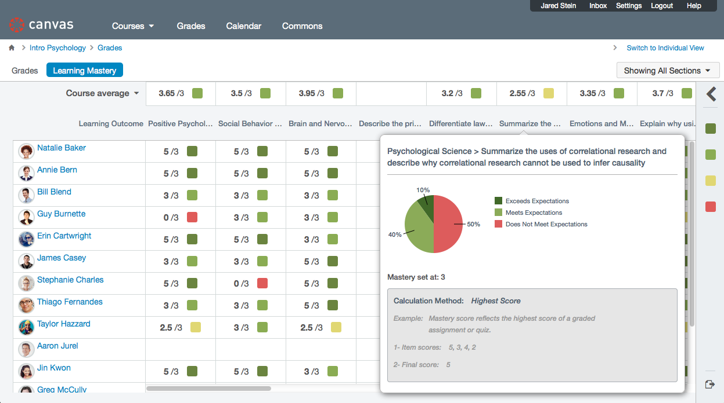
Knowledge-based Exams
Notes:
The Learning Management System has the integrated technology allowing faculty and students to see the extent to which they are reaching expected levels of achievement for each learning category.
(click) Students can visually see which learning area with which they are having difficulty. Then they are able to drill down to the specific exam, and if allowed by the professor, the question so they can adjust their understanding.
(click) Faculty can see, across multiple exams, which students are having difficulty with specific areas of learning, and which learning areas are the most difficult for the class as a whole, so to know whether to reteach a concept of skill.
Because learning is constructing, or sometimes reconstructing neurological pathways, it is essential for students to recognize mis-understandings in order for learning to occur.

